Slide 1
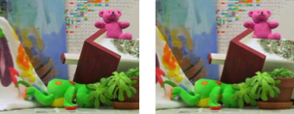

Two-View Stereo
Many slides adapted from Steve Seitz

Slide 2
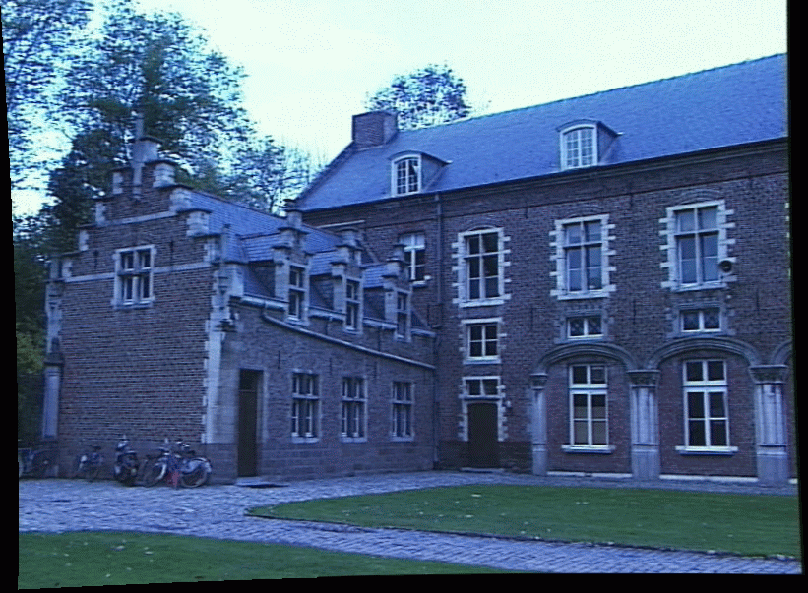
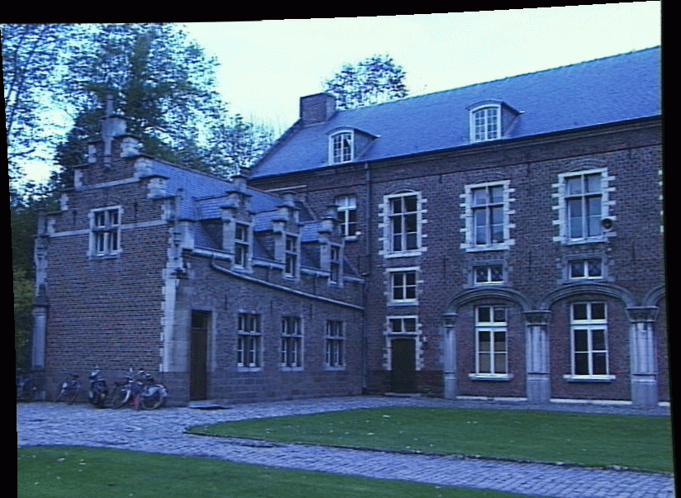
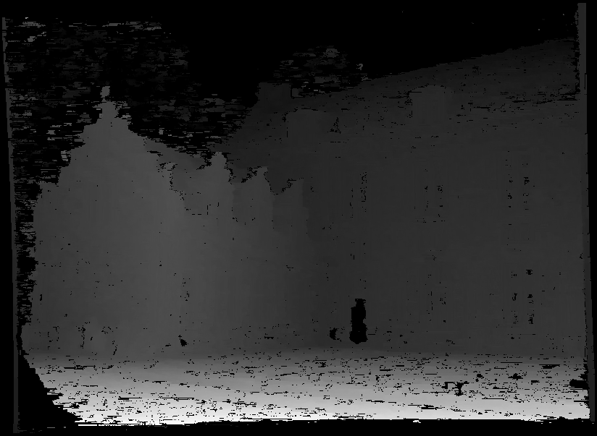
Problem formulation
Given: stereo pair (assumed calibrated)
Wanted: dense depth map

Slide 3
Outline
Motivation and history
Basic two-view stereo setup
Local stereo matching algorithm
Beyond local stereo matching
Active stereo with structured light

Slide 4
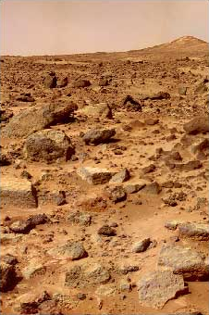
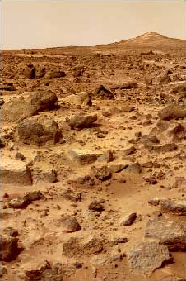
Stereo vision and perception of depth
What cues tell us about scene depth?

Slide 5
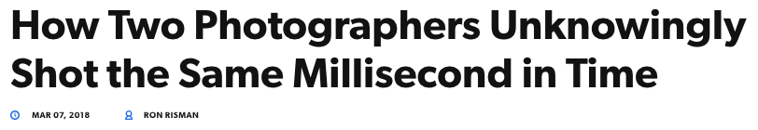

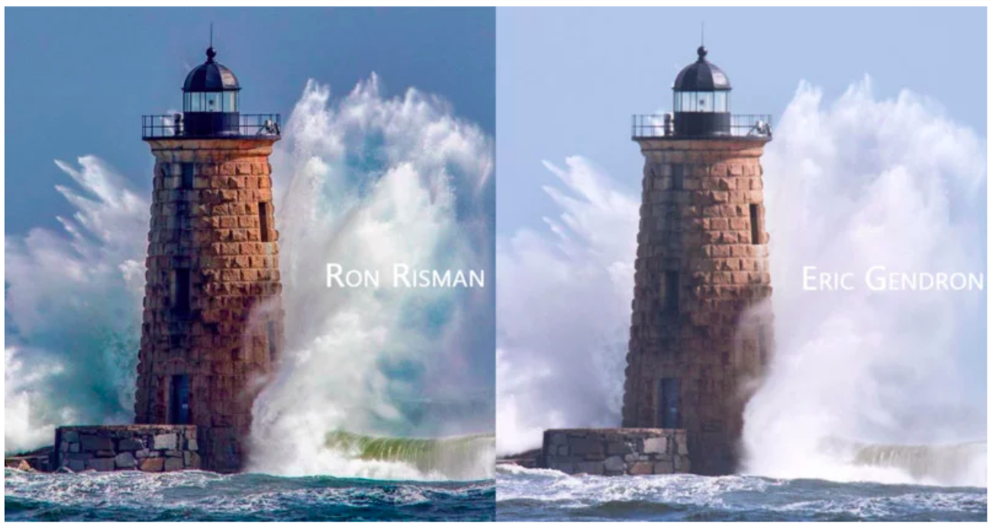
https://petapixel.com/2018/03/07/two-photographers-unknowingly-shot-millisecond-time/

Slide 6
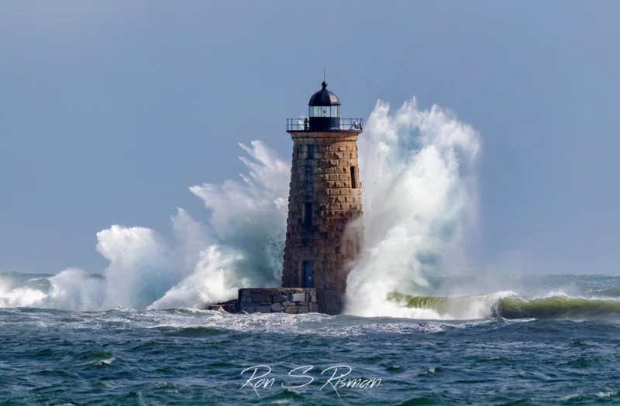
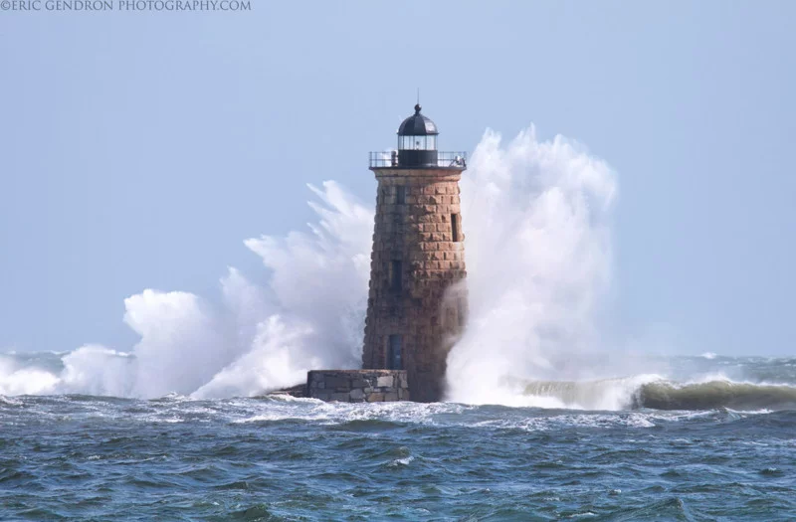
https://petapixel.com/2018/03/07/two-photographers-unknowingly-shot-millisecond-time/

Slide 7
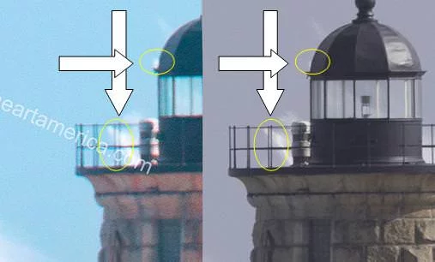
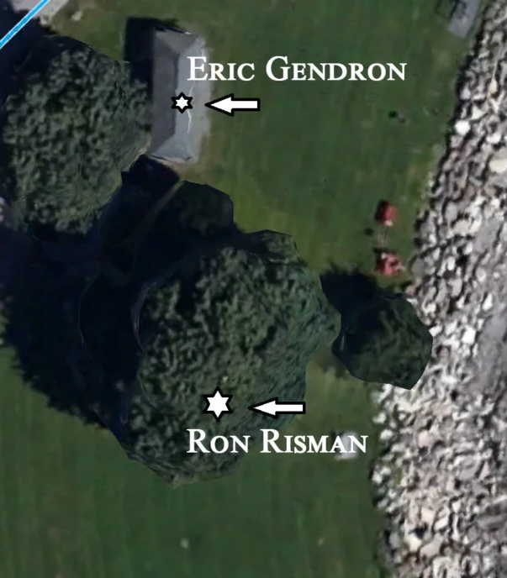
https://petapixel.com/2018/03/07/two-photographers-unknowingly-shot-millisecond-time/

Slide 8
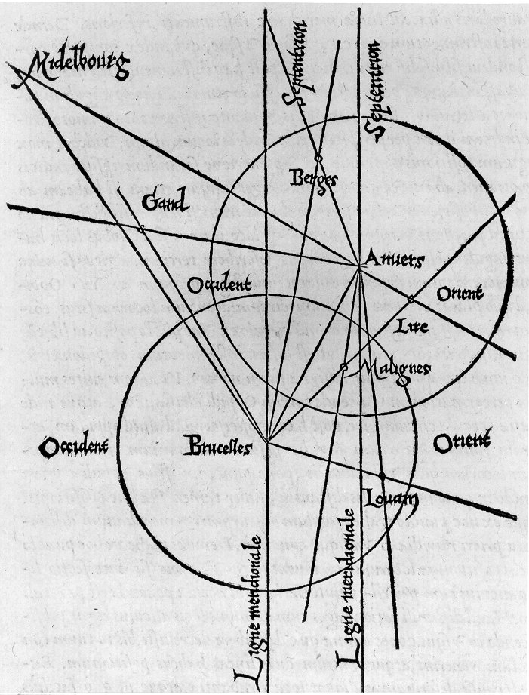
History: Triangulation
From Wikipedia: Gemma Frisius's 1533 diagram introducing the idea of triangulation into the science of surveying. Having established a baseline, e.g. the cities of Brussels and Antwerp, the location of other cities, e.g. Middelburg, Ghent etc., can be found by taking a compass direction from each end of the baseline, and plotting where the two directions cross. This was only a theoretical presentation of the concept — due to topographical restrictions, it is impossible to see Middelburg from either Brussels or Antwerp. Nevertheless, the figure soon became well known all across Europe.

Slide 9
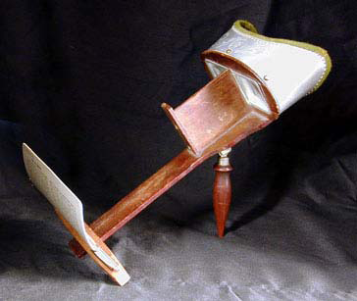
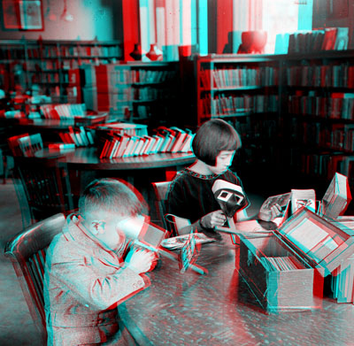
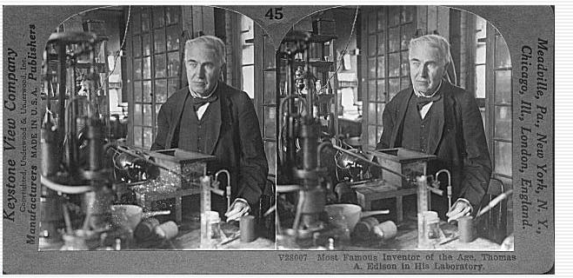
History: Stereograms
Humans can fuse pairs of images to get a sensation of depth
Stereograms: Invented by Sir Charles Wheatstone, 1838
https://en.wikipedia.org/wiki/Stereoscopy

Slide 10
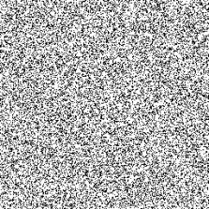
History: Random dot stereograms
Invented by Bela Julesz in the mid-20th century
Demonstration that stereo perception can happen without any monocular cues
https://en.wikipedia.org/wiki/Random_dot_stereogram

Slide 11
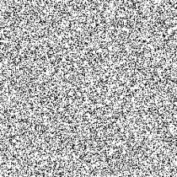
History: Random dot stereograms
Invented by Bela Julesz in the mid-20th century
Demonstration that stereo perception can happen without any monocular cues
https://en.wikipedia.org/wiki/Random_dot_stereogram
Notes:
From Wikipedia: According to Ralph Siegel, Dr. Julesz had "unambiguously demonstrated that stereoscopic depth could be computed in the absence of any identifiable objects, in the absence of any perspective, in the absence of any cues available to either eye alone."

Slide 12
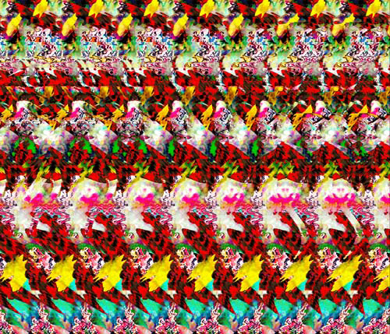
Autostereograms
Humans can fuse pairs of images to get a sensation of depth
Autostereograms: www.magiceye.com

Slide 13
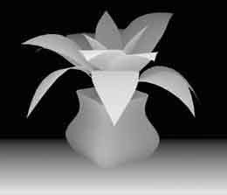
Autostereograms
Humans can fuse pairs of images to get a sensation of depth
Autostereograms: www.magiceye.com

Slide 14
Stereo: Outline
Motivation and history
Basic two-view stereo setup

Slide 15
Problem formulation
Given: stereo pair (assumed calibrated)
Wanted: dense depth map

Slide 16
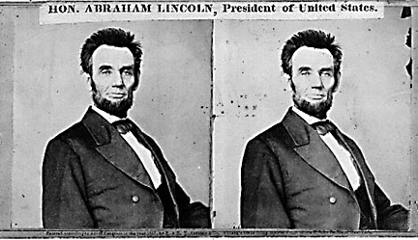
Basic stereo matching algorithm
For each pixel in the first image
  Find corresponding epipolar line in the right image
  Examine all pixels on the epipolar line and pick the best match
  Triangulate the matches to get depth information
Simplest case: epipolar lines are corresponding scanlines
  When does this happen?

Slide 17
Parallel images
Image planes of cameras are parallel to each other and to the baseline
Camera centers are at the same height
Focal lengths are the same
Then epipolar lines fall along horizontal scan lines of the images

Slide 18
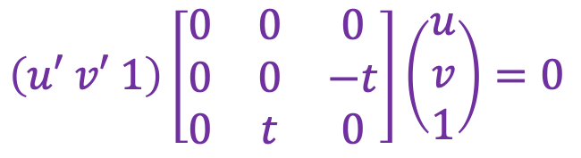
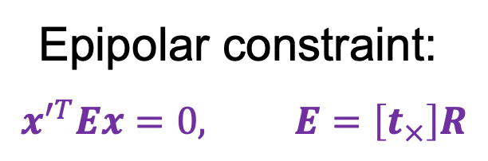
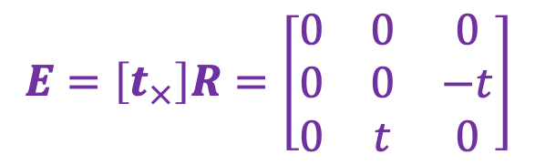


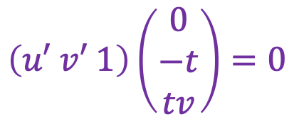


Essential matrix for parallel images
Epipolar constraint:
$$x^{′T}Ex=0, E=\left[t_{×}\right]R$$
$$R = I t = (t, 0, 0)$$
x
$$E=\left[t_{×}\right]R=\left[\begin{matrix}0 & 0 & 0 \\ 0 & 0 & −t \\ 0 & t & 0\end{matrix}\right]$$
$$x′$$
t
$$\left(u′ v′ 1\right)\left[\begin{matrix}0 & 0 & 0 \\ 0 & 0 & −t \\ 0 & t & 0\end{matrix}\right]\left(\begin{aligned}u \\ v \\ 1\end{aligned}\right)=0$$
$$\left(u′ v′ 1\right)\left(\begin{aligned}0 \\ −t \\ tv\end{aligned}\right)=0$$
$$−tv+tv′=0$$
$$v=v′$$
The $y$-coordinates of corresponding points are the same!

Slide 19
Stereo image rectification
If the image planes are not parallel, we can find homographies to project each view onto a common plane parallel to the baseline
C. Loop and Z. Zhang. Computing Rectifying Homographies for Stereo Vision. CVPR 1999

Slide 20
Stereo image rectification
If the image planes are not parallel, we can find homographies to project each view onto a common plane parallel to the baseline
C. Loop and Z. Zhang. Computing Rectifying Homographies for Stereo Vision. CVPR 1999

Slide 21
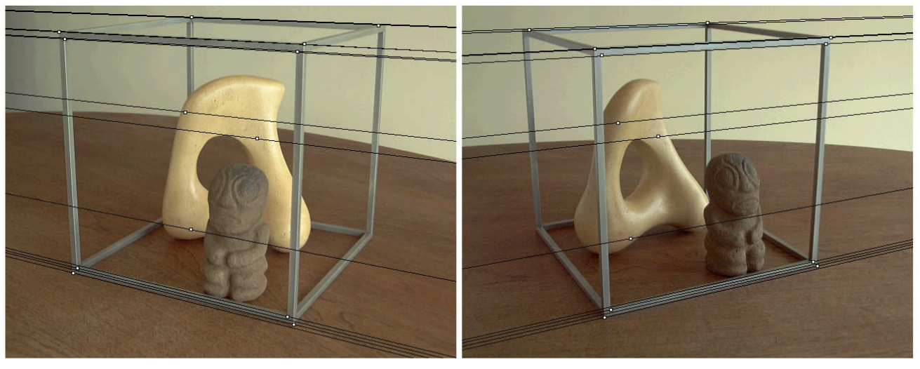
Stereo image rectification
Before rectification:
Image source

Slide 22
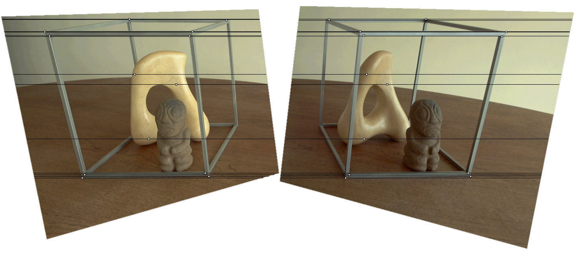
Stereo image rectification
After rectification:
Image source

Slide 23
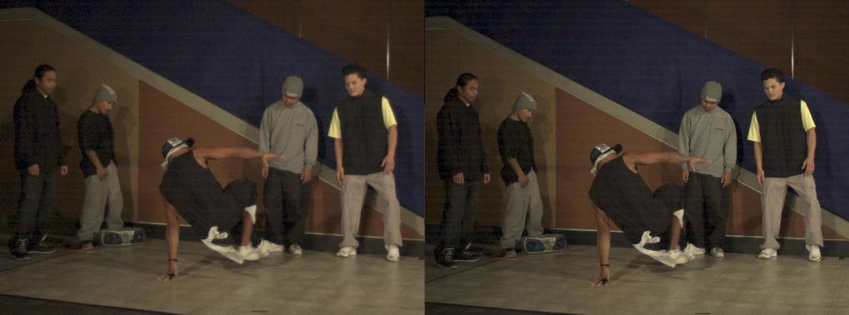
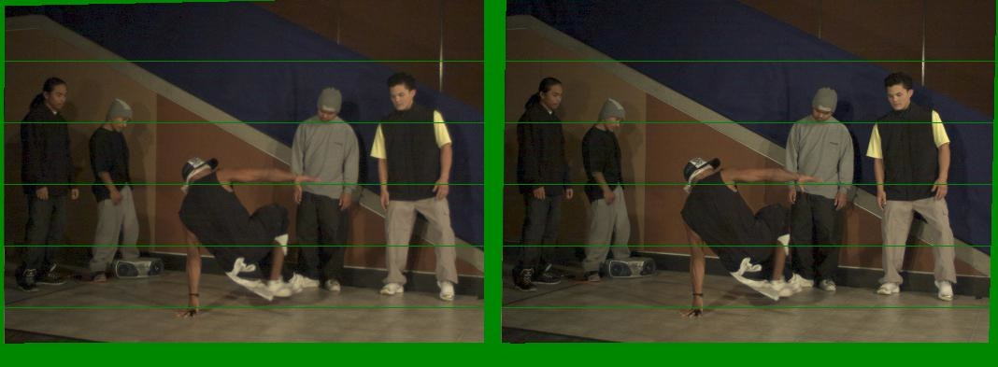
Another rectification example
Unrectified
Rectified

Slide 24
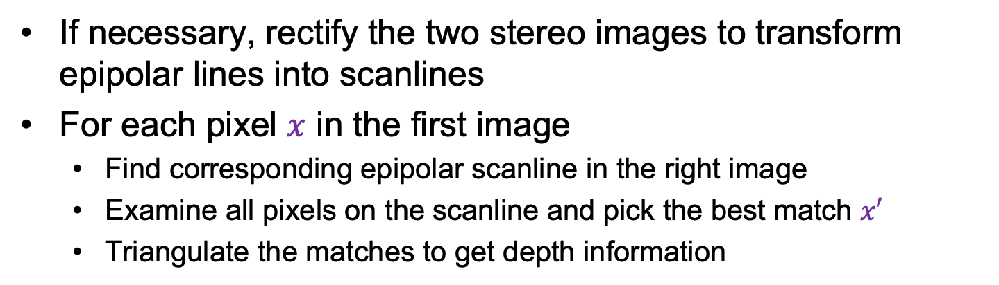
Basic stereo matching algorithm
If necessary, rectify the two stereo images to transform epipolar lines into scanlines
For each pixel $x$ in the first image
  Find corresponding epipolar scanline in the right image
  Examine all pixels on the scanline and pick the best match $x′$
  Triangulate the matches to get depth information

Slide 25


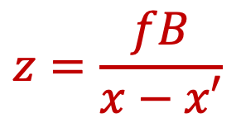



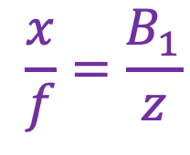
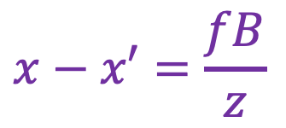



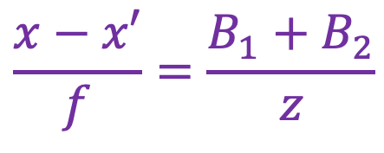



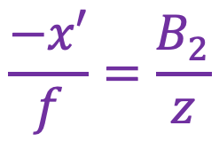
Depth from disparity
$$X$$
$$\frac{x}{f}=\frac{B_{1}}{z}$$
$$\frac{−x′}{f}=\frac{B_{2}}{z}$$
$$z$$
$$\frac{x−x′}{f}=\frac{B_{1}+B_{2}}{z}$$
$$x$$
$$x′$$
$$f$$
$$B1$$
$$B2$$
$$f$$
$$x−x′=\frac{fB}{z}$$
$$O$$
Baseline
$$B$$
$$O′$$
Disparity is inversely proportional to depth!
$$z=\frac{fB}{x−x′}$$

Slide 26


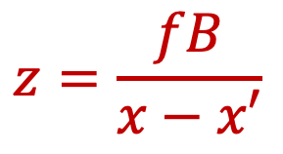



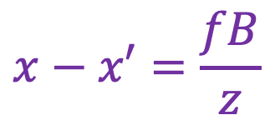
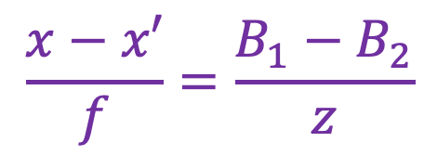




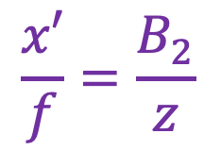
Depth from disparity
$$X$$
$$\frac{x}{f}=\frac{B_{1}}{z}$$
$$\frac{x′}{f}=\frac{B_{2}}{z}$$
$$z$$
$$\frac{x−x′}{f}=\frac{B_{1}−B_{2}}{z}$$
$$x$$
$$x′$$
$$f$$
$$B$$
$$f$$
$$O$$
$$O′$$
$$x−x′=\frac{fB}{z}$$
$$B1$$
$$z=\frac{fB}{x−x′}$$
$$B2$$

Slide 27
Effect of baseline on stereo results
  Larger baseline
    Smaller triangulation error
    Matching is more difficult
  Smaller baseline
    Higher triangulation error
    Matching is easier

Slide 28
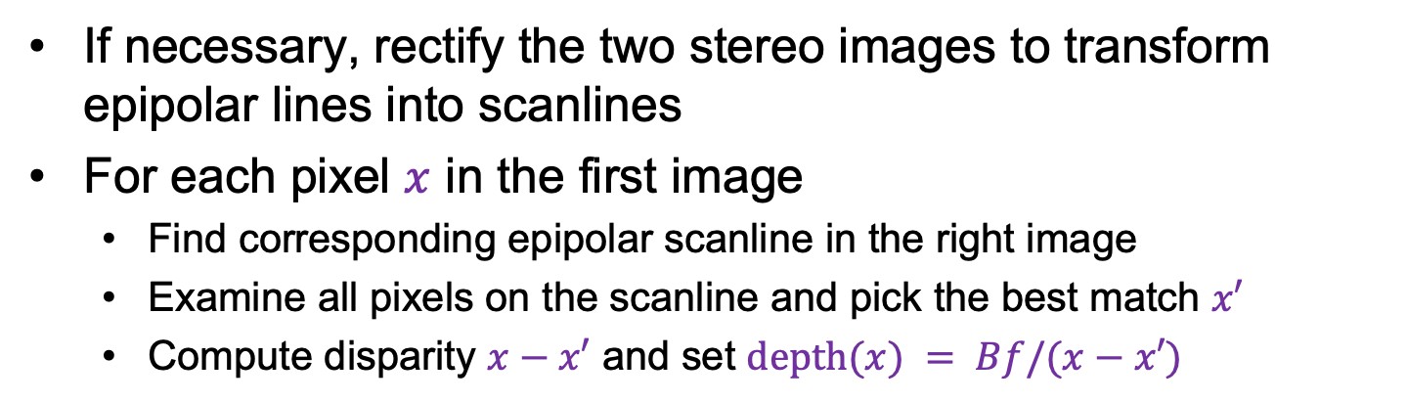
Basic stereo matching algorithm
If necessary, rectify the two stereo images to transform epipolar lines into scanlines
For each pixel $x$ in the first image
  Find corresponding epipolar scanline in the right image
  Examine all pixels on the scanline and pick the best match $x′$
  Compute disparity $x−x′$ and set $depth(x) = Bf/(x−x′)$

Slide 29
Outline
Motivation and history
Basic two-view stereo setup
Local stereo matching algorithm

Slide 30
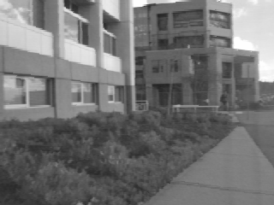
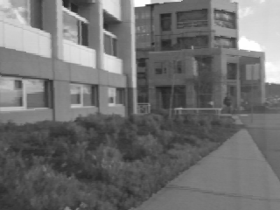
Correspondence search
Left
Right
scanline
Matching cost
disparity
Slide a window along the right scanline and compare contents of that window with the reference window in the left image
Matching cost: SSD (or SAD) or normalized correlation

Slide 31
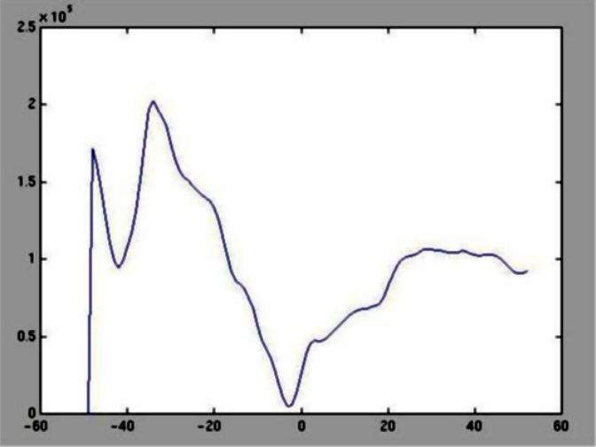
Correspondence search
Left
Right
scanline
SSD

Slide 32
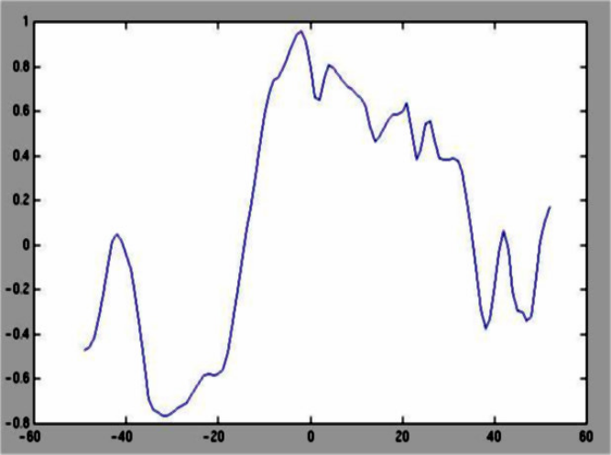
Correspondence search
Left
Right
scanline
Norm. corr

Slide 33
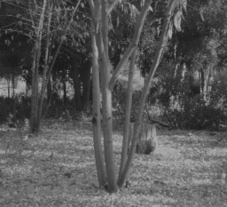
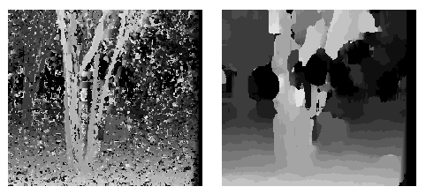
Effect of window size on correspondence search
Window size 3
Window size 20
  Smaller window:
    More detail
    More noise
  Larger window:
    Smoother disparity maps
    Less detail
Notes:
smaller window: more detail, more noise
bigger window: less noise, more detail

Slide 34

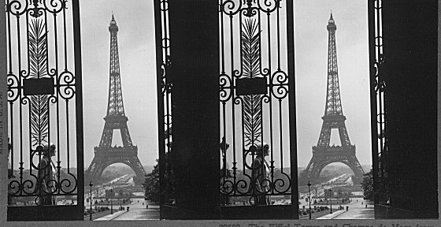
Where will basic window search fail?
Textureless surfaces
Occlusions, repetition
Non-Lambertian surfaces, specularities

Slide 35
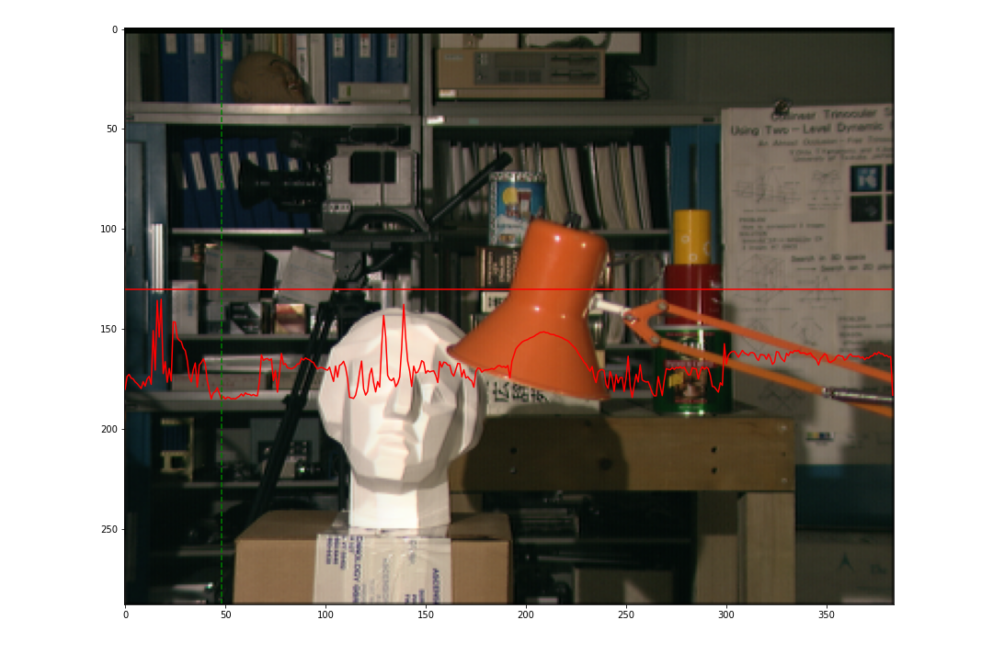
Example: Textured neighborhood
Window size: 1 pixel
Patch Size = 1 pixel
Source: D. Hoiem

Slide 36

Example: Textured neighborhood
Window size: 7 pixels
Source: D. Hoiem

Slide 37

Example: Smooth neighborhood
Window size: 1 pixel
Source: D. Hoiem

Slide 38

Example: Smooth neighborhood
Window size: 7 pixels
Source: D. Hoiem

Slide 39

Example: Edge (occlusion)
Window size: 1 pixel
Source: D. Hoiem

Slide 40

Example: Edge (occlusion)
Window size: 3 pixels
Source: D. Hoiem

Slide 41

Example: Edge (occlusion)
Window size: 7 pixels
Source: D. Hoiem

Slide 42

Example: Specular highlight
Window size: 1 pixel
Source: D. Hoiem

Slide 43

Example: Specular highlight
Window size: 7 pixels
Source: D. Hoiem

Slide 44
Outline
Motivation and history
Basic two-view stereo setup
Local stereo matching algorithm
Beyond local stereo matching

Slide 45
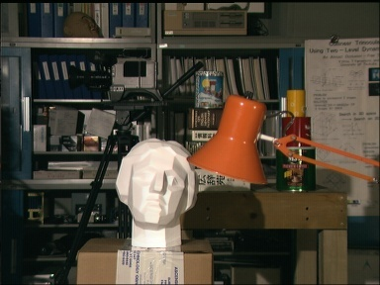

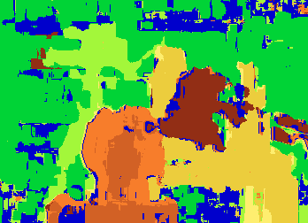

Stereo as optimization with non-local constraints
Global optimization method (graph cuts)
Data
Ground truth
Window-based matching
  Y. Boykov, O. Veksler, and R. Zabih, Fast Approximate Energy Minimization via Graph Cuts, PAMI 2001

Slide 46
Non-local constraint: Uniqueness
Each point in one image should match at most one point in the other image
Does uniqueness always hold in real life?
Source: J. Johnson and D. Fouhey

Slide 47
Non-local constraint: Uniqueness
Each point in one image should match at most one point in the other image
Does uniqueness always hold in real life?
Source: J. Johnson and D. Fouhey

Slide 48
Non-local constraint: Ordering
Corresponding points should appear in the same order
Is ordering always preserved in real life?
a
b
c
Source: J. Johnson and D. Fouhey

Slide 49
Non-local constraint: Ordering
Corresponding points should appear in the same order
Is ordering always preserved in real life?
a
b
c
d
Source: J. Johnson and D. Fouhey

Slide 50
Non-local constraint: Smoothness
We expect disparity values to change slowly (for the most part)

Slide 51

Scanline stereo by dynamic programming
Match pixels along the entire scanline while preserving uniqueness and ordering
Different scanlines are still optimized independently
Left image
Right image
  Y. Ohta and T. Kanade. Stereo by Intra- and Inter-Scanline Search Using Dynamic Programming. IEEE Trans. PAMI, 1985

Slide 52






Scanline stereo by dynamic programming
Left image
Right image
Right
occlusion
q
Left occlusion
correspondence
t
s
p
Source: Y. Boykov
  Y. Ohta and T. Kanade. Stereo by Intra- and Inter-Scanline Search Using Dynamic Programming. IEEE Trans. PAMI, 1985

Slide 53

Scanline stereo by dynamic programming
Generates streaking artifacts!

Slide 54

Stereo matching as global optimization
I₁
I₂
D
W₁(i )
W₂(i+D(i ))
D(i )
$$E\left(D\right)= \sum_{i}{{\left(W_{1}\left(i\right)−W_{2}\left(i+D\left(i\right)\right)\right)}^{2}+λ\sum_{(i,j)∈𝒩 }{ ρ\left(D\left(i\right)−D(j)\right)}}$$
Data term
Neighborhood smoothness term
Energy functions of this form can be minimized using graph cuts
  Y. Boykov, O. Veksler, and R. Zabih, Fast Approximate Energy Minimization via Graph Cuts, PAMI 2001

Slide 55

Stereo matching with deep networks
L. Lipson et al. RAFT-Stereo: Multilevel Recurrent Field Transforms for Stereo Matching. 3DV 2021

Slide 56

Self-supervised depth estimation
R. Garg et al. Unsupervised CNN for Single View Depth Estimation: Geometry to the Rescue. ECCV 2016
Notes:
At training time we consider a pair of images, source and target, with small, known camera motion between the two such as a stereo pair. We train the convolutional encoder for the task of predicting the depth map for the source image. To do so, we explicitly generate an inverse warp of the target image using the predicted depth and known inter-view displacement, to reconstruct the source image; the photometric error in the reconstruction is the reconstruction loss for the encoder.

Slide 57

Cross-View Completion
P. Weinzaepfel et al. CroCo: Self-Supervised Pre-training for 3D Vision Tasks by Cross-View Completion. NeurIPS 2022

Slide 58

Cross-View Completion
P. Weinzaepfel et al. CroCo: Self-Supervised Pre-training for 3D Vision Tasks by Cross-View Completion. NeurIPS 2022

Slide 59

Stereo datasets
Middlebury stereo datasets
KITTI
Synthetic data

Slide 60
Outline
Motivation and history
Basic two-view stereo setup
Local stereo matching algorithm
Stereo with non-local optimization
Active stereo with structured light

Slide 61


Laser scanning
Digital Michelangelo Project
Levoy et al.
http://graphics.stanford.edu/projects/mich/
Optical triangulation
  Project a single stripe of laser light
  Scan it across the surface of the object
  For each point on the stripe, look for the displacement from reference location
Source: S. Seitz

Slide 62

Laser scanned models
  The Digital Michelangelo Project, Levoy et al.
Source: S. Seitz

Slide 63

Laser scanned models
  The Digital Michelangelo Project, Levoy et al.
Source: S. Seitz

Slide 64

Laser scanned models
  The Digital Michelangelo Project, Levoy et al.
Source: S. Seitz

Slide 65

Laser scanned models
  The Digital Michelangelo Project, Levoy et al.
Source: S. Seitz

Slide 66

Laser scanned models
1.0 mm resolution (56 million triangles)
  The Digital Michelangelo Project, Levoy et al.
Source: S. Seitz

Slide 67

Aligning range images
A single range scan is not sufficient to capture a complex surface
Need techniques to register multiple range images (next lecture)
B. Curless and M. Levoy, A Volumetric Method for Building Complex Models from Range Images, SIGGRAPH 1996

Slide 68


Active stereo with structured light
Project “structured” light patterns onto the object
  Simplifies the correspondence problem
  Allows us to use only one camera
camera
projector
L. Zhang, B. Curless, and S. M. Seitz. Rapid Shape Acquisition Using Color Structured Light and Multi-pass Dynamic Programming. 3DPVT 2002

Slide 69



Active stereo with structured light
L. Zhang, B. Curless, and S. M. Seitz. Rapid Shape Acquisition Using Color Structured Light and Multi-pass Dynamic Programming. 3DPVT 2002

Slide 70
Active stereo with structured light
http://en.wikipedia.org/wiki/Structured-light_3D_scanner

Slide 71


Kinect: Structured infrared light
http://bbzippo.wordpress.com/2010/11/28/kinect-in-infrared/

Slide 72

Example: Book vs. No Book
Source (via D. Hoiem)

Slide 73

Example: Book vs. No Book
Source (via D. Hoiem)

Slide 74


Apple TrueDepth
https://www.cnet.com/news/apple-face-id-truedepth-how-it-works/

