Slide 1
Introduction to
Information Retrieval
CS276: Information Retrieval and Web Search
Text Classification 1
Chris Manning and Pandu Nayak

Slide 2
Standing queries
Introduction to Information Retrieval
Ch. 13
The path from IR to text classification:
  You have an information need to monitor, say:
    Unrest in the Niger delta region
  You want to rerun an appropriate query periodically to find new news items on this topic
  You will be sent new documents that are found
    I.e., it’s not ranking but classification (relevant vs. not relevant)
Such queries are called standing queries
  Long used by “information professionals”
  A modern mass instantiation is Google Alerts
Standing queries are (hand-written) text classifiers

Slide 3
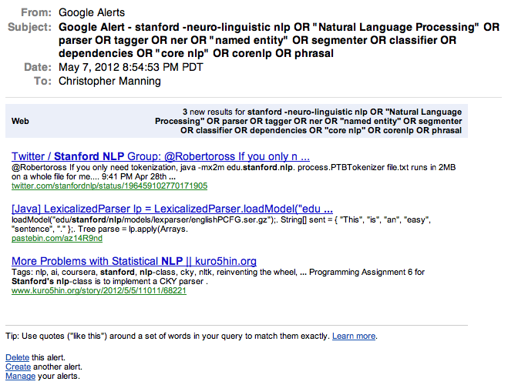
Introduction to Information Retrieval
3

Slide 4
Spam filtering
Another text classification task
Introduction to Information Retrieval
Ch. 13
From: "" <takworlld@hotmail.com>
Subject: real estate is the only way... gem oalvgkay
Anyone can buy real estate with no money down
Stop paying rent TODAY !
There is no need to spend hundreds or even thousands for similar courses
I am 22 years old and I have already purchased 6 properties using the
methods outlined in this truly INCREDIBLE ebook.
Change your life NOW !
=================================================
Click Below to order:
http://www.wholesaledaily.com/sales/nmd.htm
=================================================

Slide 5
Categorization/Classification
Introduction to Information Retrieval
Sec. 13.1
Given:
  A representation of a document d
    Issue: how to represent text documents.
    Usually some type of high-dimensional space – bag of words
  A fixed set of classes:
  C = {c₁, c₂,…, c_{J}}
Determine:
  The category of d: γ(d) ∈ C, where γ(d) is a classification function
  We want to build classification functions (“classifiers”).

Slide 6
Document Classification
Introduction to Information Retrieval
Sec. 13.1
“planning
language
proof
intelligence”
Test
Data:
(AI)
(Programming)
(HCI)
Classes:
ML
Planning
Semantics
Garb.Coll.
Multimedia
GUI
Training
Data:
learning
intelligence
algorithm
reinforcement
network...
planning
temporal
reasoning
plan
language...
programming
semantics
language
proof...
garbage
collection
memory
optimization
region...
...
...
Notes:
Say hierarchical and multiple classes

Slide 7
Classification Methods (1)
Introduction to Information Retrieval
Ch. 13
Manual classification
  Used by the original Yahoo! Directory
  Looksmart, about.com, ODP, PubMed
  Accurate when job is done by experts
  Consistent when the problem size and team is small
  Difficult and expensive to scale
    Means we need automatic classification methods for big problems

Slide 8
Classification Methods (2)
Introduction to Information Retrieval
Ch. 13
Hand-coded rule-based classifiers
  One technique used by news agencies, intelligence agencies, etc.
  Widely deployed in government and enterprise
  Vendors provide “IDE” for writing such rules

Slide 9
Classification Methods (2)
Introduction to Information Retrieval
Ch. 13
Hand-coded rule-based classifiers
  Commercial systems have complex query languages
  Accuracy can be high if a rule has been carefully refined over time by a subject expert
  Building and maintaining these rules is expensive

Slide 10
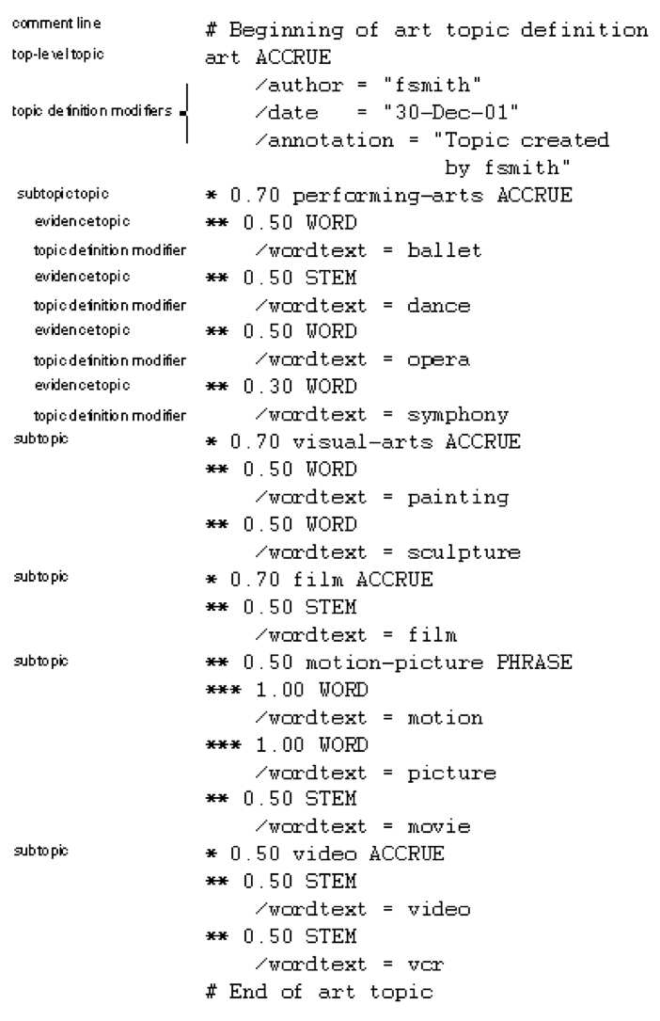
A Verity topic
A complex classification rule: art
Introduction to Information Retrieval
Ch. 13
Note:
  maintenance issues (author, etc.)
  Hand-weighting of terms
  [Verity was bought by Autonomy in 2005, which was bought by HP in 2011 – a mess; I think it no longer exists ...]

Slide 11
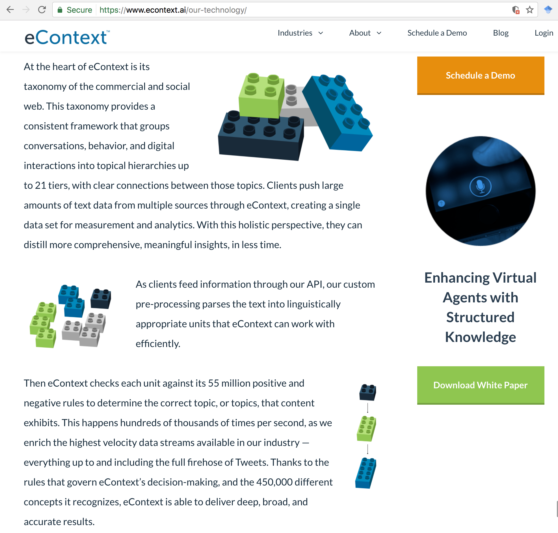
Notes:
Industries: Retail, publishing, Social, Machine Learning.
Advantage: low resource usage, high speed!
eContext’s taxonomy is curated by real people, who classify text the way humans do, taking into consideration the nuance of language, contextual meanings, jokes, and popular culture issues that impact meaning.
We’ve created a taxonomy that is 21 tiers deep with 450,000 categories and 55 million vocabulary rules.

Slide 12
Classification Methods (3):
Supervised learning
Introduction to Information Retrieval
Sec. 13.1
Given:
  A document d
  A fixed set of classes:
  C = {c₁, c₂,…, c_{J}}
  A training set D of documents each with a label in C
Determine:
  A learning method or algorithm which will enable us to learn a classifier γ
  For a test document d, we assign it the class
  γ(d) ∈ C

Slide 13
Classification Methods (3)
Introduction to Information Retrieval
Ch. 13
Supervised learning
  Naive Bayes (simple, common) – see video, cs229
  k-Nearest Neighbors (simple, powerful)
  Support-vector machines (newer, generally more powerful)
  Decision trees → random forests →
  gradient-boosted decision trees (e.g., xgboost)
  … plus many other methods
  No free lunch: need hand-classified training data
  But data can be built up by amateurs
Many commercial systems use a mix of methods

Slide 14
Features
Introduction to Information Retrieval
Supervised learning classifiers can use any sort of feature
  URL, email address, punctuation, capitalization, dictionaries, network features
In the simplest bag of words view of documents
  We use only word features
  we use all of the words in the text (not a subset)

Slide 15
The bag of words representation
Introduction to Information Retrieval
I love this movie! It's sweet, but with satirical humor. The dialogue is great and the adventure scenes are fun… It manages to be whimsical and romantic while laughing at the conventions of the fairy tale genre. I would recommend it to just about anyone. I've seen it several times, and I'm always happy to see it again whenever I have a friend who hasn't seen it yet.
γ(
)=c

Slide 16
The bag of words representation
Introduction to Information Retrieval
great | 2
love | 2
recommend | 1
laugh | 1
happy | 1
... | ...
γ(
)=c

Slide 17
Feature Selection: Why?
Introduction to Information Retrieval
Sec.13.5
Text collections have a large number of features
  10,000 – 1,000,000 unique words … and more
Selection may make a particular classifier feasible
  Some classifiers can’t deal with 1,000,000 features
Reduces training time
  Training time for some methods is quadratic or worse in the number of features
Makes runtime models smaller and faster
Can improve generalization (performance)
  Eliminates noise features
  Avoids overfitting

Slide 18
Feature Selection: Frequency
Introduction to Information Retrieval
The simplest feature selection method:
  Just use the commonest terms
  No particular foundation
  But it make sense why this works
    They’re the words that can be well-estimated and are most often available as evidence
  In practice, this is often 90% as good as better methods
Smarter feature selection:
  chi-squared, etc.

Slide 19
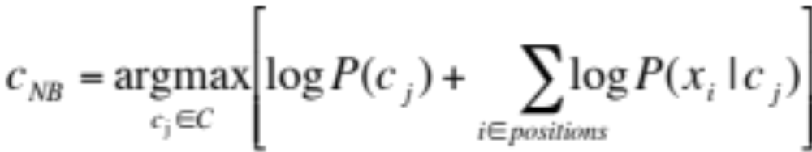
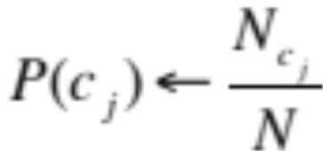
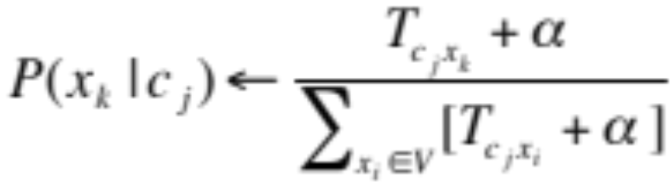
Naïve Bayes: See IIR 13 or cs124 lecture on Coursera or cs229
Classify based on prior weight of class and conditional parameter for what each word says:
Training is done by counting and dividing:
Don’t forget to smooth

Slide 20
SpamAssassin
Introduction to Information Retrieval
Naïve Bayes has found a home in spam filtering
  Paul Graham’s A Plan for Spam
  Widely used in spam filters
  But many features beyond words:
    black hole lists, etc.
    particular hand-crafted text patterns
Notes:
Apache SpamAssassin is the #1 Open Source anti-spam platform. Written in Perl!

Slide 21
SpamAssassin Features:
Introduction to Information Retrieval
  Basic (Naïve) Bayes spam probability
  Mentions: Generic Viagra
  Regex: millions of (dollar) ((dollar) NN,NNN,NNN.NN)
  Phrase: impress ... girl
  Phrase: ‘Prestigious Non-Accredited Universities’
  From: starts with many numbers
  Subject is all capitals
  HTML has a low ratio of text to image area
  Relay in RBL, http://www.mail-abuse.com/enduserinfo_rbl.html
  RCVD line looks faked
  http://spamassassin.apache.org/tests_3_3_x.html

Slide 22
Naive Bayes is Not So Naive
Introduction to Information Retrieval
Very fast learning and testing (basically just count words)
Low storage requirements
Very good in domains with many equally important features
More robust to irrelevant features than many learning methods
  Irrelevant features cancel out without affecting results

Slide 23
Naive Bayes is Not So Naive
Introduction to Information Retrieval
More robust to concept drift (changing class definition over time)
Naive Bayes won 1st and 2nd place in KDD-CUP 97 competition out of 16 systems
  Goal: Financial services industry direct mail response prediction: Predict if the recipient of mail will actually respond to the advertisement – 750,000 records.
A good dependable baseline for text classification (but not the best)!

Slide 24
Evaluating Categorization
Introduction to Information Retrieval
Sec.13.6
Evaluation must be done on test data that are independent of the training data
  Sometimes use cross-validation (averaging results over multiple training and test splits of the overall data)
Easy to get good performance on a test set that was available to the learner during training (e.g., just memorize the test set)

Slide 25
Evaluating Categorization
Introduction to Information Retrieval
Sec.13.6
Measures: precision, recall, F1, classification accuracy
Classification accuracy: r/n where n is the total number of test docs and r is the number of test docs correctly classified

Slide 26

WebKB Experiment (1998)
Introduction to Information Retrieval
Sec.13.6
Classify webpages from CS departments into:
  student, faculty, course, project
Train on ~5,000 hand-labeled web pages
  Cornell, Washington, U.Texas, Wisconsin
Crawl and classify a new site (CMU) using Naïve Bayes
Results

Slide 27
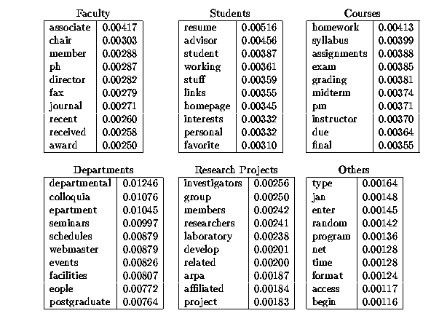
Introduction to Information Retrieval

Slide 28
Remember: Vector Space Representation
Sec.14.1
Each document is a vector, one component for each term (= word).
Normally normalize vectors to unit length.
High-dimensional vector space:
  Terms are axes
  10,000+ dimensions, or even 100,000+
  Docs are vectors in this space
How can we do classification in this space?

Slide 29
Classification Using Vector Spaces
Introduction to Information Retrieval
In vector space classification, training set corresponds to a labeled set of points (equivalently, vectors)
Premise 1: Documents in the same class form a contiguous region of space
Premise 2: Documents from different classes don’t overlap (much)
Learning a classifier: build surfaces to delineate classes in the space

Slide 30
Documents in a Vector Space
Sec.14.1
Government
Science
Arts

Slide 31
Test Document of what class?
Sec.14.1
Government
Science
Arts

Slide 32
Test Document = Government
Sec.14.1
Government
Science
Arts
Our focus: how to find good separators

Slide 33
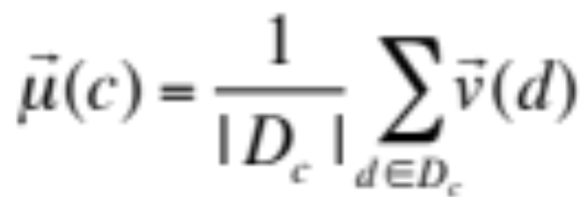
Definition of centroid
Sec.14.2
Where D_{c} is the set of all documents that belong to class c and v(d) is the vector space representation of d.
Note that centroid will in general not be a unit vector even when the inputs are unit vectors.

Slide 34
Rocchio classification
Sec.14.2
Rocchio forms a simple representative for each class: the centroid/prototype
Classification: nearest prototype/centroid
It does not guarantee that classifications are consistent with the given training data
Why not?

Slide 35
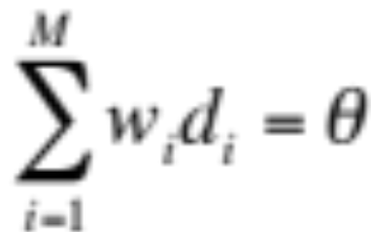
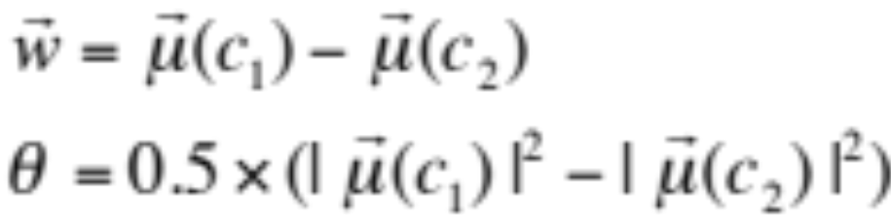
Two-class Rocchio as a linear classifier
Sec.14.2
Line or hyperplane defined by:
For Rocchio, set:

Slide 36
Linear classifier: Example
Sec.14.4
Class: “interest” (as in interest rate)
Example features of a linear classifier
w_{i} t_{i} w_{i} t_{i}
To classify, find dot product of feature vector and weights
0.70 prime
0.67 rate
0.63 interest
0.60 rates
0.46 discount
0.43 bundesbank
−0.71 dlrs
−0.35 world
−0.33 sees
−0.25 year
−0.24 group
−0.24 dlr

Slide 37
Rocchio classification
Sec.14.2
A simple form of Fisher’s linear discriminant
Little used outside text classification
  It has been used quite effectively for text classification
  But in general worse than Naïve Bayes
Again, cheap to train and test documents

Slide 38
k Nearest Neighbor Classification
Sec.14.3
kNN = k Nearest Neighbor
To classify a document d:
Define k-neighborhood as the k nearest neighbors of d
Pick the majority class label in the k-neighborhood
For larger k can roughly estimate P(c|d) as #(c)/k

Slide 39
Test Document = Science
Sec.14.1
Government
Science
Arts
Voronoi diagram

Slide 40
Nearest-Neighbor Learning
Sec.14.3
Learning: just store the labeled training examples D
Testing instance x (under 1NN):
  Compute similarity between x and all examples in D.
  Assign x the category of the most similar example in D.
Does not compute anything beyond storing the examples
Also called:
  Case-based learning
  Memory-based learning
  Lazy learning
Rationale of kNN: contiguity hypothesis

Slide 41
k Nearest Neighbor
Sec.14.3
Using only the closest example (1NN) is subject to errors due to:
  A single atypical example.
  Noise (i.e., an error) in the category label of a single training example.
More robust: find the k examples and return the majority category of these k
k is typically odd to avoid ties; 3 and 5 are most common

Slide 42
Nearest Neighbor with Inverted Index
Sec.14.3
Naively finding nearest neighbors requires a linear search through |D| documents in collection
But determining k nearest neighbors is the same as determining the k best retrievals using the test document as a query to a database of training documents.
Use standard vector space inverted index methods to find the k nearest neighbors.
Testing Time: O(B|V_{t}|) where B is the average number of training documents in which a test-document word appears.
  Typically B << |D|

Slide 43
kNN: Discussion
Sec.14.3
No feature selection necessary
No training necessary
Scales well with large number of classes
  Don’t need to train n classifiers for n classes
Classes can influence each other
  Small changes to one class can have ripple effect
Done naively, very expensive at test time
In most cases it’s more accurate than NB or Rocchio
  As the amount of data goes to infinity, it has to be a great classifier! – it’s “Bayes optimal”

Slide 44
Let’s test our intuition
Can a bag of words always be viewed as a vector space?
What about a bag of features?
Can we always view a standing query as a contiguous region in a vector space?
Do far away points influence classification in a kNN classifier? In a Rocchio classifier?
Can a Rocchio classifier handle disjunctive classes?
Why do linear classifiers actually work well for text?

Slide 45
Rocchio Anomaly
Sec.14.2
Prototype models have problems with polymorphic (disjunctive) categories.

Slide 46
3 Nearest Neighbor vs. Rocchio
Nearest Neighbor tends to handle polymorphic categories better than Rocchio/NB.

Slide 47
Bias vs. capacity – notions and terminology
Sec.14.6
Consider asking a botanist: Is an object a tree?
  Too much capacity, low bias
    Botanist who memorizes
    Will always say “no” to new object (e.g., different # of leaves)
  Not enough capacity, high bias
    Lazy botanist
    Says “yes” if the object is green
  You want the middle ground
        (Example due to C. Burges)
Notes:
Bias/variance in terms of resulting classifier given randomly selected training set; why it is a tradeoff; when to choose low-bias method, when to choose low-variance method

Slide 48
kNN vs. Naive Bayes
Sec.14.6
Bias/Variance tradeoff
  Variance ≈ Capacity
kNN has high variance and low bias.
  Infinite memory
Rocchio/NB has low variance and high bias.
  Linear decision surface between classes
Notes:
Bias/variance in terms of resulting classifier given randomly selected training set; why it is a tradeoff; when to choose low-bias method, when to choose low-variance method

Slide 49
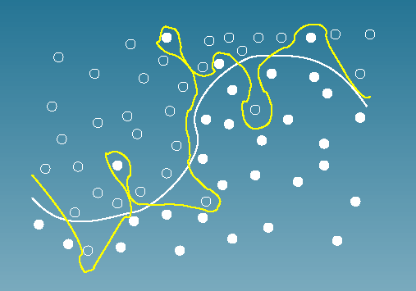
Bias vs. variance:
Choosing the correct model capacity
Sec.14.6

Slide 50
Summary: Representation of
Text Categorization Attributes
Representations of text are usually very high dimensional
  “The curse of dimensionality”
High-bias algorithms should generally work best in high-dimensional space
  They prevent overfitting
  They generalize more
For most text categorization tasks, there are many relevant features & many irrelevant ones
Notes:
Explain supervised learning

Slide 51
Which classifier do I use for a given text classification problem?
Is there a learning method that is optimal for all text classification problems?
No, because there is a tradeoff between bias and variance.
Factors to take into account:
  How much training data is available?
  How simple/complex is the problem? (linear vs. nonlinear decision boundary)
  How noisy is the data?
  How stable is the problem over time?
    For an unstable problem, it’s better to use a simple and robust classifier.

