Slide 1
CS276: Information Retrieval and Web Search
Christopher Manning and Pandu Nayak
Lecture 13: Decision trees and machine learning on documents
Some slides borrowed from John Canny

Slide 2
Text classification
Last lecture: Basic algorithms for text classification
  Naive Bayes classifier
    Simple, cheap, high bias, linear
  K Nearest Neighbor classification
    Simple, expensive at test time, high variance, non-linear
  Vector space classification: Rocchio
    Simple linear discriminant classifier; perhaps too simple*
Today
  Decision trees
  Some empirical evaluation and comparison
  Decision tree ensembles
    Will lead into using tree-based methods (GBRT) for ranking
  Text-specific issues in classification
Notes:
*Li and Yiming Yang 2003 ICML give very good performance from Rocchio, whereas Dumais et al. don’t

Slide 3
Text Classification Evaluation:
Classic Reuters-21578 Data Set
Sec. 15.2.4
Most (over)used data set
21578 documents
9603 training, 3299 test articles (ModApte/Lewis split)
118 categories
  An article can be in more than one category
  Learn 118 binary category distinctions
Average document: about 90 types, 200 tokens
Average number of classes assigned
  1.24 for docs with at least one category
Only about 10 out of 118 categories are large
Common categories
(#train, #test)
Earn (2877, 1087)
Acquisitions (1650, 179)
Money-fx (538, 179)
Grain (433, 149)
Crude (389, 189)
Trade (369,119)
Interest (347, 131)
Ship (197, 89)
Wheat (212, 71)
Corn (182, 56)

Slide 4
Reuters Text Categorization data set (Reuters-21578) document
Sec. 15.2.4
<REUTERS TOPICS="YES" LEWISSPLIT="TRAIN" CGISPLIT="TRAINING-SET" OLDID="12981" NEWID="798">
<DATE> 2-MAR-1987 16:51:43.42</DATE>
<TOPICS><D>livestock</D><D>hog</D></TOPICS>
<TITLE>AMERICAN PORK CONGRESS KICKS OFF TOMORROW</TITLE>
<DATELINE> CHICAGO, March 2 - </DATELINE><BODY>The American Pork Congress kicks off tomorrow, March 3, in Indianapolis with 160 of the nations pork producers from 44 member states determining industry positions on a number of issues, according to the National Pork Producers Council, NPPC.
Delegates to the three day Congress will be considering 26 resolutions concerning various issues, including the future direction of farm policy and the tax law as it applies to the agriculture sector. The delegates will also debate whether to endorse concepts of a national PRV (pseudorabies virus) control and eradication program, the NPPC said.
A large trade show, in conjunction with the congress, will feature the latest in technology in all areas of the industry, the NPPC added. Reuter
&#3;</BODY></TEXT></REUTERS>

Slide 5
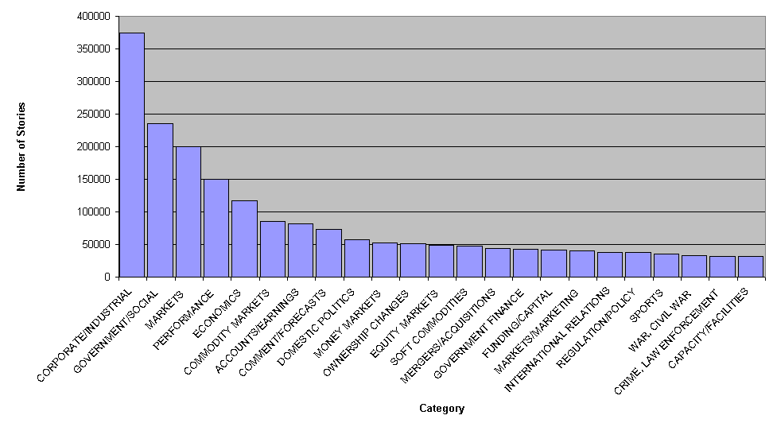
Newer Reuters data: RCV1: 810,000 docs
Top topics in Reuters RCV1

Slide 6
Decision Trees for text classification
A tree with internal nodes labeled by terms
Branches are labeled by tests on the weight that the term has (or just presence/absence)
Leaves are labeled by categories
Classifier categorizes document by descending tree following tests to leaf
The label of the leaf node is then assigned to the document
Most decision trees are binary trees (never disadvantageous; may require extra internal nodes)

Slide 7
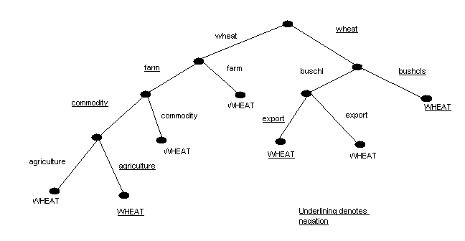
Decision Tree Example
bushel
bushel

Slide 8
Decision Tree Learning
Learn a sequence of tests on features, typically using top-down, greedy search
  At each stage choose unused feature with highest Information Gain
At leaves, either categorical (yes/no) or continuous decisions
f₁
!f₁
f₇
!f₇
P(class) = .9
P(class) = .6
P(class) = .2

Slide 9
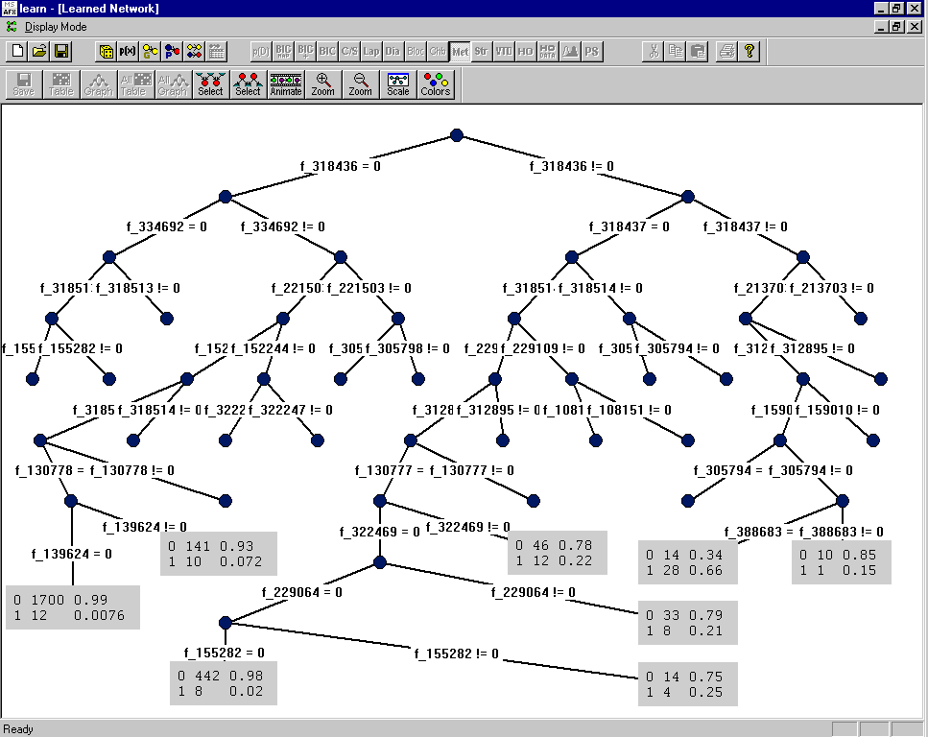
Note that you can reuse the same attribute
Category: “interest”
rate=1
rate.t=1
lending=0
prime=0
discount=0
pct=1
year=0
year=1

Slide 10
Decision tree learning
If there are k features, a decision tree might have up to 2^{k} nodes. This is almost always much too big!
We want to find “efficient” (small but effective) trees.
We can do this in a greedy manner by recursively choosing a best split feature at each node.

Slide 11
Choosing an attribute
Idea: a good features splits the examples into subsets that are (ideally) “all positive” or “all negative”
  This is binary case. Same idea and method works for n-ary case except for a bias towards many valued features.
A good feature A bad feature: Wheat is still 60%
bushel?
canada?
Yes
No
Yes
No

Slide 12
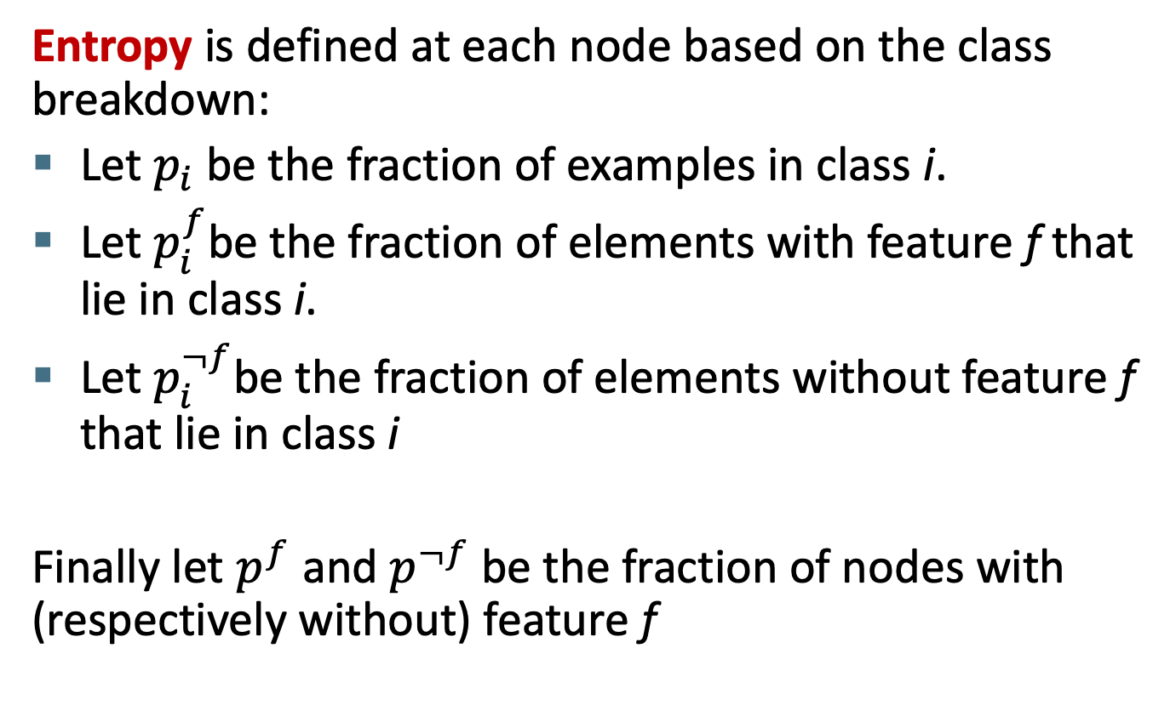
Using Information Theory
Entropy is defined at each node based on the class breakdown:
Let $p_{i}$ be the fraction of examples in class i.
Let $p_{i}^{f}$be the fraction of elements with feature f that lie in class i.
Let $p_{i}^{¬f}$be the fraction of elements without feature f that lie in class i
Finally let $p^{f}$ and $p^{¬f}$ be the fraction of nodes with (respectively without) feature f

Slide 13
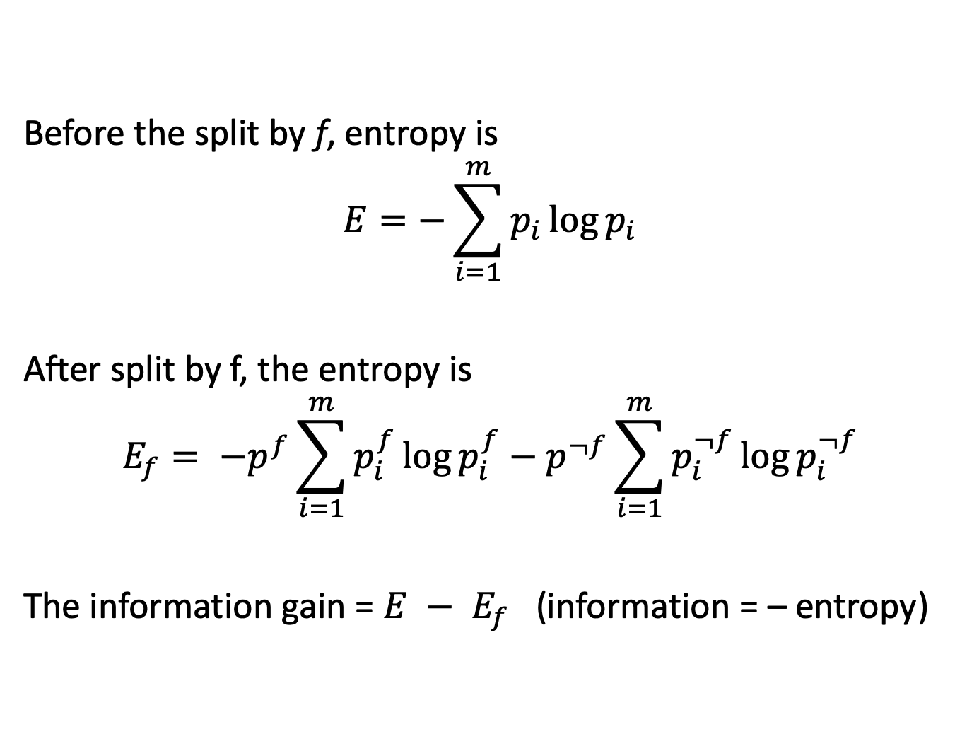
Information Gain
Before the split by f, entropy is
$$E=−\sum_{i=1}^{m}{p_{i}\log{p_{i}}}$$
After split by f, the entropy is
$$E_{f}= {−p}^{f}\sum_{i=1}^{m}{p_{i}^{f}\log{p_{i}^{f}}}−p^{¬f}\sum_{i=1}^{m}{p_{i}^{¬f}\log{p_{i}^{¬f}}}$$
The information gain = $E − E_{f}$ (information = – entropy)

Slide 14
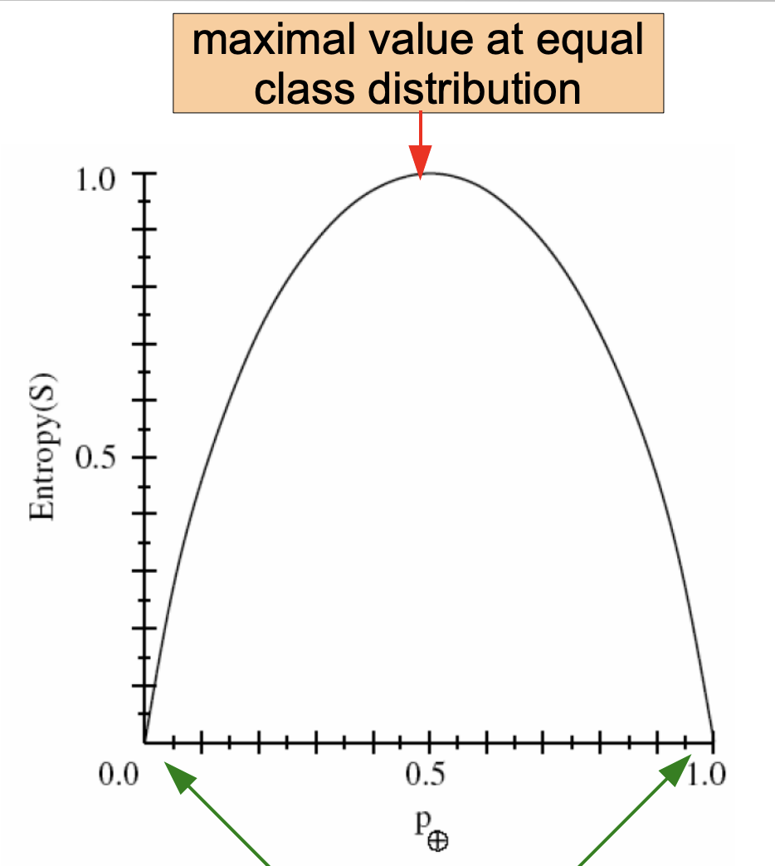
Using Information Theory
Entropy: amount of uncertainty in class distribution
Two class case:
Zero when all items of the same class

Slide 15
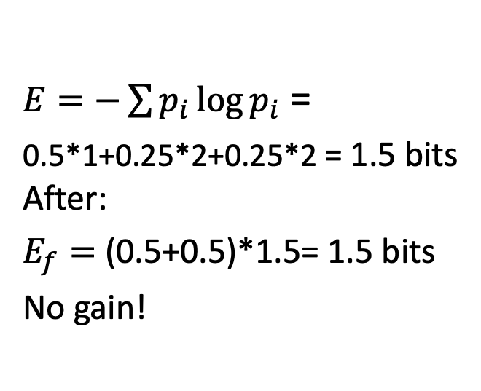
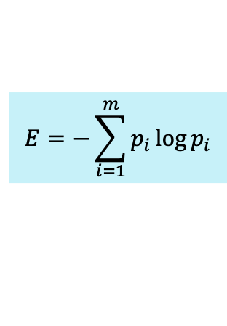
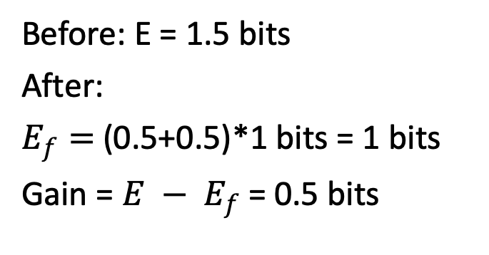
Example
$$E=−\sum_{i=1}^{m}{p_{i}\log{p_{i}}}$$
P = (0.5,0.25,0.25)
P = (0.5,0.25,0.25)
AAAA
BB
CC
Classes A, B, C
AAAA
BB
CC
Split by
canada feature
Split by
bushel feature
AA
B
C
AA
B
C
AA
CC
AA
BB
(0.5,0.25,0.25)
(0.5,0.25,0.25)
(0.5,0,0.5)
(0.5,0.5,0)
$E=−\sum{p_{i}\log{p_{i}}}$ =
0.5*1+0.25*2+0.25*2 = 1.5 bits
After:
$E_{f}=$ (0.5+0.5)*1.5= 1.5 bits
No gain!
Before: E = 1.5 bits
After:
$E_{f}=$ (0.5+0.5)*1 bits = 1 bits
Gain = $E − E_{f}$ = 0.5 bits
Notes:
Since parent is constant, you’re just minimizing weighted average entropy of children. But helps to see if you are winning.

Slide 16
Choosing best features
At each node, we choose the feature f which maximizes the information gain.
This tends to be produce mixtures of classes at each node that are more and more “pure” as you go down the tree.
If a node has examples all of one class c, we make it a leaf and output “c”. Otherwise, we potentially continue to build
If a leaf still has a mixed distribution, we output the most popular class at that node.

Slide 17
Numeric features (e.g., tf-idf, etc.)
Commonly make a binary split (f < t), but where?
Exhaustively: evaluate each split point between observed values for information gain.
  Slow.
  Can be made a bit more efficient by optimizing counting
Discretize into bins
  Divide all numeric values into k bins.
  Feature is treated as if categorical
  Binning can be based on statistics of the entire dataset
    For instance one might use k-means clustering on values of feature

Slide 18
When to stop?
When all the examples at a node are of the same class
When a fixed tree depth d is reached
When there isn’t an attribute you can split on where the split differentiates classes with statistical significance (e.g., with chi-square or Fisher’s Exact)
Commonest/best: Use separate validation data
  Grow a big tree (perhaps with depth threshold)
  Prune nodes bottom up that fail to (significantly) improve classification performance on the validation data

Slide 19
Decision Tree Models
As tree depth increases, bias decreases and variance generally increases. Why? (Hint: think about k-NN)
Some of the stuff fit deep in a tree is fairly random facts and associations in the training data
Bias decreases
with tree depth
Variance increases
with tree depth

Slide 20
Decision trees classify via rectangular regions
The (rectangular) regions are aligned with feature axes
The model cannot learn arbitrary linear decision boundaries
Overall, the result is a non-linear classifier

Slide 21
Decision Tree Learning for Text
Most people’s intuitions are that text has many words and you have a lot of weak-evidence features
  Hence, use of a small number of feature tests is potentially bad for text classification
  But in fact the method can sometime do pretty well – such as for the Reuters dataset. Topics can have marker words.
Decision trees are easily interpreted by humans – much more easily than methods like Naive Bayes
  You can extract rules from decision trees, in fact.

Slide 22
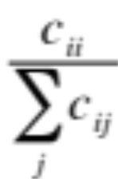
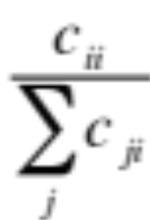
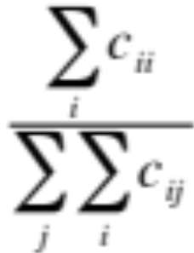
Text classification
Per class evaluation measures
Sec. 15.2.4
Recall: Fraction of docs in class i classified correctly:
Precision: Fraction of docs assigned class i that are actually about class i:
Accuracy: (1 - error rate) Fraction of docs classified correctly:

Slide 23
Micro- vs. Macro-Averaging
Sec. 15.2.4
If we have more than one class, how do we combine multiple performance measures into one quantity?
Macroaveraging: Compute performance for each class, then average.
Microaveraging: Collect decisions for all classes, compute contingency table, evaluate.

Slide 24
Micro- vs. Macro-Averaging: Example
Sec. 15.2.4
Class 1
Class 2
Micro Ave. Table
 | Truth: yes | Truth: no
Classifier: yes | 10 | 10
Classifier: no | 10 | 970
 | Truth: yes | Truth: no
Classifier: yes | 90 | 10
Classifier: no | 10 | 890
 | Truth: yes | Truth: no
Classifier: yes | 100 | 20
Classifier: no | 20 | 1860
Macroaveraged precision: (0.5 + 0.9)/2 = 0.7
Microaveraged precision: 100/120 = .83
Microaveraged score is dominated by score on common classes

Slide 25
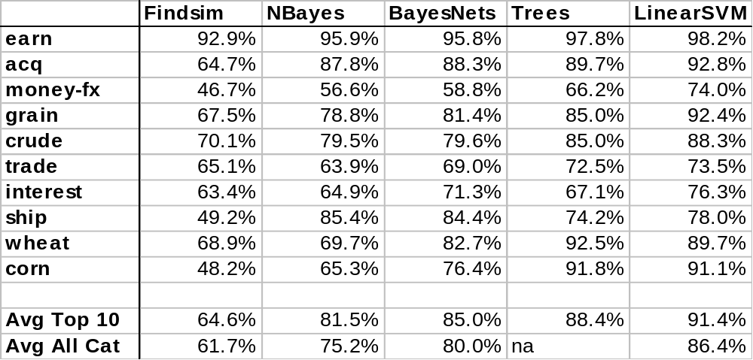
Dumais et al. 1998:
Reuters – Break-even F1
Micro
Recall: % labeled in category among those stories that are really in category
Precision: % really in category among those stories labeled in category
Break Even: When recall equals precision

Slide 26
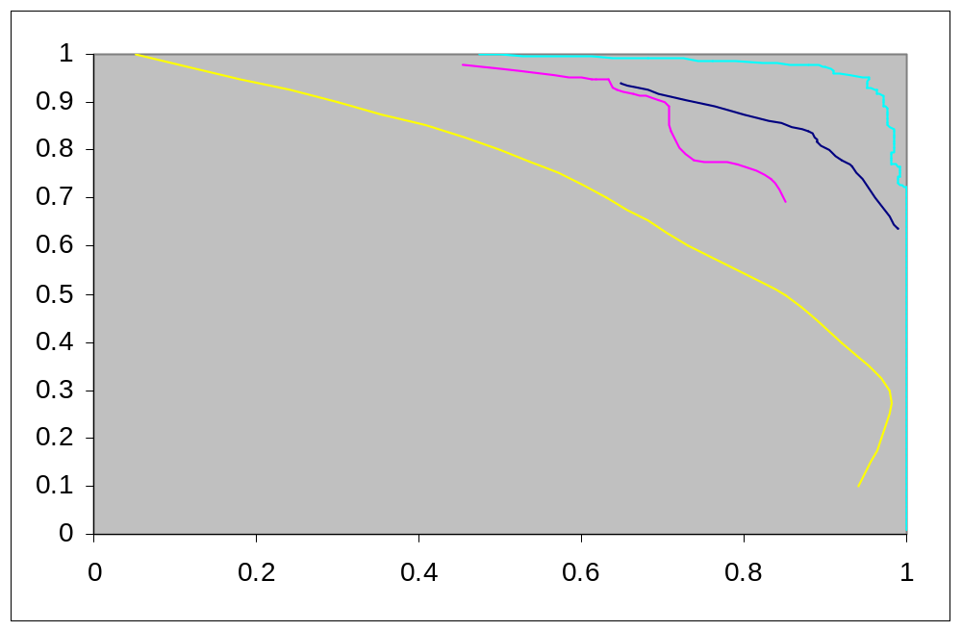
Reuters ROC - Category Grain
Recall
LSVM
Decision Tree Naïve Bayes
Find Similar
Precision
Recall: % labeled in category among those stories that are really in category
Precision: % really in category among those stories labeled in category

Slide 27
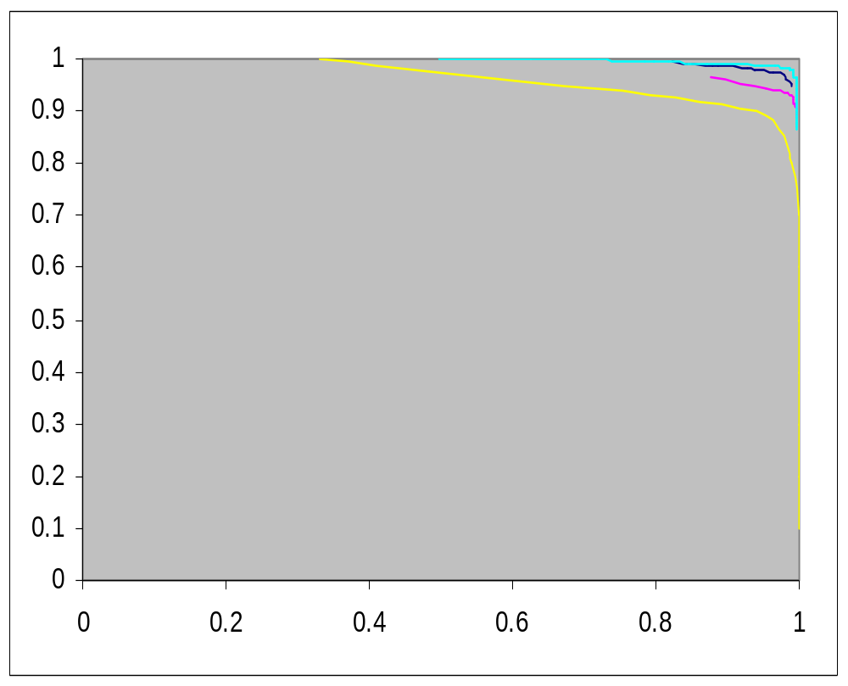
ROC for Category - Earn
Recall
LSVM
Decision Tree Naïve Bayes
Find Similar
Precision

Slide 28
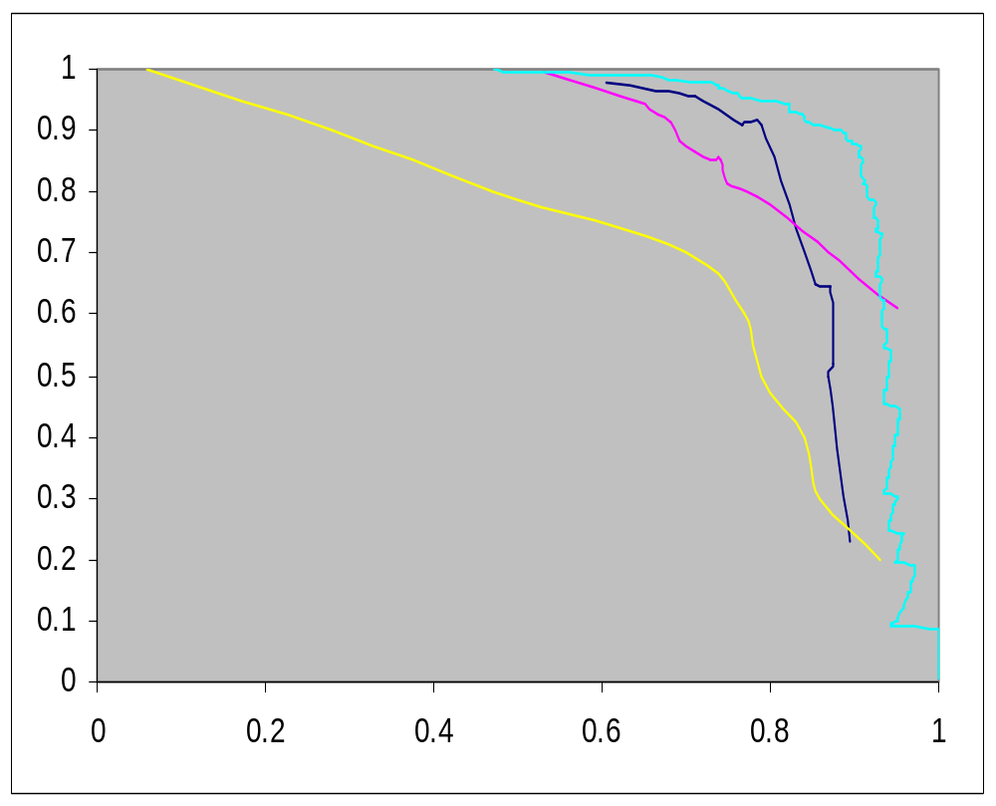
ROC for Category - Crude
Recall
LSVM
Decision Tree Naïve Bayes
Find Similar
Precision

Slide 29
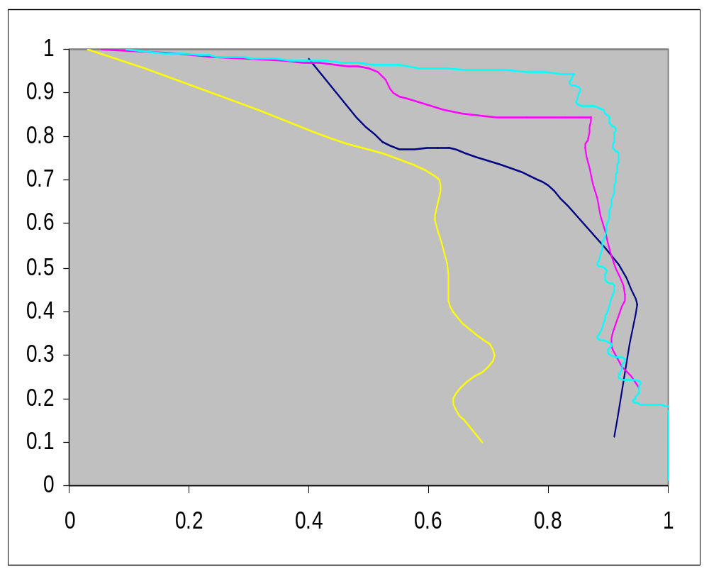
ROC for Category - Ship
Recall
LSVM
Decision Tree Naïve Bayes
Find Similar
Precision

Slide 30
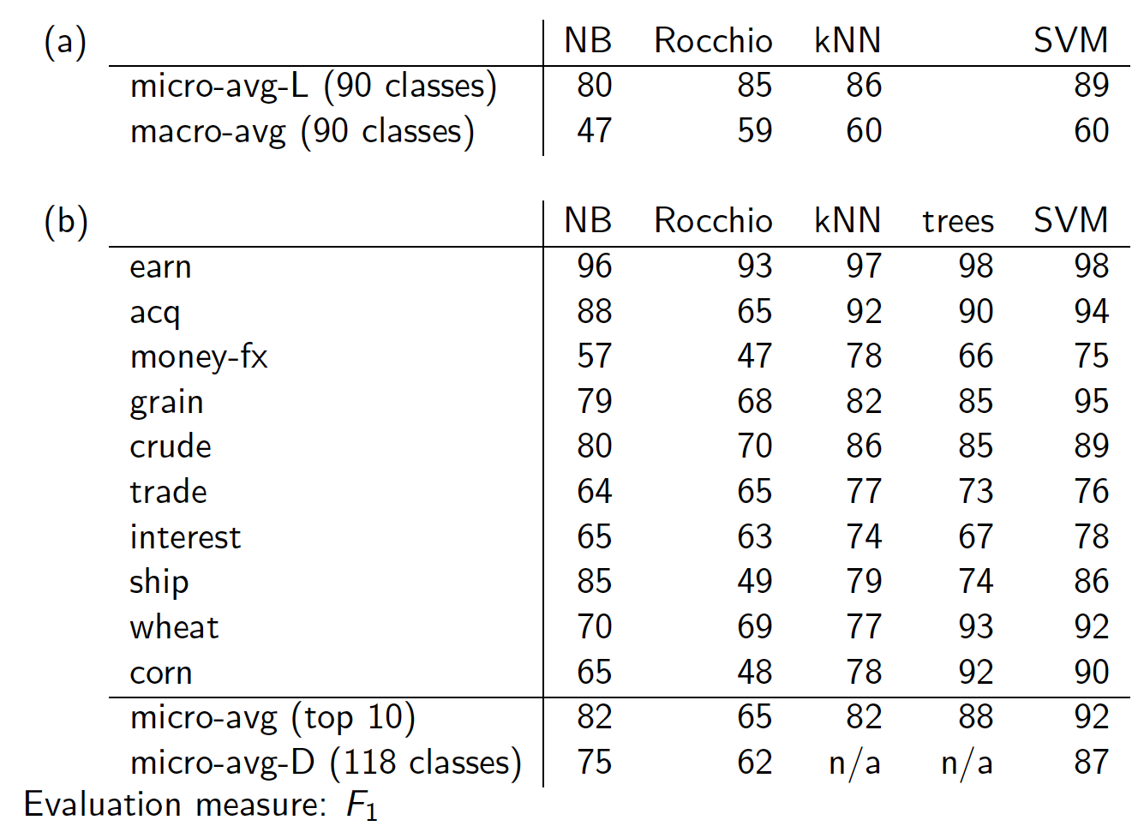
Sec. 15.2.4
Notes:
Top numbers Li and Yang 2003, bottom Joachims 1998 or Dumais et al 1998

Slide 31
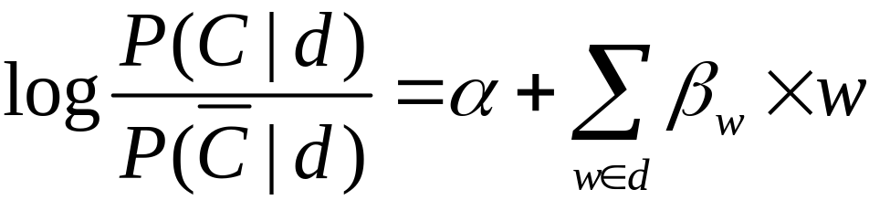
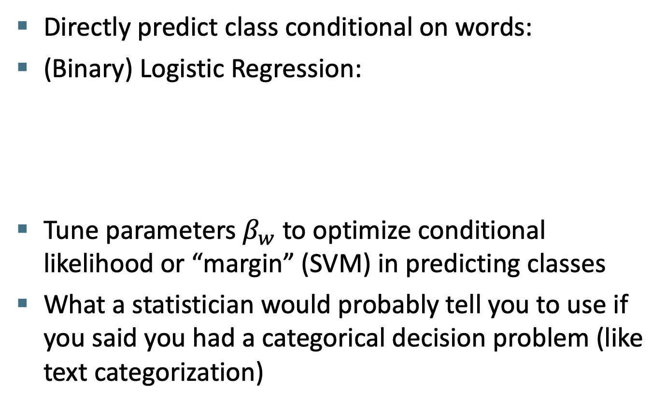
The discriminative alternative: Logistic Regression and Support vector machines
Directly predict class conditional on words:
(Binary) Logistic Regression:
Tune parameters $β_{w}$ to optimize conditional likelihood or “margin” (SVM) in predicting classes
What a statistician would probably tell you to use if you said you had a categorical decision problem (like text categorization)

Slide 32
LogR/SVM Performance
Early results with LogR were disappointing, because people didn’t understand the means to regularize (smooth) LogR to cope with sparse textual features
Done right, LogR clearly outperforms NB in text categorization and batch filtering studies
SVMs were seen as the best general text classification method in the period c. 1997– 2005
LogR seems as good as SVMs (Tong & Oles 2001)
But now challenged by:
  Neural net methods (improve word similarity models)
  Ensemble methods, e.g. random forests, boosting

Slide 33
Ensemble Methods
Are like Crowdsourced machine learning algorithms:
Take a collection of simple or weak learners
Combine their results to make a single, better learner
Types:
Bagging: train learners in parallel on different samples of the data, then combine by voting (discrete output) or by averaging (continuous output).
Stacking: feed output of first-level model(s) as features into a second-stage learner like logistic regression.
Boosting: train subsequent learners on the filtered/weighted output of earlier learners so they fix the stuff that the earlier learners got wrong

Slide 34
Random Forests
Grow K trees on datasets sampled from the original dataset with replacement (bootstrap samples), p = number of features.
Draw K bootstrap samples of size N (size of original dataset)
Grow each Decision Tree, by selecting a random set of m out of p features at each node, and choosing the best feature to split on.
  Typically m might be e.g. sqrt(p)
Runtime: Aggregate the predictions of the trees (most popular vote) to produce the final class.

Slide 35
Random Forests
Principles: we want to take a vote between different learners so we don’t want the models to be too similar. These two criteria ensure diversity in the individual trees:
Data bagging: Draw K bootstrap samples of size N:
  Each tree is trained on different data.
Feature bagging: Grow a Decision Tree, by selecting a random set of m out of p features at each node, and choosing the best feature to split on.
  Corresponding nodes in different trees (usually) can’t use the same feature to split.

Slide 36
Random Forests
Very popular in practice, at one point the most popular classifier for dense data (<= a few thousand features)
Easy to implement (train a lot of trees).
Parallelizes easily (but not necessarily efficiently). Good match for MapReduce.
Now not quite state-of-the-art accuracy – Gradient-boosted trees (less features) and Deep NNs (vision, speech, language, …) generally do better
Needs many passes over the data – at least the max depth of the trees. (<< boosted trees though)
Easy to overfit – need to balance accuracy/fit tradeoff.

Slide 37
Boosted Decision Trees
A more recent alternative to random Forests
In contrast to RFs whose trees are trained independently, BDT trees are trained sequentially by boosting:
  Each successive tree is trained on weighted data which emphasizes instances incorrectly labeled by the previous trees.
Both methods can produce very high-quality models
But boosted decision trees are now normally the method of choice for datasets with a medium number of features

Slide 38
Random Forests vs Boosted Trees
The “geometry” of the methods is very different:
Random forest use 10’s of deep, large trees:
Depth
20-30
…
thousands of nodes
Bias reduction
through depth
10’s of trees
Variance reduction through the ensemble aggregate

Slide 39
Random Forests vs Boosted Trees
The “geometry” of the methods is very different:
Boosted decision trees use 1000’s of shallow, small trees:
…
Depth
10-15
Less nodes
1000’s of trees
Bias reduction through boosting – variance already low

Slide 40
Random Forests vs Boosted Trees
RF training embarrassingly parallel, can be very fast
Evaluation of trees (runtime) also much faster for RFs
Depth
20-30
…
thousands of nodes
10’s of trees
…
Depth
10-15
Less nodes
1000’s of trees

Slide 41
The Real World
Sec. 15.3
P. Jackson and I. Moulinier. 2002. Natural Language Processing for Online Applications
“There is no question concerning the commercial value of being able to classify documents automatically by content. There are myriad potential applications of such a capability for corporate intranets, government departments, and Internet publishers”
“Understanding the data is one of the keys to successful categorization, yet this is an area in which most categorization tool vendors are extremely weak. Many of the ‘one size fits all’ tools on the market have not been tested on a wide range of content types.”

Slide 42
The Real World
Sec. 15.3.1
Gee, I’m building a text classifier for real, now!
What should I do?
How much training data do you have?
  None
  Very little
  Quite a lot
  A huge amount and its growing
Notes:
Only got up to here in 2017! Move some stuff from this lecture to the last lecture?

Slide 43
Manually written rules
Sec. 15.3.1
No training data, adequate editorial staff?
Never forget the hand-written rules solution!
  If (wheat or grain) and not (whole or bread) then
    Categorize as grain
In practice, rules get a lot bigger than this
  Can also be phrased using tf or tf.idf weights
With careful crafting (human tuning on development data) performance is high:
  Construe: 94% recall, 84% precision over 675 categories (Hayes and Weinstein IAAI 1990)
Amount of work required is huge
  Estimate 2 days per class … plus maintenance

Slide 44
Very little data?
Sec. 15.3.1
If you’re just doing supervised classification, you should stick to something high bias
  There are theoretical results that Naïve Bayes should do well in such circumstances (Ng and Jordan 2002 NIPS)
The interesting theoretical answer is to explore semi-supervised training methods:
  Bootstrapping, EM over unlabeled documents, …
The practical answer is to get more labeled data as soon as you can
  How can you insert yourself into a process where humans will be willing to label data for you??

Slide 45
A reasonable amount of data?
Sec. 15.3.1
Perfect!
We can use all our clever classifiers
Roll out logistic regression/SVMs/random forests!
But if you are using an SVM/NB etc., you should probably be prepared with the “hybrid” solution where there is a Boolean overlay
  Or else to use user-interpretable Boolean-like models like decision trees
  Users like to hack, and management likes to be able to implement quick fixes immediately

Slide 46
A huge amount of data?
Sec. 15.3.1
This is great in theory for doing accurate classification…
But it could easily mean that expensive methods like SVMs (train time) or kNN (test time) are less practical
Naïve Bayes can come back into its own again!
  Or other methods with linear training/test complexity like (regularized) logistic regression (though much more expensive to train)

Slide 47
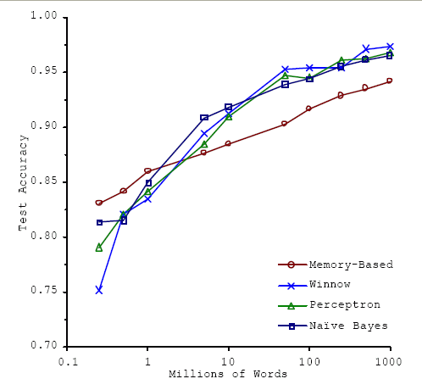
Accuracy as a function of data size
Sec. 15.3.1
With enough data the choice of classifier may not matter much, and the best choice may be unclear
  Data: Brill and Banko on context-sensitive spelling correction
But the fact that you have to keep doubling your data to improve performance is a little unpleasant

Slide 48
How many categories?
Sec. 15.3.2
A few (well separated ones)?
  Easy!
A zillion closely related ones?
  Think: Yahoo! Directory, Library of Congress classification, legal applications
  Quickly gets difficult!
    Classifier combination is always a useful technique
      Voting, bagging, or boosting multiple classifiers
    Much literature on hierarchical classification
      Mileage fairly unclear, but helps a bit (Tie-Yan Liu et al. 2005)
      Definitely helps for scalability, even if not in accuracy
    May need a hybrid automatic/manual solution

Slide 49
Good practice department:
Make a confusion matrix
Sec. 15.2.4
This (i, j) entry means 53 of the docs actually in
class i were put in class j by the classifier.
Class assigned by classifier
Actual Class
53
In a perfect classification, only the diagonal has non-zero entries
Look at common confusions and how they might be addressed

Slide 50
Good practice department:
N-Fold Cross-Validation
Results can vary based on sampling error due to different training and test sets.
Average results over multiple training and test sets (splits of the overall data) for the best results.
Ideally, test and training sets are independent on each trial.
  But this would require too much labeled data.
Partition data into N equal-sized disjoint segments.
Run N trials, each time using a different segment of the data for testing, and training on the remaining N−1 segments.
This way, at least test-sets are independent.
Report average classification accuracy over the N trials.
Typically, N = 10.

Slide 51
Good practice department:
Learning Curves
In practice, labeled data is usually rare and expensive.
Would like to know how performance varies with the number of training instances.
Learning curves plot classification accuracy on independent test data (Y axis) versus number of training examples (X axis).
One can do both the above and produce learning curves averaged over multiple trials from cross-validation

Slide 52
How can one tweak performance?
Sec. 15.3.2
Aim to exploit any domain-specific useful features that give special meanings or that zone the data
  E.g., an author byline or mail headers
Aim to collapse things that would be treated as different but shouldn’t be.
  E.g., part numbers, chemical formulas
Does putting in “hacks” help?
  You bet! Easiest way to improve practical systems
    Feature design and non-linear weighting is very important in the performance of real-world systems

Slide 53
Upweighting
Sec. 15.3.2
You can get a lot of value by differentially weighting contributions from different document zones:
That is, you count as two instances of a word when you see the word in, say, the abstract
  Upweighting title words helps (Cohen & Singer 1996)
    Doubling the weighting on the title words is a good rule of thumb
    Like what we talked about for BM25F
  Upweighting the first sentence of each paragraph helps (Murata, 1999)
  Upweighting sentences that contain title words helps (Ko et al, 2002)

Slide 54
Two techniques for zones
Sec. 15.3.2
Have a completely separate set of features/parameters for different zones like the title
Use the same features (pooling/tying their parameters) across zones, but upweight the contribution of different zones
Commonly the second method is more successful: it costs you nothing in terms of sparsifying the data, but can give a very useful performance boost
    Which is best is a contingent fact about the data

Slide 55
Text Summarization techniques in text classification
Sec. 15.3.2
Text Summarization: Process of extracting key pieces from text, normally by features on sentences reflecting position and content
Much of this work can be used to suggest weightings for terms in text categorization
    See: Kolcz, Prabakarmurthi, and Kalita, CIKM 2001: Summarization as feature selection for text categorization
  Categorizing with title,
  Categorizing with first paragraph only
  Categorizing with paragraph with most keywords
  Categorizing with first and last paragraphs, etc.

Slide 56
Does stemming/lowercasing/… help?
Sec. 15.3.2
As always, it’s hard to tell, and empirical evaluation is normally the gold standard
But note that the role of tools like stemming is rather different for TextCat vs. IR:
  For IR, you often want to collapse forms of the verb oxygenate and oxygenation, since all of those documents will be relevant to a query for oxygenation
  For TextCat, with sufficient training data, stemming does no good. It only helps in compensating for data sparseness (which can be severe in TextCat applications). Overly aggressive stemming can easily degrade performance.

Slide 57
Measuring Classification
Figures of Merit
Accuracy of classification
  Main evaluation criterion in academia
Speed of training statistical classifier
  Some methods are very cheap; some very costly
Speed of classification (docs/hour)
  No big differences for most algorithms
  Exceptions: kNN, complex preprocessing requirements
Effort in creating training set/hand-built classifier
  human hours/topic

Slide 58
Measuring Classification
Figures of Merit
Not just accuracy; in the real world, there are economic measures:
  Your choices are:
    Do no classification
      That has a cost (hard to compute)
    Do it all manually
      Has an easy-to-compute cost if you’re doing it like that now
    Do it all with an automatic classifier
      Mistakes have a cost
    Do it with a combination of automatic classification and manual review of uncertain/difficult/”new” cases
  Commonly the last method is cost efficient and is adopted
    With more theory and Turkers: Werling, Chaganty, Liang, and Manning (2015). On-the-Job Learning with Bayesian Decision Theory. http://arxiv.org/abs/1506.03140
Notes:
This is the slide I got to in 2015. SHORTEN!

Slide 59
A common problem: Concept Drift
Categories change over time
Example: “president of the united states”
  1998: clinton is great feature
  2018: clinton is bad feature
One measure of a text classification system is how well it protects against concept drift.
  Favors simpler models like Naïve Bayes
Feature selection: can be bad in lessening protection against concept drift

Slide 60
Summary
Decision trees
  Simple non-linear, discriminative classifier
  Easy to interpret
  Moderately effective for text classification
Logistic regression and Support vector machines (SVM)
  Linear discriminative classifiers
  Close to state of art (except perhaps NNs) for a single classifier
  We’re not covering them in this year’s class
Classifier ensembles
  Random forests (bagging)
  Boosting
Comparative evaluation of methods
Real world: exploit domain specific structure!

Slide 61
Resources for today’s lecture
Ch. 15
S. T. Dumais. 1998. Using SVMs for text categorization, IEEE Intelligent Systems, 13(4)
Yiming Yang, Xin Liu. 1999. A re-examination of text categorization methods. 22nd Annual International SIGIR
Tong Zhang, Frank J. Oles. 2001. Text Categorization Based on Regularized Linear Classification Methods. Information Retrieval 4(1): 5-31
Trevor Hastie, Robert Tibshirani and Jerome Friedman. Elements of Statistical Learning: Data Mining, Inference and Prediction. Springer-Verlag, New York.
T. Joachims, Learning to Classify Text using Support Vector Machines. Kluwer, 2002.
Fan Li, Yiming Yang. 2003. A Loss Function Analysis for Classification Methods in Text Categorization. ICML 2003: 472-479.
Tie-Yan Liu, Yiming Yang, Hao Wan, et al. 2005. Support Vector Machines Classification with Very Large Scale Taxonomy, SIGKDD Explorations, 7(1): 36-43.
‘Classic’ Reuters-21578 data set: http://www.daviddlewis.com/resources/testcollections/reuters21578/
Notes:
Put in recent SVM work!

