Slide 1
BM25, BM25F, and User Behavior
Chris Manning and Pandu Nayak
Notes:
ADD FOR NEXT YEAR: The big advantage of a saturating function like BM25 is that it disallows any one word from dominating. For a multiword query, it can never be better to match a document which has one word many times versus all the words several times.

Slide 2
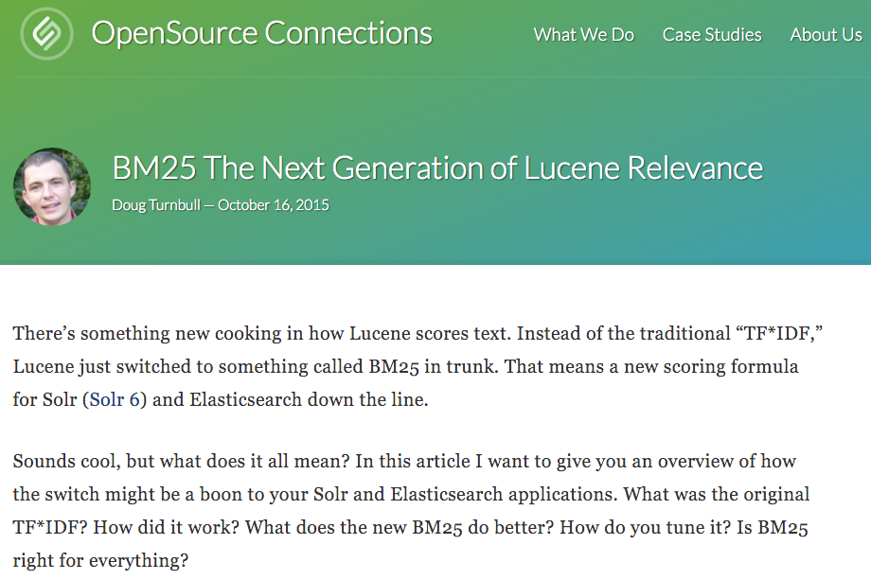
Notes:
Lucene 6.0 released 8 April 2016 has this!

Slide 3
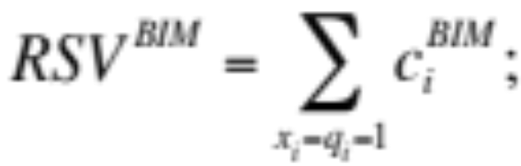
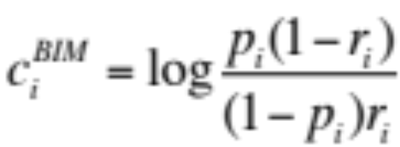
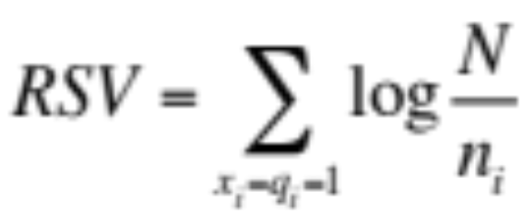
Summary – BIM [Robertson & Spärck-Jones 1976]
Boils down to
where
With constant p_{i} = 0.5, simplifies to IDF weighting:
Log odds
ratio
 | document | relevant (R=1) | not relevant (R=0)
term present | x_{i} = 1 | p_{i} | r_{i}
term absent | x_{i} = 0 | (1 – p_{i}) | (1 – r_{i})
Notes:
Main point: Can start with PRP and end up with scoring function which is just simple sum of weights for query terms present in a document.

Slide 4
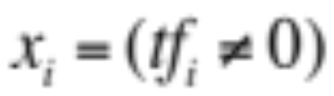

Graphical model for BIM – Bernoulli NB
R
x_{i}
Binary
variables

Slide 5
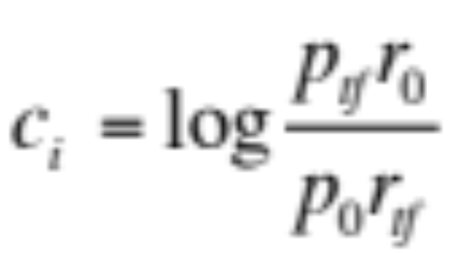
A key limitation of the BIM
BIM – like much of original IR – was designed for titles or abstracts, and not for modern full text search
We want to pay attention to term frequency and document lengths, just like in other models we discuss
Want
Want some model of how often terms occur in docs
Notes:
Mention the huge disk in the Gates ground floor lobby. 5 MB

Slide 6
1. Okapi BM25 [Robertson et al. 1994, TREC City U.]
BM25 “Best Match 25” (they had a bunch of tries!)
  Developed in the context of the Okapi system
  Started to be increasingly adopted by other teams during the TREC competitions
  It works well
Goal: be sensitive to term frequency and document length while not adding too many parameters
  (Robertson and Zaragoza 2009; Spärck Jones et al. 2000)

Slide 7

Generative model for documents
Words are drawn independently from the vocabulary using a multinomial distribution
... the draft is that each team is given a position in the draft …
basic
team
the
given
draft
each
nfl
annual
team
of
draft
nfl
football
design
is
that
football
…

Slide 8

Generative model for documents
Distribution of term frequencies (tf) follows a binomial distribution – approximated by a Poisson
... the draft is that each team is given a position in the draft …
draft
…
…

Slide 9
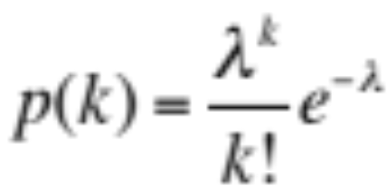
Poisson distribution
  The Poisson distribution models the probability of k, the number of events occurring in a fixed interval of time/space, with known average rate λ ( = cf/T), independent of the last event
Examples
  Number of cars arriving at the toll booth per minute
  Number of typos on a page

Slide 10
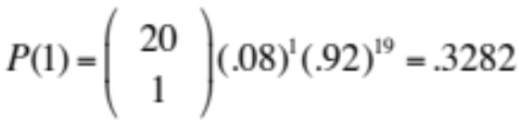
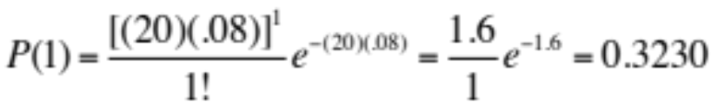
Poisson distribution
  If T is large and p is small, we can approximate a binomial distribution with a Poisson where λ = Tp
  Mean = Variance = λ = Tp.
  Example p = 0.08, T = 20. Chance of 1 occurrence is:
    Binomial
    Poisson … already close

Slide 11
Poisson model
Assume that term frequencies in a document (tf_{i}) follow a Poisson distribution
  “Fixed interval” implies fixed document length … think roughly constant-sized document abstracts
    … will fix later

Slide 12
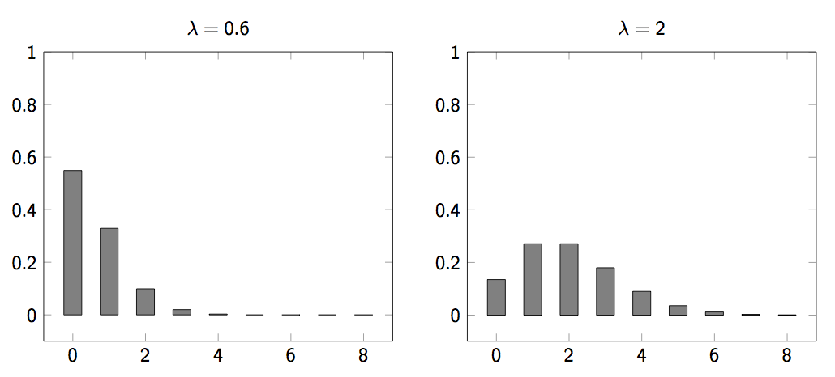
Poisson distributions

Slide 13
(One) Poisson Model
Is a reasonable fit for “general” words
Is a poor fit for topic-specific words
  get higher p(k) than predicted too often
 |  | Documents containing k occurrences of word (λ = 53/650)
Freq | Word | 0 | 1 | 2 | 3 | 4 | 5 | 6 | 7 | 8 | 9 | 10 | 11 | 12
53 | expected | 599 | 49 | 2
52 | based | 600 | 48 | 2
53 | conditions | 604 | 39 | 7
55 | cathexis | 619 | 22 | 3 | 2 | 1 | 2 | 0 | 1
51 | comic | 642 | 3 | 0 | 1 | 0 | 0 | 0 | 0 | 0 | 0 | 1 | 1 | 2
Harter, “A Probabilistic Approach to Automatic Keyword Indexing”, JASIST, 1975
Notes:
Cathexis = the concentration of mental energy on one particular person, idea, or object (especially to an unhealthy degree).

Slide 14
Eliteness (“aboutness”)
Model term frequencies using eliteness
What is eliteness?
  Hidden variable for each document-term pair, denoted as E_{i} for term i
  Represents aboutness: a term is elite in a document if, in some sense, the document is about the concept denoted by the term
  Eliteness is binary
  Term occurrences depend only on eliteness…
  … but eliteness depends on relevance

Slide 15
Elite terms
Text from the Wikipedia page on the NFL draft showing elite terms
The National Football League Draft is an annual event in which the National Football League (NFL) teams select eligible college football players. It serves as the league’s most common source of player recruitment. The basic design of the draft is that each team is given a position in the draft order in reverse order relative to its record …

Slide 16
Graphical model with eliteness
R
E_{i}
Binary
variables
tf_{i}
Frequencies
(not binary)
Notes:
Simple topic model … if you know other topic models like LDA, you might think of other ways of doing this. Here, the model directly boosts the term frequency of a bunch of words. Generative language model.

Slide 17
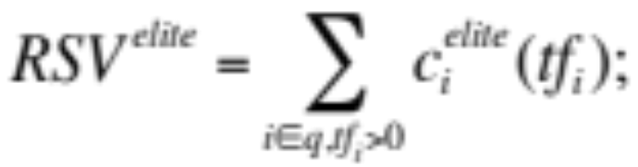
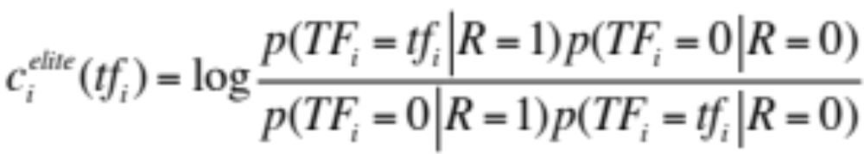
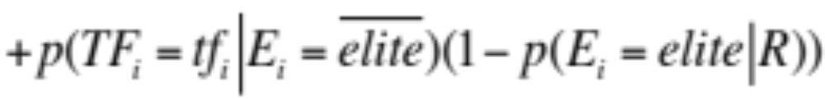
Retrieval Status Value
Similar to the BIM derivation, we have
where
and using eliteness, we have:

Slide 18
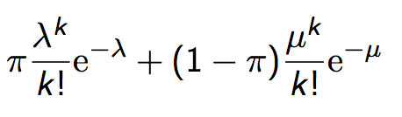
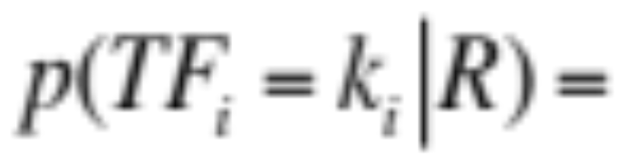
2-Poisson model
The problems with the 1-Poisson model suggests fitting two Poisson distributions
In the “2-Poisson model”, the distribution is different depending on whether the term is elite or not
where π is probability that document is elite for term
but, unfortunately, we don’t know π, λ, μ

Slide 19
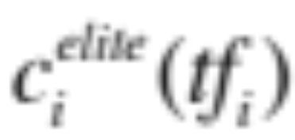
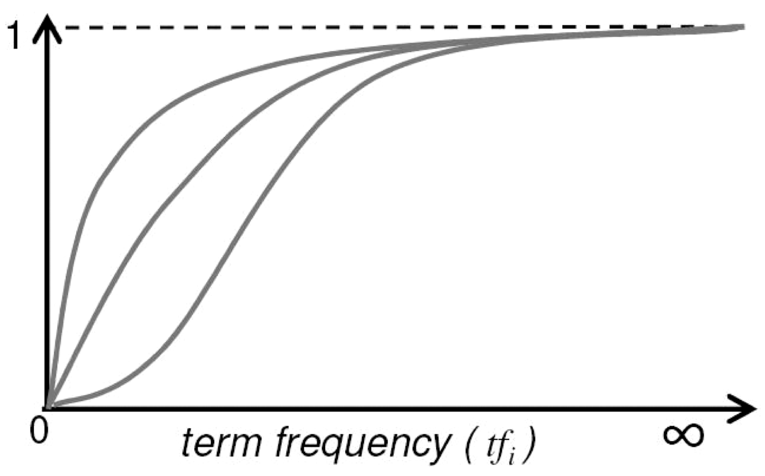
Let’s get an idea: Graphing for different parameter values of the 2-Poisson
Notes:
Concave upper two curves are for more “realistic” parameter values, so we want to approximate those ones not bottom ones.

Slide 20
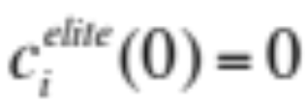


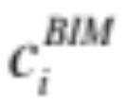
Qualitative properties
increases monotonically with tf_{i}
… but asymptotically approaches a maximum value as [not true for simple scaling of tf]
… with the asymptotic limit being
Weight of
eliteness
feature

Slide 21
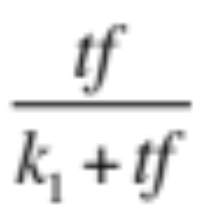
Approximating the saturation function
Estimating parameters for the 2-Poisson model is not easy
… So approximate it with a simple parametric curve that has the same qualitative properties

Slide 22
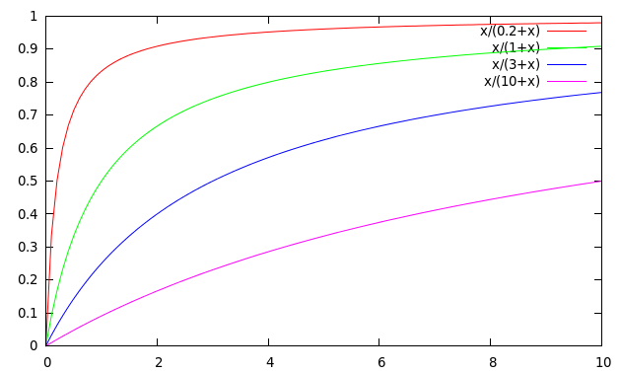
Saturation function
For high values of k₁, increments in tf_{i} continue to contribute significantly to the score
Contributions tail off quickly for low values of k₁

Slide 23
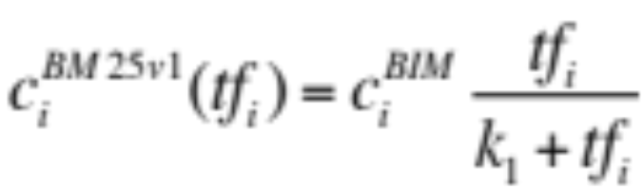
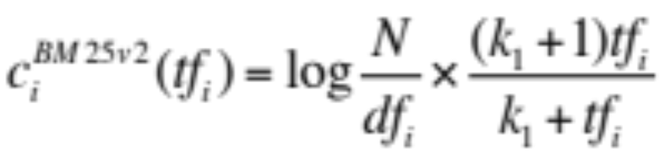
“Early” versions of BM25
Version 1: using the saturation function
Version 2: BIM simplification to IDF
  (k₁+1) factor doesn’t change ranking, but makes
  term score 1 when tf_{i} = 1
  Similar to tf-idf, but term scores are bounded
Notes:
But still don’t model document length

Slide 24
Document length normalization
Longer documents are likely to have larger tf_{i} values
Why might documents be longer?
  Verbosity: suggests observed tf_{i} too high
  Larger scope: suggests observed tf_{i} may be right
A real document collection probably has both effects
… so should apply some kind of partial normalization

Slide 25
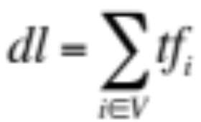
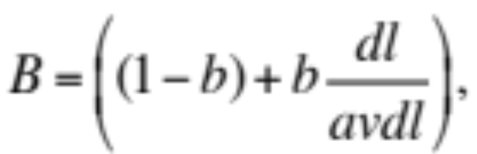

Document length normalization
Document length:
avdl: Average document length over collection
Length normalization component
  b = 1 full document length normalization
  b = 0 no document length normalization
Notes:
Starts second half!

Slide 26
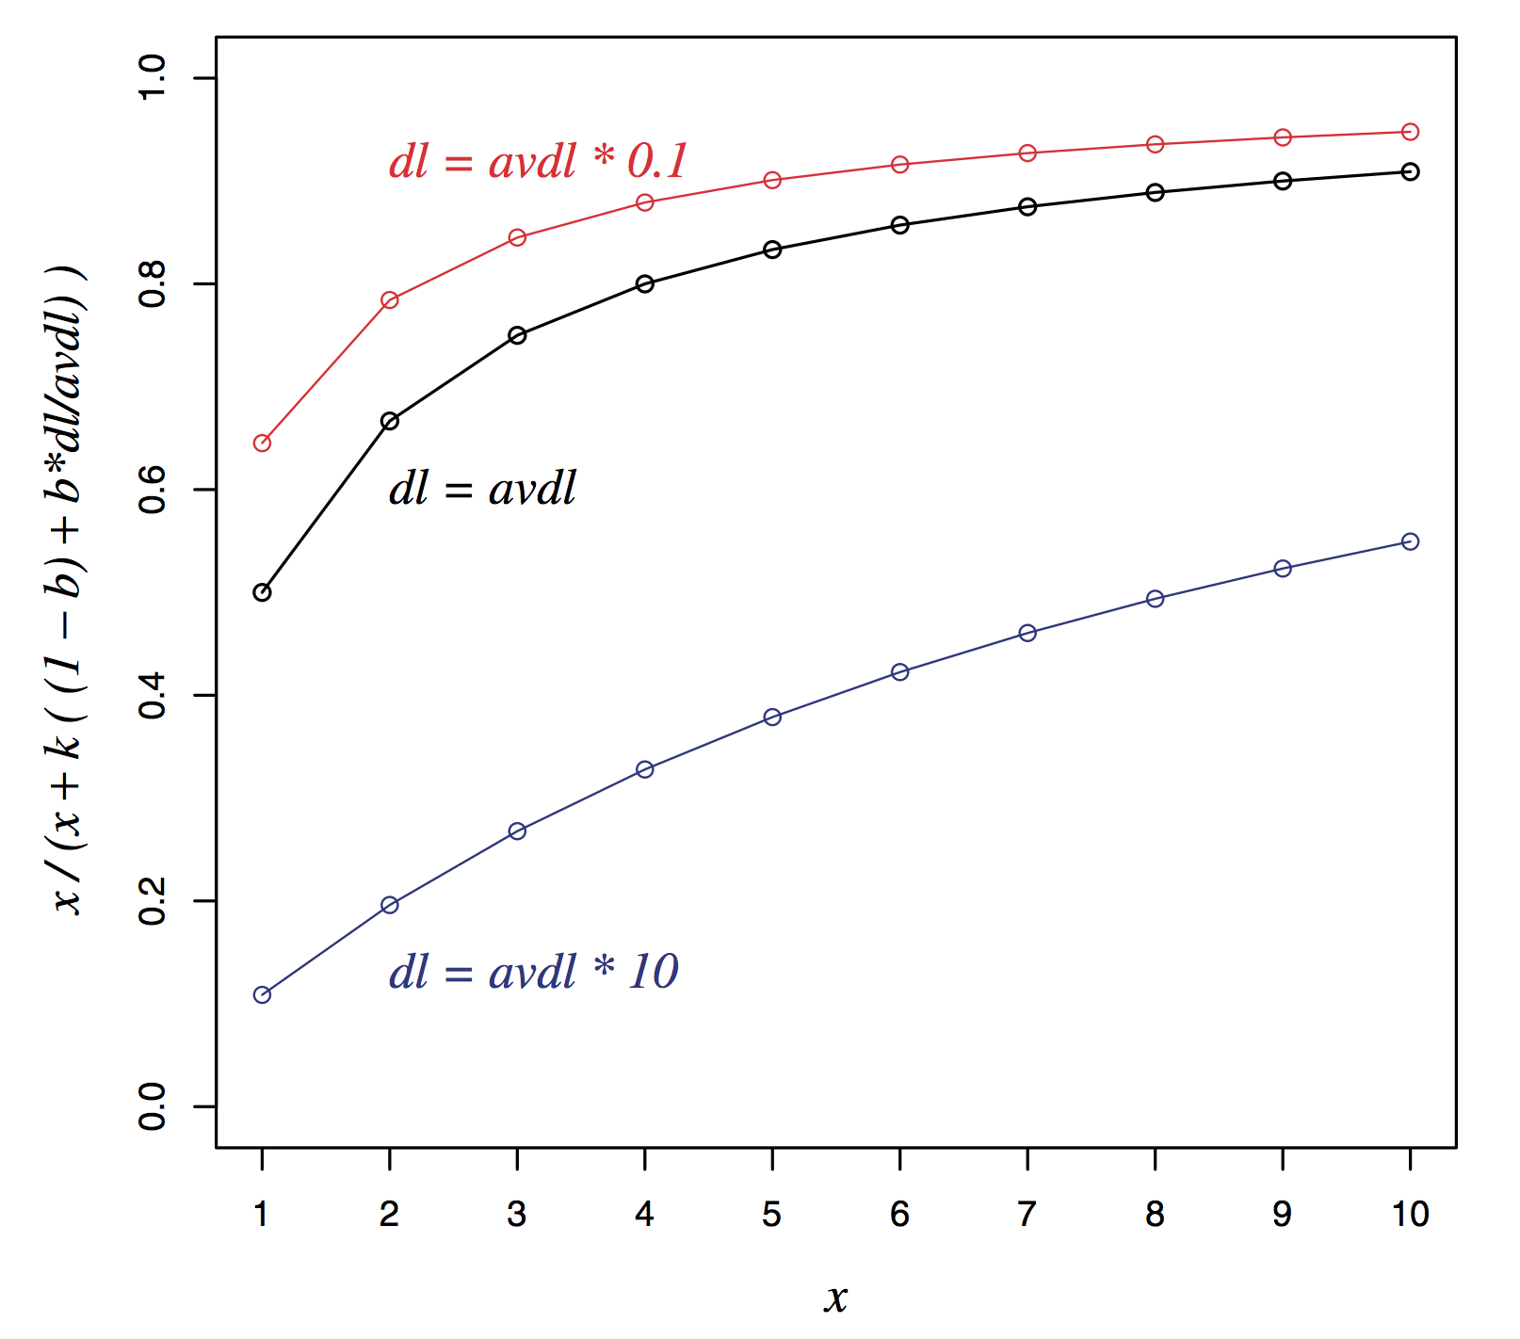
Document length normalization

Slide 27
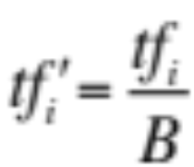
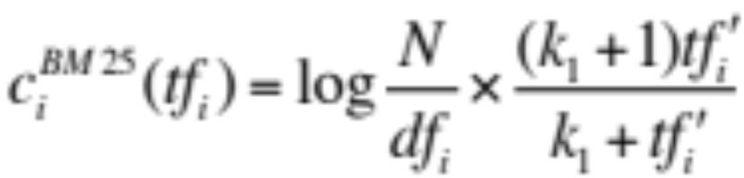
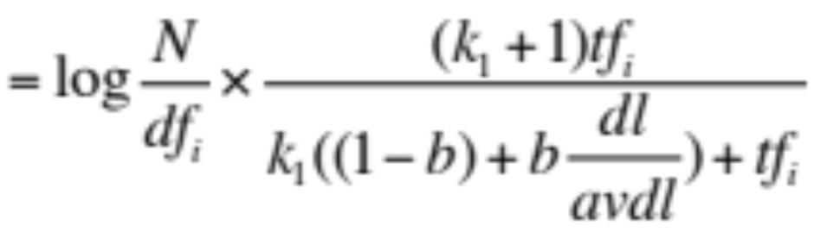
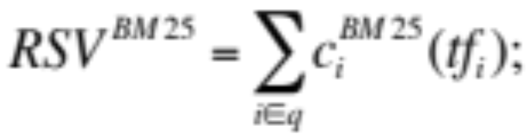
Okapi BM25
Normalize tf using document length
BM25 ranking function

Slide 28
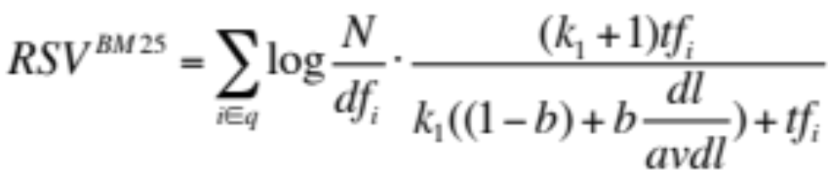
Okapi BM25
k₁ controls term frequency scaling
  k₁ = 0 is binary model; k₁ large is raw term frequency
b controls document length normalization
  b = 0 is no length normalization; b = 1 is relative frequency (fully scale by document length)
Typically, k₁ is set around 1.2–2 and b around 0.75
IIR sec. 11.4.3 discusses incorporating query term weighting and (pseudo) relevance feedback

Slide 29
Why is BM25 better than VSM tf-idf?
Suppose your query is [machine learning]
Suppose you have 2 documents with term counts:
  doc1: learning 1024; machine 1
  doc2: learning 16; machine 8
tf-idf: log₂ tf * log₂ (N/df)
  doc1: 11 * 7 + 1 * 10 = 87
  doc2: 5 * 7 + 4 * 10 = 75
BM25: k₁ = 2
  doc1: 7 * 3 + 10 * 1 = 31
  doc2: 7 * 2.67 + 10 * 2.4 = 42.7

Slide 30
2. Ranking with features
Textual features
  Zones: Title, author, abstract, body, anchors, …
  Proximity
  …
Non-textual features
  File type
  File age
  Page rank
  …
Notes:
Lucene calls zones “fields”

Slide 31
Ranking with zones
Straightforward idea:
  Apply your favorite ranking function (BM25) to each zone separately
  Combine zone scores using a weighted linear combination
But that seems to imply that the eliteness properties of different zones are different and independent of each other
  …which seems unreasonable

Slide 32
Ranking with zones
Alternate idea
  Assume eliteness is a term/document property shared across zones
  … but the relationship between eliteness and term frequencies are zone-dependent
    e.g., denser use of elite topic words in title
Consequence
  First combine evidence across zones for each term
  Then combine evidence across terms
Notes:
First is evidence for eliteness. Calculate saturation here.
Second is final document score

Slide 33
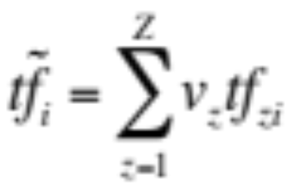
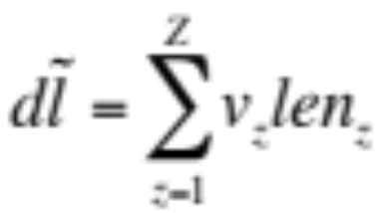


BM25F with zones
Calculate a weighted variant of total term frequency
… and a weighted variant of document length
where
    v_{z} is zone weight
    tf_{zi} is term frequency in zone z
    len_{z} is length of zone z
    Z is the number of zones
Average
across all
documents

Slide 34
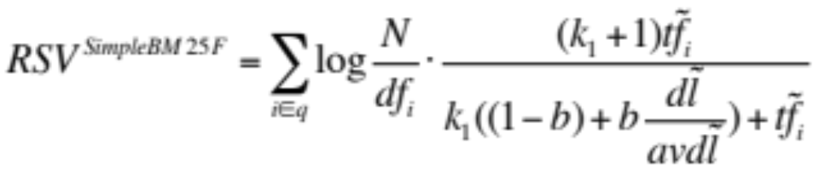
Simple BM25F with zones
Simple interpretation: zone z is “replicated” v_{z} times
But we may want zone-specific parameters (k₁, b, IDF)
Notes:
If poisson parameters are different for different zones, should vary BM25F parameters.

Slide 35
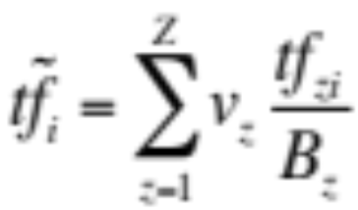
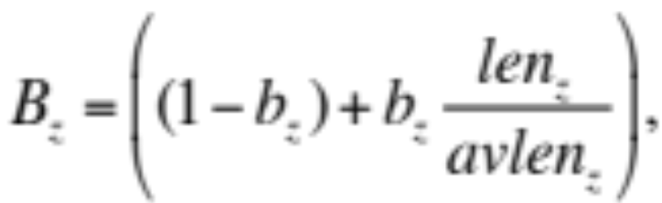

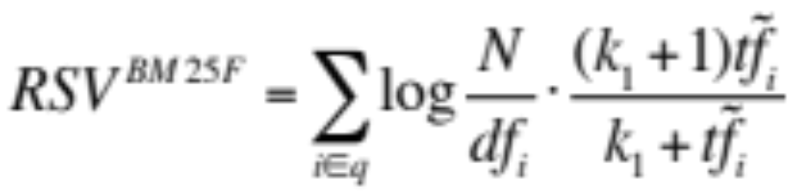
BM25F
Empirically, zone-specific length normalization (i.e., zone-specific b) has been found to be useful
See Robertson and Zaragoza (2009: 364)

Slide 36
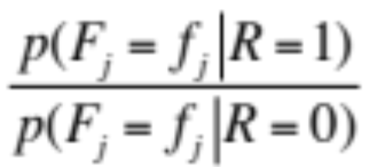
Ranking with non-textual features
Assumptions
  Usual independence assumption
    Independent of each other and of the textual features
    Allows us to factor out in BIM-style derivation
  Relevance information is query independent
    Usually true for features like page rank, age, type, …
    Allows us to keep all non-textual features in the BIM-style derivation where we drop non-query terms

Slide 37
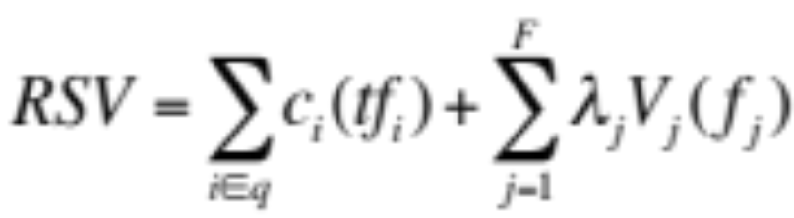
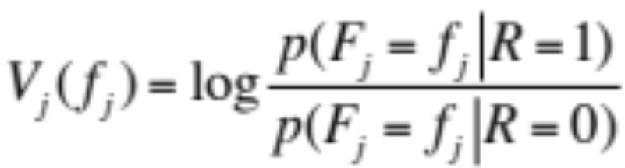

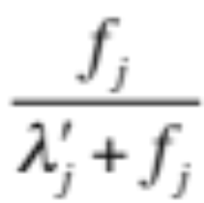
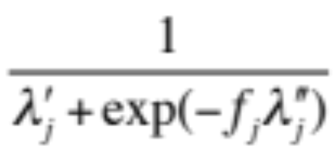
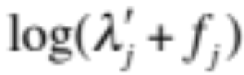
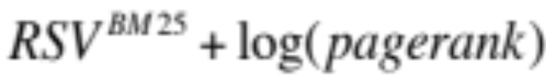
Ranking with non-textual features
where
and is an artificially added free parameter to account for rescalings in the approximations
Care must be taken in selecting V_{j} depending on F_{j}. E.g.
Explains why works well

Slide 38
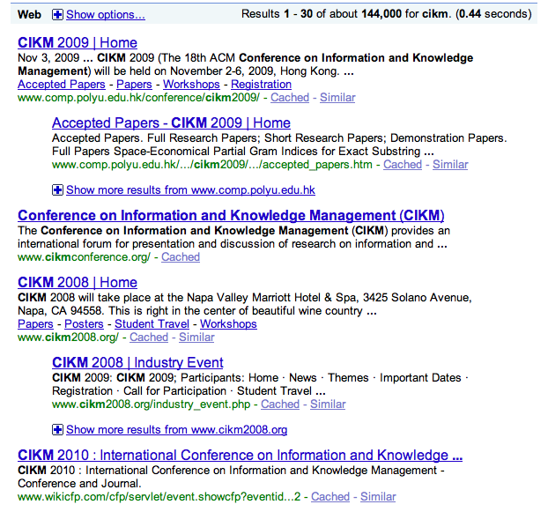
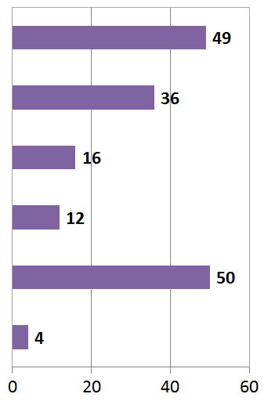

User Behavior
Taken with slight adaptation from Fan Guo and Chao Liu’s 2009/2010 CIKM tutorial: Statistical Models for Web Search: Click Log Analysis
Search Results for “CIKM” (in 2010!)
# of clicks received
Notes:
Does this show that our results are wrong?

Slide 39
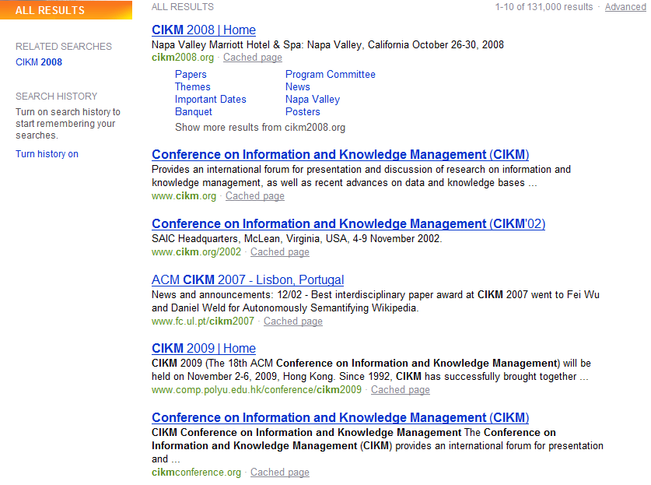
User Behavior
Adapt ranking to user clicks?
# of clicks received

Slide 40
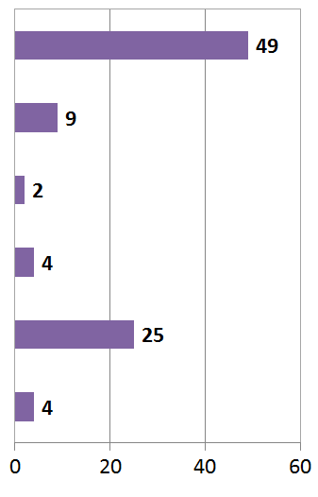

User Behavior
Tools needed for non-trivial cases
# of clicks received

Slide 41
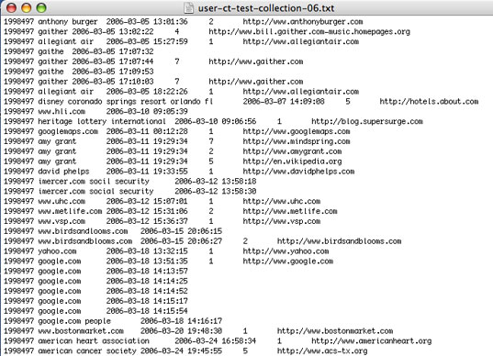
Web search click log
An example

Slide 42


Web Search Click Log
How large is the click log?
  search logs: 10+ TB/day
  In existing publications:
    [Silverstein+99]: 285M sessions
    [Craswell+08]: 108k sessions
    [Dupret+08] : 4.5M sessions (21 subsets * 216k sessions)
    [Guo +09a] : 8.8M sessions from 110k unique queries
    [Guo+09b]: 8.8M sessions from 110k unique queries
    [Chapelle+09]: 58M sessions from 682k unique queries
    [Liu+09a]: 0.26PB data from 103M unique queries

Slide 43
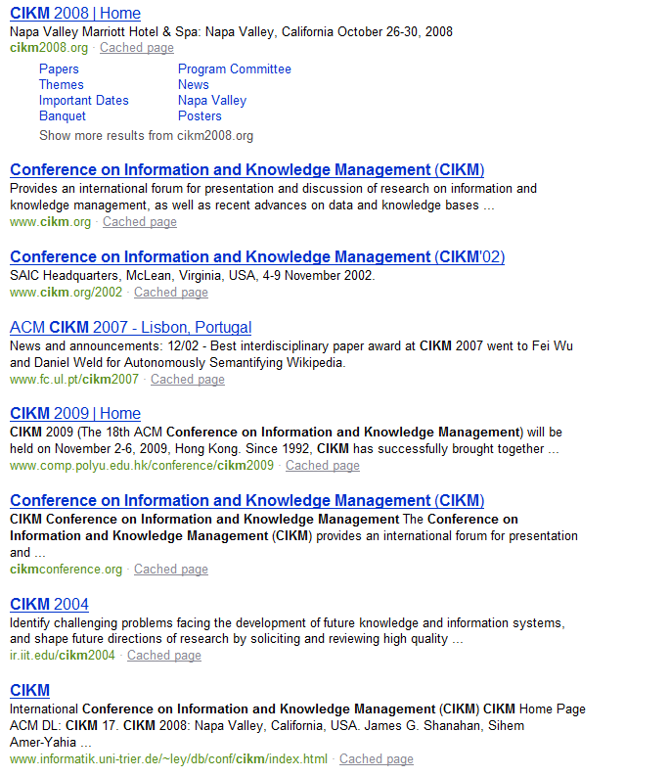


Interpret Clicks: an Example
Clicks are good…
  Are these two clicks equally “good”?
Non-clicks may have excuses:
  Not relevant
  Not examined

Slide 44



Eye-tracking User Study
Notes:
MENTION MORE CLEARLY THAT THIS SUPPORTS THE IDEA OF RANKING UP AN ITEM THAT IS CLICKED AND BELOW AN ITEM THAT ISN”T CLICKED.

Slide 45


Click Position-bias
Higher positions receive more user attention (eye fixation) and clicks than lower positions.
This is true even in the extreme setting where the order of positions is reversed.
“Clicks are informative but biased”.
Percentage
Normal Position
Percentage
[Joachims+07]
Reversed Impression

Slide 46
User behavior
User behavior is an intriguing source of relevance data
  Users make (somewhat) informed choices when they interact with search engines
  Potentially a lot of data available in search logs
But there are significant caveats
  User behavior data can be very noisy
  Interpreting user behavior can be tricky
  Spam can be a significant problem
  Not all queries will have user behavior

Slide 47
Features based on user behavior
From [Agichtein, Brill, Dumais 2006; Joachims 2002]
Click-through features
  Click frequency, click probability, click deviation
  Click on next result? previous result? above? below>?
Browsing features
  Cumulative and average time on page, on domain, on URL prefix; deviation from average times
  Browse path features
Query-text features
  Query overlap with title, snippet, URL, domain, next query
  Query length

Slide 48
Incorporating user behavior into ranking algorithm
Incorporate user behavior features into a ranking function like BM25F
  But requires an understanding of user behavior features so that appropriate V_{j} functions are used
Incorporate user behavior features into learned ranking function
Either of these ways of incorporating user behavior signals improve ranking

Slide 49
Resources
S. E. Robertson and H. Zaragoza. 2009. The Probabilistic Relevance Framework: BM25 and Beyond. Foundations and Trends in Information Retrieval 3(4): 333-389.
K. Spärck Jones, S. Walker, and S. E. Robertson. 2000. A probabilistic model of information retrieval: Development and comparative experiments. Part 1. Information Processing and Management 779–808.
T. Joachims. Optimizing Search Engines using Clickthrough Data. 2002. SIGKDD.
E. Agichtein, E. Brill, S. Dumais. 2006. Improving Web Search Ranking By Incorporating User Behavior Information. 2006. SIGIR.

