Slide 1
CS276: Information Retrieval and Web Search
Christopher Manning and Pandu Nayak
Lecture 14: Learning to Rank

Slide 2
Machine learning for IR ranking?
Sec. 15.4
We’ve looked at methods for ranking documents in IR
  Cosine similarity, inverse document frequency, BM25, proximity, pivoted document length normalization, (will look at) Pagerank, …
We’ve looked at methods for classifying documents using supervised machine learning classifiers
  Rocchio, kNN, SVMs, etc.
Surely we can also use machine learning to rank the documents displayed in search results?
  Sounds like a good idea
  A.k.a. “machine-learned relevance” or “learning to rank”

Slide 3


Slide 4
Machine learning for IR ranking
This “good idea” has been actively researched – and actively deployed by major web search engines – in the last 7–10 years
Why didn’t it happen earlier?
  Modern supervised ML has been around for about 20 years…
  Naïve Bayes has been around for about 50 years…

Slide 5
Machine learning for IR ranking
There’s some truth to the fact that the IR community wasn’t very connected to the ML community
But there were a whole bunch of precursors:
  Wong, S.K. et al. 1988. Linear structure in information retrieval. SIGIR 1988.
  Fuhr, N. 1992. Probabilistic methods in information retrieval. Computer Journal.
  Gey, F. C. 1994. Inferring probability of relevance using the method of logistic regression. SIGIR 1994.
  Herbrich, R. et al. 2000. Large Margin Rank Boundaries for Ordinal Regression. Advances in Large Margin Classifiers.

Slide 6
Why weren’t early attempts very successful/influential?
Sometimes an idea just takes time to be appreciated…
Limited training data
  Especially for real world use (as opposed to writing academic papers), it was very hard to gather test collection queries and relevance judgments that are representative of real user needs and judgments on documents returned
    This has changed, both in academia and industry
Poor machine learning techniques
Insufficient customization to IR problem
Not enough features for ML to show value

Slide 7
Why wasn’t ML much needed?
Traditional ranking functions in IR used a very small number of features, e.g.,
  Term frequency
  Inverse document frequency
  Document length
It was easy possible to tune weighting coefficients by hand
  And people did
  You students do it in PA3
Notes:
Some of you even grid searched a bit. Some of you suffered spending a lot of time tuning

Slide 8
Why is ML needed now?
Modern systems – especially on the Web – use a great number of features:
    Arbitrary useful features – not a single unified model
  Log frequency of query word in anchor text?
  Query word in color on page?
  # of images on page?
  # of (out) links on page?
  PageRank of page?
  URL length?
  URL contains “~”?
  Page edit recency?
  Page loading speed
The New York Times in 2008-06-03 quoted Amit Singhal as saying Google was using over 200 such features (“signals”)

Slide 9
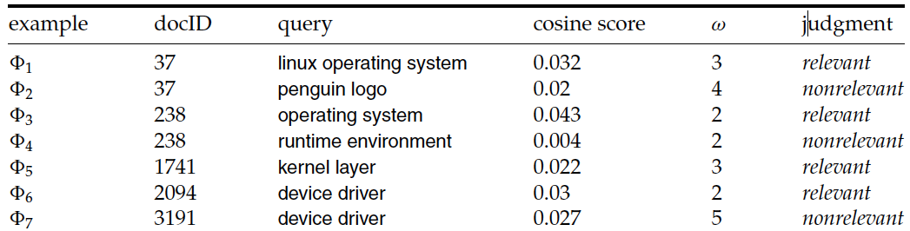
Simple example:
Using classification for ad hoc IR
Sec. 15.4.1
Collect a training corpus of (q, d, r) triples
  Relevance r is here binary (but may be multiclass, with 3–7 values)
  Document is represented by a feature vector
    x = (α, ω) α is cosine similarity, ω is minimum query window size
      ω is the the shortest text span that includes all query words
      Query term proximity is an important new weighting factor
  Train a machine learning model to predict the class r of a document-query pair
Notes:
But query term proximity isn’t so good on our PA3 dataset….

Slide 10
Simple example:
Using classification for ad hoc IR
Sec. 15.4.1
A linear score function is then
Score(d, q) = Score(α, ω) = aα + bω + c
And the linear classifier is
Decide relevant if Score(d, q) > θ
… just like when we were doing text classification

Slide 11
Simple example:
Using classification for ad hoc IR
Sec. 15.4.1
0.05
Decision surface
R
cosine score α
R
N
R
R
R
R
R
N
N
0.025
R
R
R
R
N
N
N
N
N
N
N
0
2
3
4
5
Term proximity ω

Slide 12
More complex example of using classification for search ranking [Nallapati 2004]
We can generalize this to classifier functions over more features
We can use methods we have seen previously for learning the linear classifier weights

Slide 13
An SVM classifier for information retrieval [Nallapati 2004]
Let relevance score g(r|d,q) = w•f(d,q) + b
SVM training: want g(r|d,q) ≤ −1 for nonrelevant documents and g(r|d,q) ≥ 1 for relevant documents
SVM testing: decide relevant iff g(r|d,q) ≥ 0
Features are not word presence features (how would you deal with query words not in your training data?) but scores like the summed (log) tf of all query terms
Unbalanced data (which can result in trivial always-say-nonrelevant classifiers) is dealt with by undersampling nonrelevant documents during training (just take some at random) [there are other ways of doing this – cf. Cao et al. later]
Notes:
The r here is the notion of being relevant, like P(R|D,Q) in BIM model of probabilistic IR. It’s really irrelevant and could be a constant r=1.

Slide 14
An SVM classifier for information retrieval [Nallapati 2004]
Experiments:
  4 TREC data sets
  Comparisons with Lemur, a state-of-the-art open source IR engine (Language Model (LM)-based – see IIR ch. 12)
  Linear kernel normally best or almost as good as quadratic kernel, and so used in reported results
  6 features, all variants of tf, idf, and tf.idf scores

Slide 15
An SVM classifier for information retrieval [Nallapati 2004]
Train \ Test |  | Disk 3 | Disk 4-5 | WT10G (web)
TREC Disk 3 | Lemur | 0.1785 | 0.2503 | 0.2666
 | SVM | 0.1728 | 0.2432 | 0.2750
Disk 4-5 | Lemur | 0.1773 | 0.2516 | 0.2656
 | SVM | 0.1646 | 0.2355 | 0.2675
At best the results are about equal to Lemur
  Actually a little bit below
Paper’s advertisement: Easy to add more features
  This is illustrated on a homepage finding task on WT10G:
    Baseline Lemur 52% success@10, baseline SVM 58%
    SVM with URL-depth, and in-link features: 78% success@10

Slide 16
“Learning to rank”
Sec. 15.4.2
Classification probably isn’t the right way to think about approaching ad hoc IR:
  Classification problems: Map to an unordered set of classes
  Regression problems: Map to a real value [Start of PA4]
  Ordinal regression problems: Map to an ordered set of classes
    A fairly obscure sub-branch of statistics, but what we want here
This formulation gives extra power:
  Relations between relevance levels are modeled
  Documents are good versus other documents for query given collection; not an absolute scale of goodness

Slide 17
“Learning to rank”
Assume a number of categories C of relevance exist
  These are totally ordered: c₁ < c₂ < … < c_{J}
  This is the ordinal regression setup
Assume training data is available consisting of document-query pairs represented as feature vectors ψ_{i} and relevance ranking c_{i}
We could do point-wise learning, where we try to map items of a certain relevance rank to a subinterval (e.g, Crammer et al. 2002 PRank)
But most work does pair-wise learning, where the input is a pair of results for a query, and the class is the relevance ordering relationship between them

Slide 18
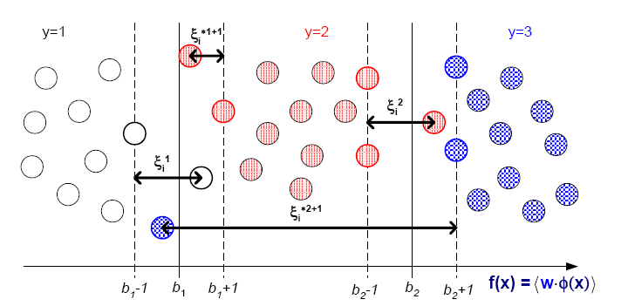
Point-wise learning
Goal is to learn a threshold to separate each rank

Slide 19
Pairwise learning: The Ranking SVM
[Herbrich et al. 1999, 2000; Joachims et al. 2002]
Sec. 15.4.2
Aim is to classify instance pairs as correctly ranked or incorrectly ranked
  This turns an ordinal regression problem back into a binary classification problem in an expanded space
We want a ranking function f such that
c_{i} > c_{k} iff f(ψ_{i}) > f(ψ_{k})
… or at least one that tries to do this with minimal error
Suppose that f is a linear function
f(ψ_{i}) = w•ψ_{i}

Slide 20
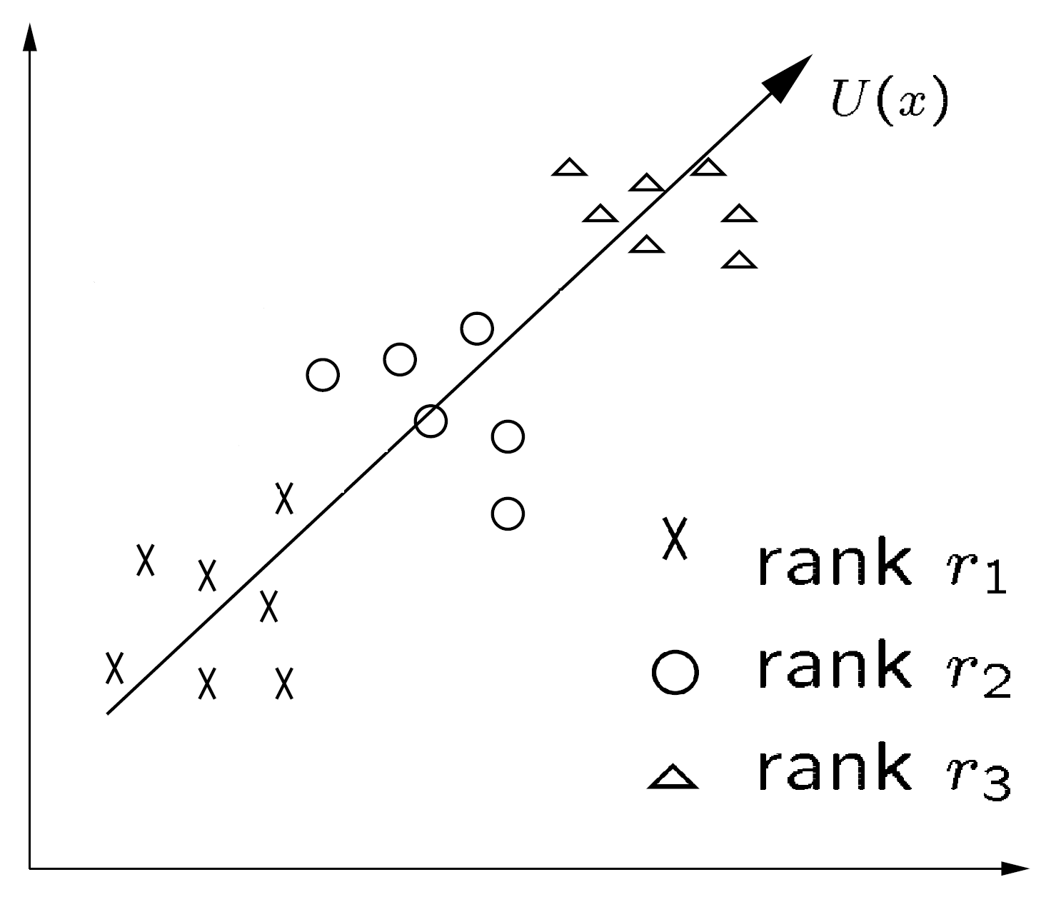
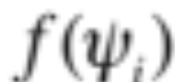
The Ranking SVM
[Herbrich et al. 1999, 2000; Joachims et al. 2002]
Sec. 15.4.2
Ranking Model: f(ψ_{i})

Slide 21
The Ranking SVM
[Herbrich et al. 1999, 2000; Joachims et al. 2002]
Sec. 15.4.2
Then (combining c_{i} > c_{k} iff f(ψ_{i}) > f(ψ_{k}) and f(ψ_{i}) = w•ψ_{i}):
c_{i} > c_{k} iff w•(ψ_{i} − ψ_{k}) > 0
Let us then create a new instance space from such pairs:
Φ_{u} = Φ(d_{i}, d_{k}, q) = ψ_{i} − ψ_{k}
z_{u} = +1, 0, −1 as c_{i} >,=,< c_{k}
We can build model over just cases for which z_{u} = −1
From training data S = {Φ_{u}}, we train an SVM
Notes:
Don’t learn from draws.
Each example appears twice, one in each direction, so you only need to use one.

Slide 22
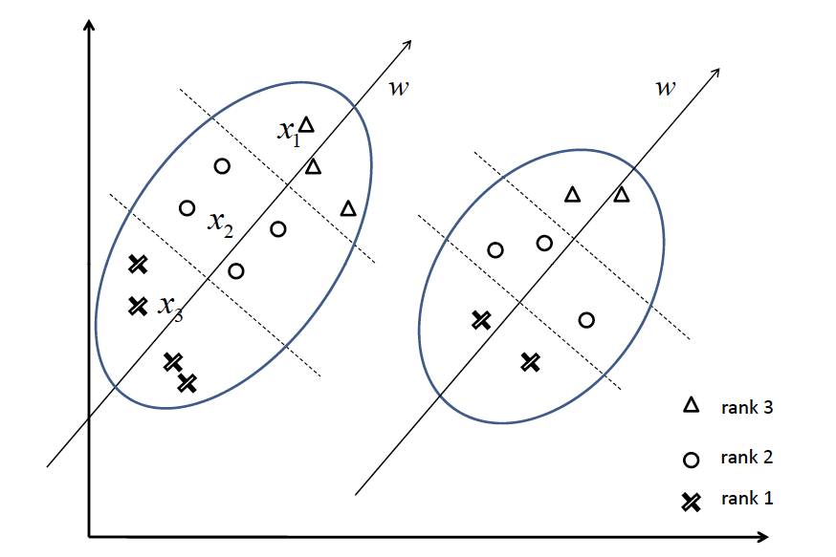
Two queries in the original space

Slide 23
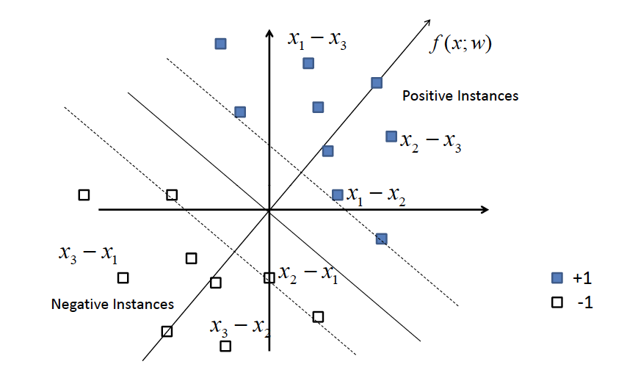
Two queries in the pairwise space

Slide 24
The Ranking SVM
[Herbrich et al. 1999, 2000; Joachims et al. 2002]
Sec. 15.4.2
The SVM learning task is then like other examples that we saw before
Find w and ξ_{u} ≥ 0 such that
  ½w^{T}w + C Σ ξ_{u} is minimized, and
  for all Φ_{u} such that z_{u} < 0, w•Φ_{u} ≥ 1 − ξ_{u}
We can just do the negative z_{u}, as ordering is antisymmetric
You can again use libSVM or SVMlight (or other SVM libraries) to train your model (SVMrank specialization)

Slide 25
Aside: The SVM loss function
The minimization
min_{w} ½w^{T}w + C Σ ξ_{u}
  and for all Φ_{u} such that z_{u} < 0, w•Φ_{u} ≥ 1 − ξ_{u}
can be rewritten as
min_{w} (1/2C)w^{T}w + Σ ξ_{u}
  and for all Φ_{u} such that z_{u} < 0, ξ_{u} ≥ 1 − (w•Φ_{u})
Now, taking λ = 1/2C, we can reformulate this as
min_{w} Σ [1 − (w•Φ_{u})]₊ + λw^{T}w
Where []₊ is the positive part (0 if a term is negative)

Slide 26
Aside: The SVM loss function
The reformulation
min_{w} Σ [1 − (w•Φ_{u})]₊ + λw^{T}w
shows that an SVM can be thought of as having an empirical “hinge” loss combined with a weight regularizer (smaller weights are preferred)
Hinge loss
Regularizer of ‖w‖
Loss
1 w•Φ_{u}

Slide 27
Adapting the Ranking SVM for (successful) Information Retrieval
[Yunbo Cao, Jun Xu, Tie-Yan Liu, Hang Li, Yalou Huang, Hsiao-Wuen Hon SIGIR 2006]
A Ranking SVM model already works well
  Using things like vector space model scores as features
  As we shall see, it outperforms standard IR in evaluations
But it does not model important aspects of practical IR well
This paper addresses two customizations of the Ranking SVM to fit an IR utility model

Slide 28
The ranking SVM fails to model the IR problem well …
Correctly ordering the most relevant documents is crucial to the success of an IR system, while misordering less relevant results matters little
  The ranking SVM considers all ordering violations as the same
Some queries have many (somewhat) relevant documents, and other queries few. If we treat all pairs of results for queries equally, queries with many results will dominate the learning
  But actually queries with few relevant results are at least as important to do well on

Slide 29
Experiments use LETOR test collection
https://www.microsoft.com/en-us/research/project/letor-learning-rank-information-retrieval/
  From Microsoft Research Asia
  An openly available standard test collection with pregenerated features, baselines, and research results for learning to rank
It’s availability has really driven research in this area
OHSUMED, MEDLINE subcollection for IR
  350,000 articles
  106 queries
  16,140 query-document pairs
  3 class judgments: Definitely relevant (DR), Partially Relevant (PR), Non-Relevant (NR)
TREC GOV collection (predecessor of GOV2, cf. IIR p. 142)
  1 million web pages
  125 queries

Slide 30
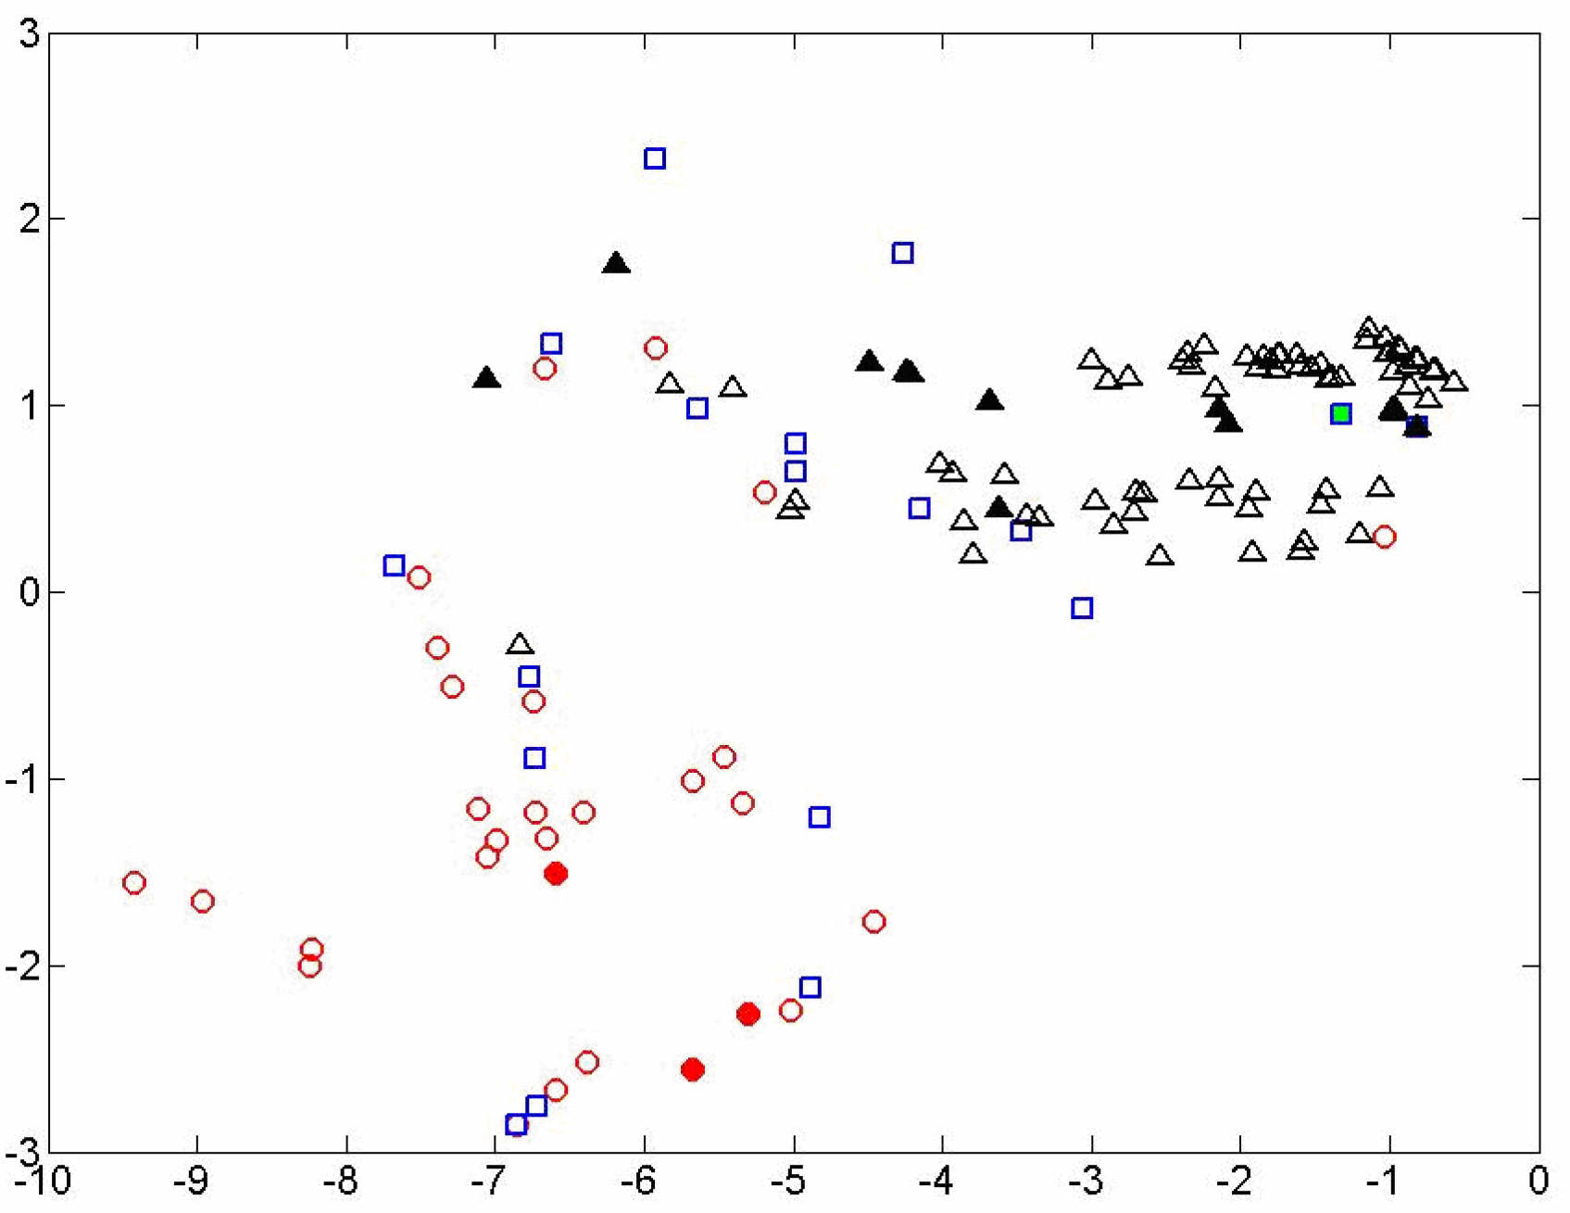
Principal components projection of 2 queries
[solid = q12, open = q50; circle = DR, square = PR, triangle = NR]
Notes:
Two different queries by open/solid; 3 different relevance levels by shape and color.

Slide 31
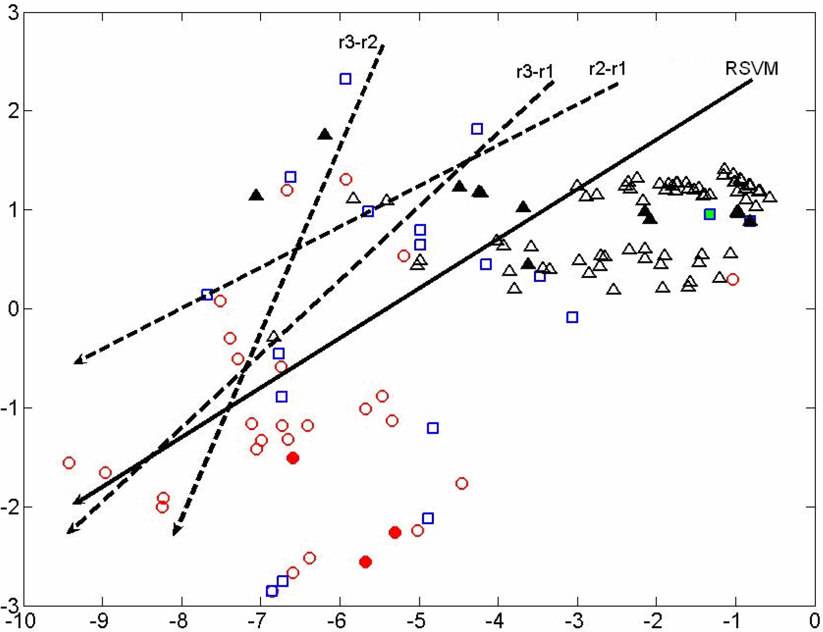
Ranking scale importance discrepancy
[r3 = Definitely Relevant, r2 = Partially Relevant, r1 = Nonrelevant]
Notes:
Rank r2 and r1 documents dominate, so RSVM is close to them, not the crucial r3-r2 distinction

Slide 32
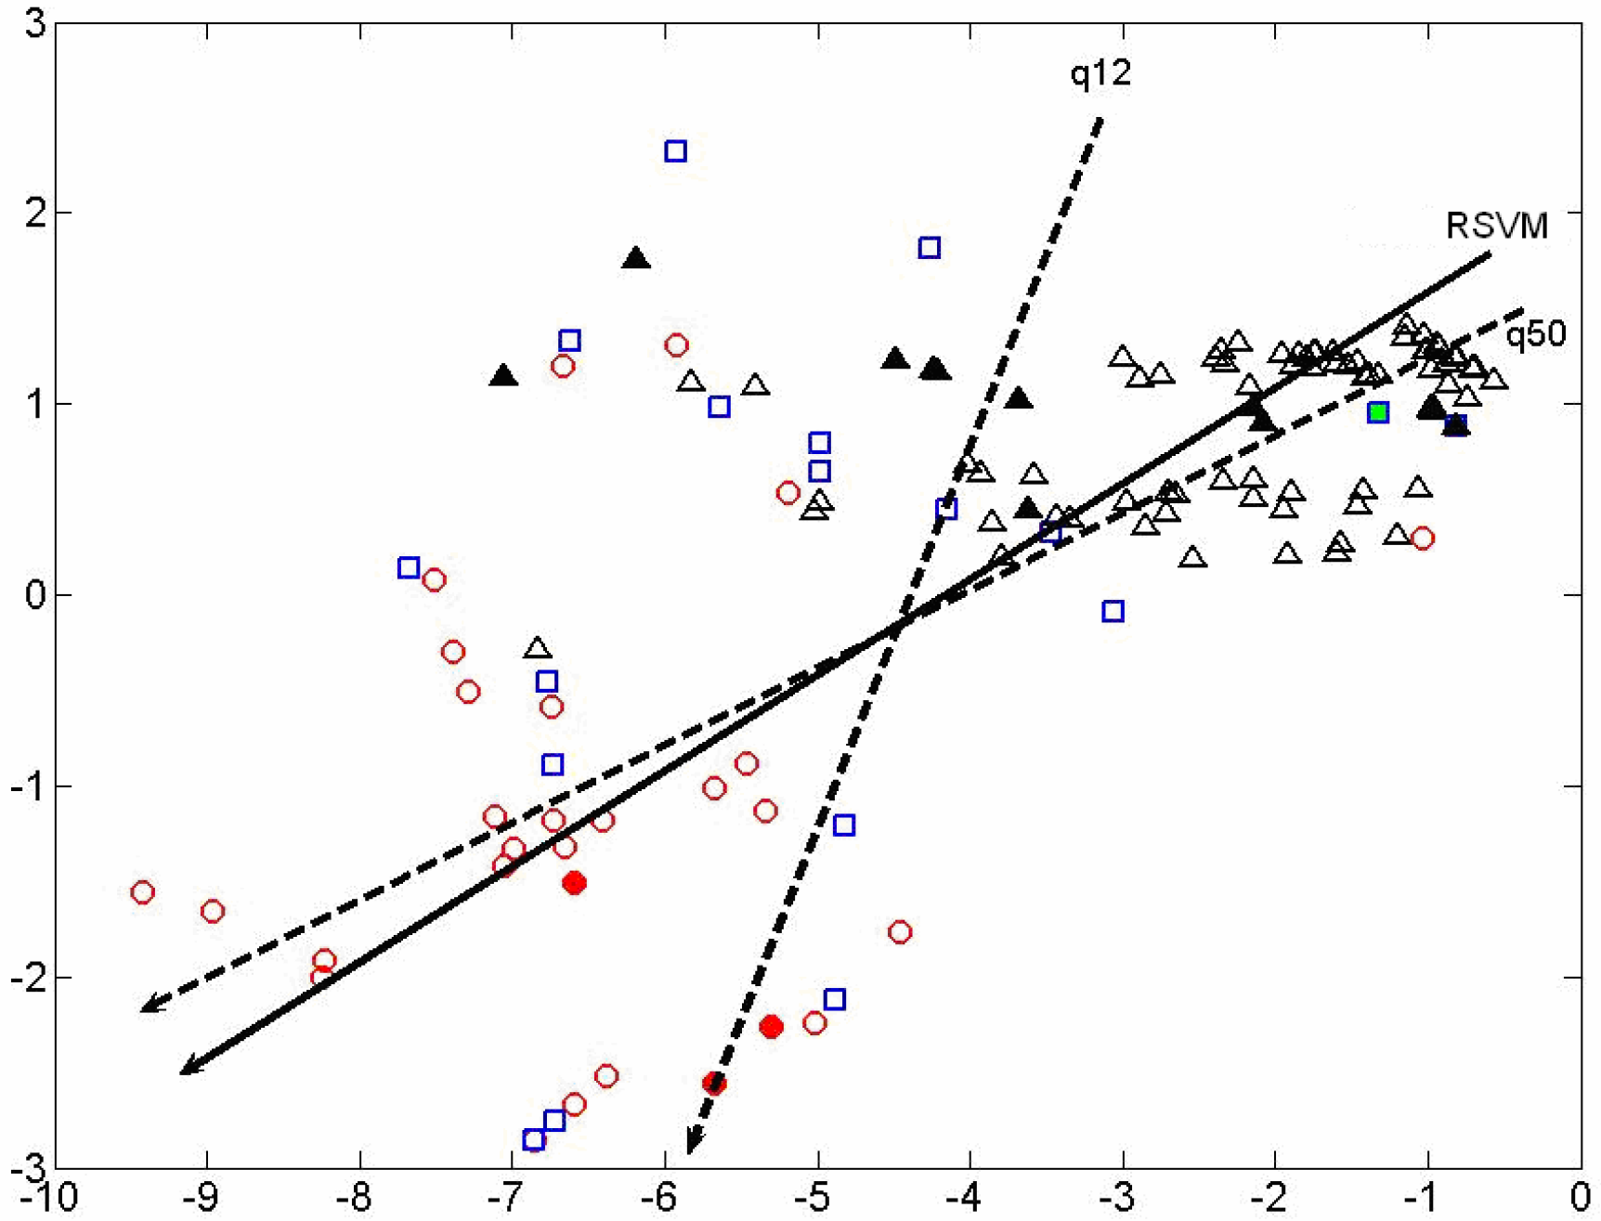
Number of training documents per query discrepancy [solid = q12, open = q50]
Notes:
There are many more training documents for q50 than q12, so it dominates where the normal vector is drawn.

Slide 33
IR Evaluation Measures
Some evaluation measures strongly weight doing well in highest ranked results:
  MAP (Mean Average Precision)
  NDCG (Normalized Discounted Cumulative Gain)
NDCG has been especially popular in machine learned relevance research
  It handles multiple levels of relevance (MAP doesn’t)
  It seems to have the right kinds of properties in how it scores system rankings

Slide 34

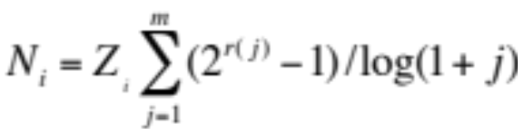


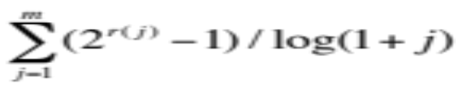
Normalized Discounted Cumulative Gain (NDCG) evaluation measure
Sec. 8.4
Query:
DCG at position m:
NDCG at position m: average over queries
Example
  (3, 3, 2, 2, 1, 1, 1)
  (7, 7, 3, 3, 1, 1, 1)
  (1, 0.63, 0.5, 0.43, 0.39, 0.36, 0.33)
  (7, 11.41, 12.91, 14.2, 14.59, 14.95, 15.28)
Z_{i} normalizes against best possible result for query, the above, versus lower scores for other rankings
    Necessarily: High ranking number is good (more relevant)
rank r
gain
discount

Slide 35
Recap: Two Problems with Direct Application of the Ranking SVM
Cost sensitivity: negative effects of making errors on top ranked documents
  d: definitely relevant, p: partially relevant, n: not relevant
  ranking 1: p d p n n n n
  ranking 2: d p n p n n n
Query normalization: number of instance pairs varies according to query
q1: d p p n n n n
q2: d d p p p n n n n n
q1 pairs: 2*(d, p) + 4*(d, n) + 8*(p, n) = 14
q2 pairs: 6*(d, p) + 10*(d, n) + 15*(p, n) = 31
Notes:
Note how number of pairs blows out versus size of scored result set. This is doing in the model what NDCG does in evaluation.

Slide 36
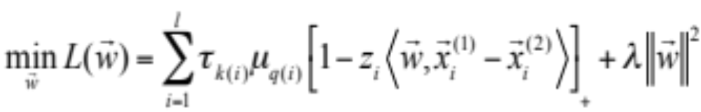
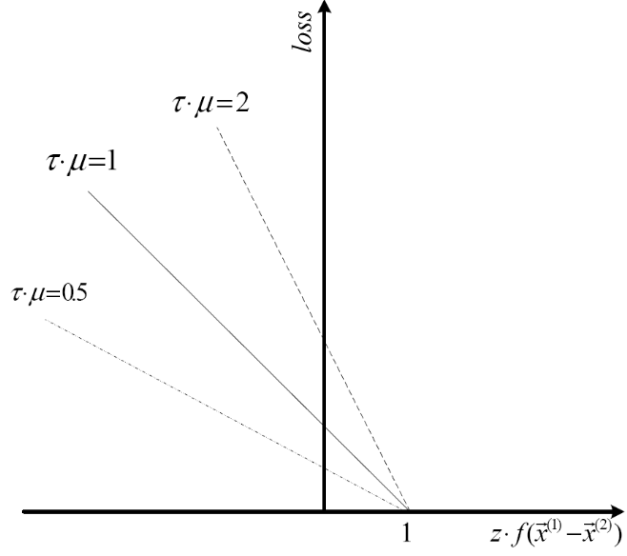
These problems are solved with a new Loss function
τ weights for type of rank difference
  Estimated empirically from effect on NDCG
μ weights for size of ranked result set
  Linearly scaled versus biggest result set

Slide 37
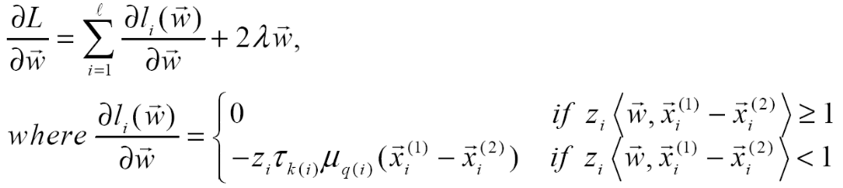
Optimization (Gradient Descent)

Slide 38
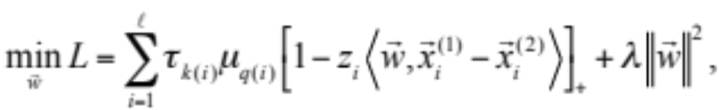
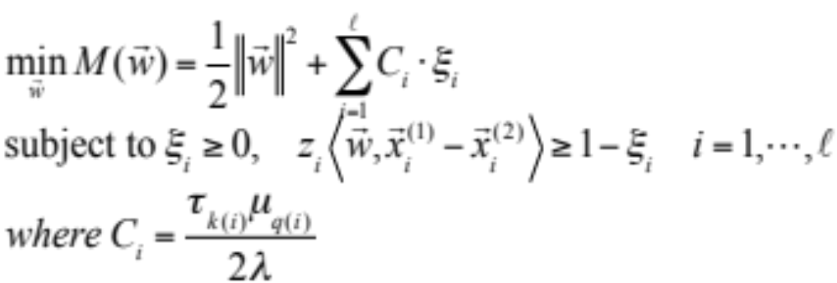
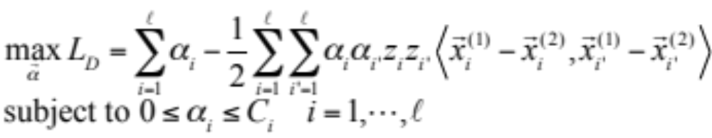
Optimization (Quadratic Programming)

Slide 39
Experiments
OHSUMED (from LETOR)
Features:
  6 that represent versions of tf, idf, and tf.idf factors
  BM25 score (IIR sec. 11.4.3)
Notes:
A scoring function derived from a probabilistic approach to IR, which has traditionally done well in TREC evaluations, etc.

Slide 40
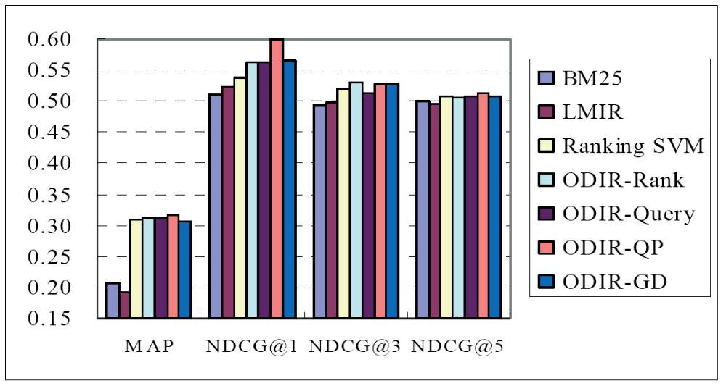
Experimental Results (OHSUMED)
Notes:
Bottom level groupings are different evaluation measures, MAP and NDCG, looking at top K results.
ODIR is their method. You can optimize it by Quadratic Programming or Gradient Descent
You can also apply only the adjustment focusing on high ranks, or only the adjustment focusing on the number of results per query.
Or you can do both.

Slide 41
MSN Search [now Bing]
Second experiment with MSN search
Collection of 2198 queries
6 relevance levels rated:
  Definitive 8990
  Excellent 4403
  Good 3735
  Fair 20463
  Bad 36375
  Detrimental 310

Slide 42
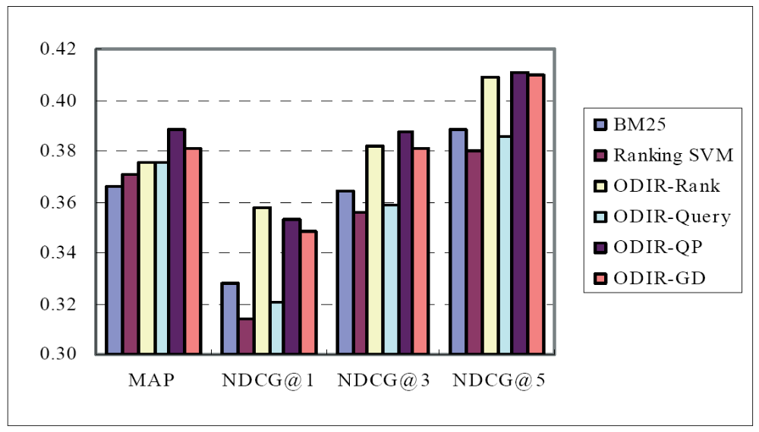
Experimental Results (MSN search)

Slide 43
Alternative: Optimizing Rank-Based Measures
[Yue et al. SIGIR 2007]
If we think that NDCG is a good approximation of the user’s utility function from a result ranking
Then, let’s directly optimize this measure
  As opposed to some proxy (weighted pairwise prefs)
But, there are problems …
  Objective function no longer decomposes
    Pairwise prefs decomposed into each pair
  Objective function is flat or discontinuous

Slide 44
Discontinuity Example
NDCG computed using rank positions
Ranking via retrieval scores
Slight changes to model parameters
  Slight changes to retrieval scores
  No change to ranking
  No change to NDCG
 | d₁ | d₂ | d₃
Retrieval Score | 0.9 | 0.6 | 0.3
Rank | 1 | 2 | 3
Relevance | 0 | 1 | 0
NDCG = 0.63
NDCG discontinuous w.r.t model parameters!

Slide 45


Structural SVMs [Tsochantaridis et al., 2007]
Structural SVMs are a generalization of SVMs where the output classification space is not binary or one of a set of classes, but some complex object (such as a sequence or a parse tree)
Here, it is a complete (weak) ranking of documents for a query
The Structural SVM attempts to predict the complete ranking for the input query and document set
The true labeling is a ranking where the relevant documents are all ranked in the front, e.g.,
An incorrect labeling would be any other ranking, e.g.,
There are an intractable number of rankings, thus an intractable number of constraints!
Notes:
References:
I. Tsochantaridis, T. Joachims, T. Hofmann, Y. Altun. “Large Margin Methods for Structured and Interdependent Output Variables.” Journal of Machine Learning Research, 6, 1453-1484, 2005.

Slide 46
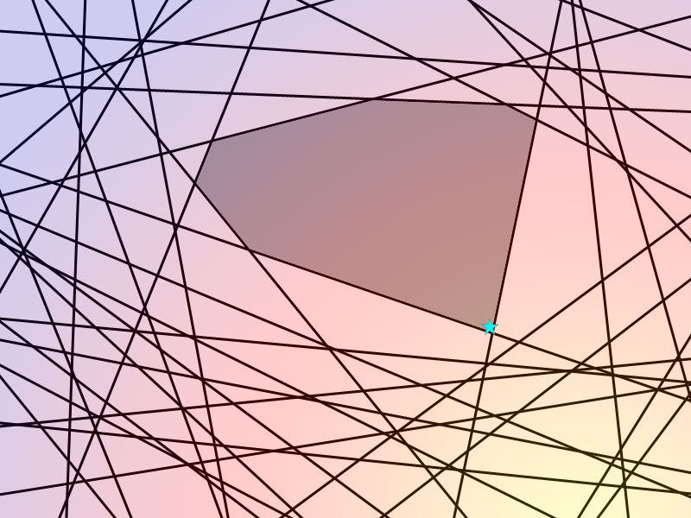

Structural SVM training
[Tsochantaridis et al., 2007]
Structural SVM training proceeds incrementally by starting with a working set of constraints, and adding in the most violated constraint at each iteration
Original SVM Problem
Exponential constraints
Most are dominated by a small set of “important” constraints
Structural SVM Approach
Repeatedly finds the next most violated constraint…
…until a set of constraints which is a good approximation is found

Slide 47
Other machine learning methods for learning to rank
Of course!
I’ve only presented the use of SVMs for machine learned relevance, but other machine learning methods have also been used successfully
  Boosting: RankBoost
  Ordinal Regression loglinear models
  Neural Nets: RankNet, RankBrain
  (Gradient-boosted) Decision Trees

Slide 48
The Limitations of Machine Learning
Everything that we have looked at (and most work in this area) produces linear models over features
This contrasts with most of the clever ideas of traditional IR, which are nonlinear scalings and combinations (products, etc.) of basic measurements
  log term frequency, idf, tf.idf, pivoted length normalization
At present, ML is good at weighting features, but not as good at coming up with nonlinear scalings
  Designing the basic features that give good signals for ranking remains the domain of human creativity
  Or maybe we can do it with deep learning ☺

Slide 49
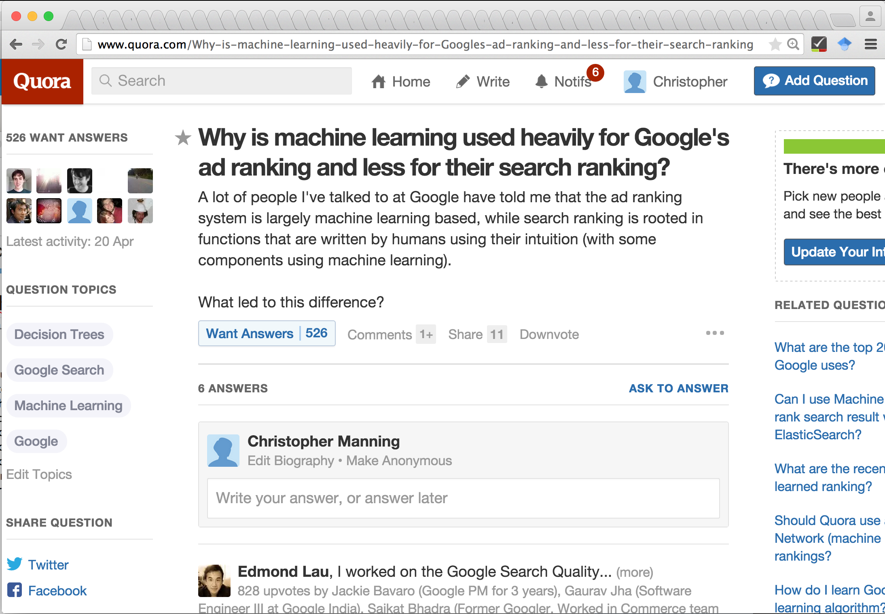
http://www.quora.com/Why-is-machine-learning-used-heavily-for-Googles-ad-ranking-and-less-for-their-search-ranking

Slide 50
Summary
The idea of learning ranking functions has been around for about 20 years
But only more recently have ML knowledge, availability of training datasets, a rich space of features, and massive computation come together to make this a hot research area
It’s too early to give a definitive statement on what methods are best in this area … it’s still advancing rapidly
But machine-learned ranking over many features now easily beats traditional hand-designed ranking functions in comparative evaluations [in part by using the hand-designed functions as features!]
There is every reason to think that the importance of machine learning in IR will grow in the future.

Slide 51
Resources
IIR secs 6.1.2–3 and 15.4
LETOR benchmark datasets
  Website with data, links to papers, benchmarks, etc.
  http://research.microsoft.com/users/LETOR/
  Everything you need to start research in this area!
Nallapati, R. Discriminative models for information retrieval. SIGIR 2004.
Cao, Y., Xu, J. Liu, T.-Y., Li, H., Huang, Y. and Hon, H.-W. Adapting Ranking SVM to Document Retrieval, SIGIR 2006.
Y. Yue, T. Finley, F. Radlinski, T. Joachims. A Support Vector Method for Optimizing Average Precision. SIGIR 2007.

