Slide 1
Do not edit
How to change the design
Join at slido.com
#9803087
The Slido app must be installed on every computer you’re presenting from

Slide 2

Backpropagation
9803087
Lecture 13
Computing gradients efficiently: numerical, symbolic, and automatic differentiation

Slide 3
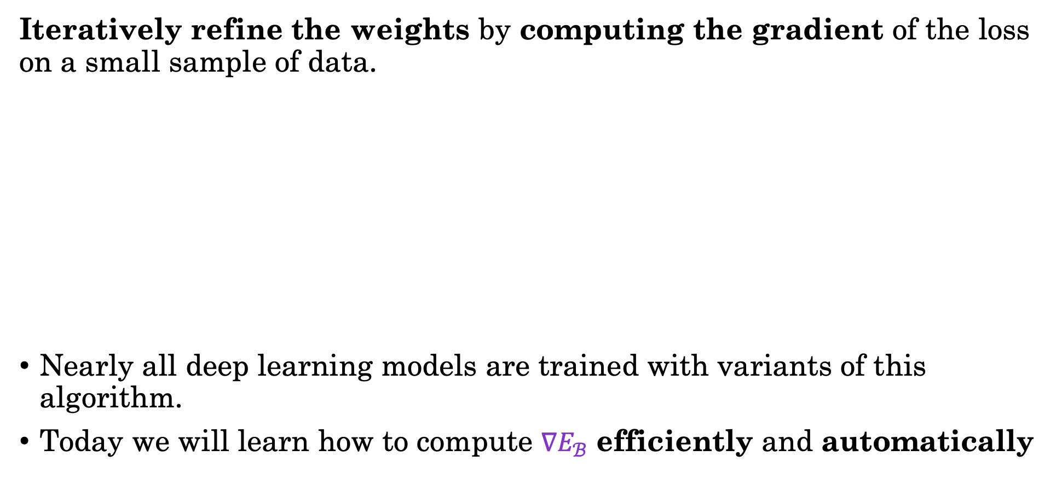
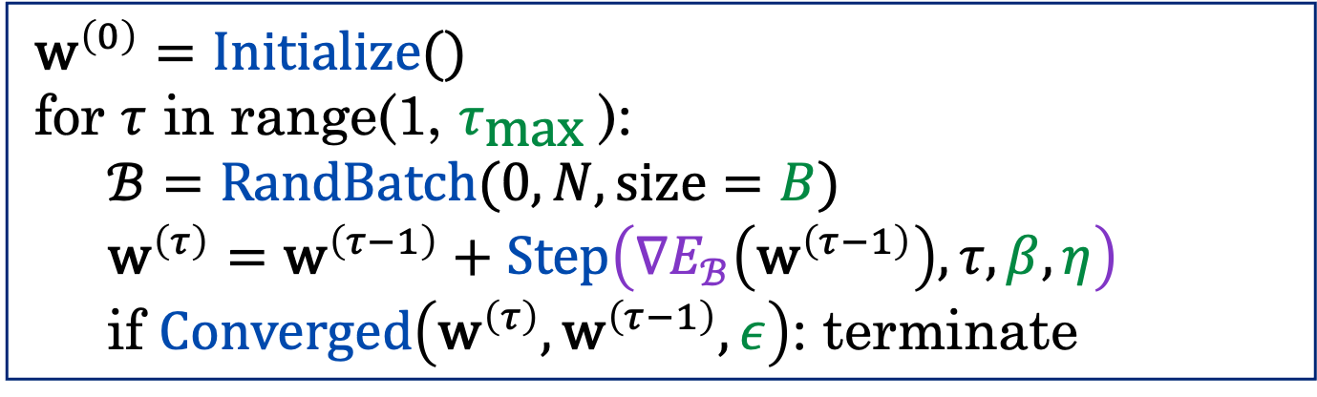
Recap: Stochastic Gradient Descent
Iteratively refine the weights by computing the gradient of the loss on a small sample of data.
Nearly all deep learning models are trained with variants of this algorithm.
Today we will learn how to compute $∇E_{ℬ}$ efficiently and automatically
$${\text{w}}^{\left(0\right)}=Initialize()$$
for $τ$ in range(1, $τ_{\text{max}}$):
$$ℬ=\text{RandBatch}(0,N, \text{size}=B)$$
$${\text{w}}^{\left(τ\right)}={\text{w}}^{\left(τ−1\right)}+Step\left(∇E_{ℬ}\left({\text{w}}^{\left(τ−1\right)}\right),τ, β,η\right)$$
if $Converged\left({\text{w}}^{\left(τ\right)},{\text{w}}^{\left(τ−1\right)},ε\right)$: terminate
Notes:
Step through algorithm:
We initialize the weights
We iterate through the total number of steps
We sample a random batch from our full dataset
We calculate the gradient
We calculate the update. Beta and eta are optimizer hyperparameter
We apply the update
We stop if we reach some convergence threshold
Everyone uses stochastic gradient descent because it is faster and more practical than full gradient descent

Slide 4



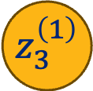
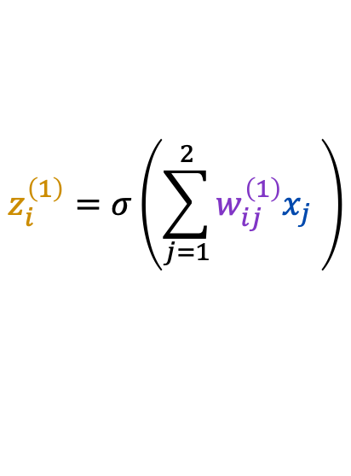

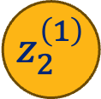
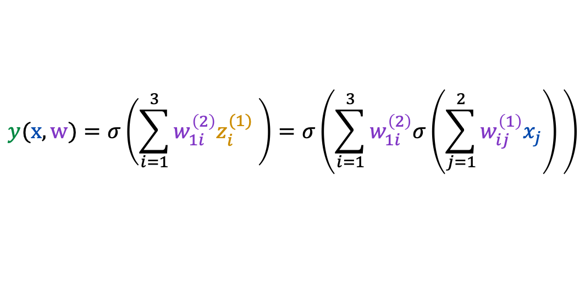
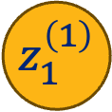

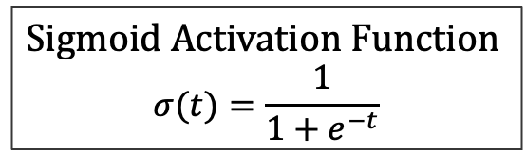


A Small Example
Consider the following single hidden layer classification network
$$z_{i}^{\left(1\right)}=σ\left(\sum_{j=1}^{2}{w_{ij}^{\left(1\right)}x_{j} }\right)$$
Sigmoid Activation Function
$$σ(t)=\frac{1}{1+e^{−t}}$$
Hidden
Layer
Inputs
$$z_{1}^{\left(1\right)}$$
$$x_{1}$$
$$y(x,w)=σ\left(\sum_{i=1}^{3}{w_{1i}^{\left(2\right)}z_{i}^{(1)} }\right)=σ\left(\sum_{i=1}^{3}{w_{1i}^{\left(2\right)}σ\left(\sum_{j=1}^{2}{w_{ij}^{\left(1\right)}x_{j}}\right) }\right)$$
Output
$$z_{2}^{\left(1\right)}$$
$$y$$
Substituting $z_{i}^{\left(1\right)}$
$$x_{2}$$
$$p\left(t=1 | x,w\right)=y(x,w)=σ\left(W^{\left(2\right)}σ\left(W^{\left(1\right)}x\right)\right)$$
$$z_{3}^{\left(1\right)}$$
Matrix Notation
No bias parameters in this example.
1
$$W^{\left(2\right)}$$
$$W^{\left(1\right)}$$
$$x$$
3
3
2
1
2
Notes:
Network parameters: 2 inputs, hidden layer of size 3, 1 output, no bias, sigmoid activation
Step through how each value is calculated
Explain matrix notation

Slide 5
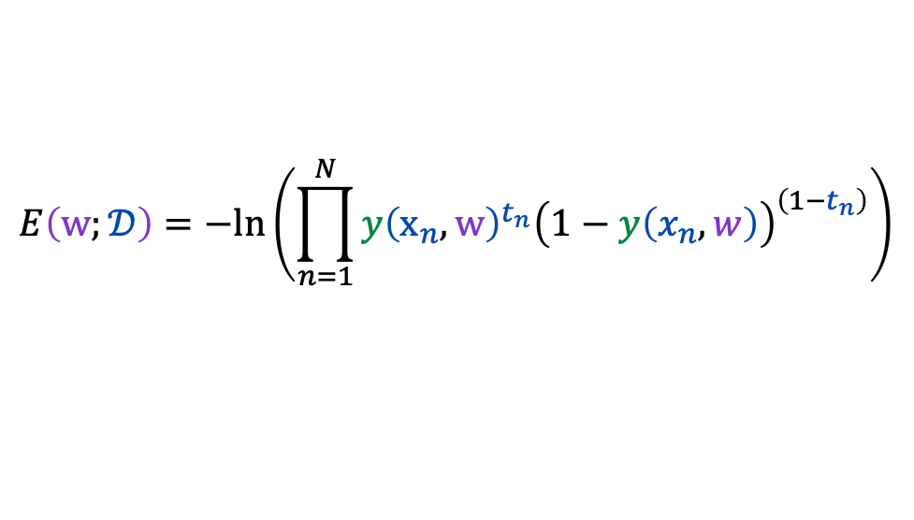
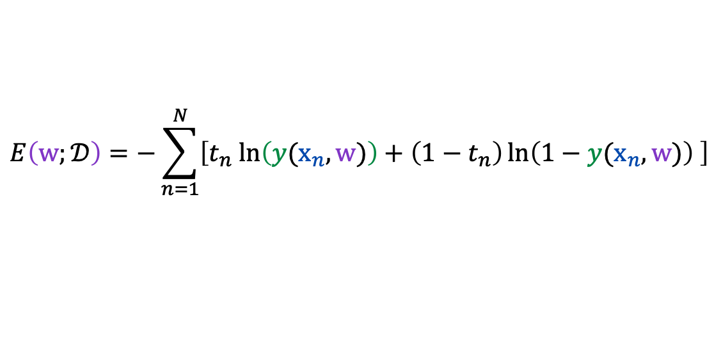
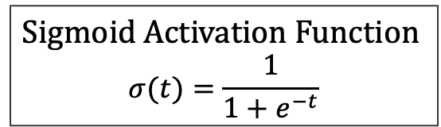

Defining the Error Function
Computing the negative log likelihood of the data $𝒟$:
Hidden
Layer
$$p\left(t=1 | x,w\right)=y(x,w)=σ\left(W^{\left(2\right)}σ\left(W^{\left(1\right)}x\right)\right)$$
Inputs
$$z_{1}^{\left(1\right)}$$
$$E\left(w;𝒟\right)=−ln\left(\prod_{n=1}^{N}{y{\left(x_{n},w\right)}^{t_{n}}{\left(1−y\left(x_{n},w\right)\right)}^{\left(1−t_{n}\right)}}\right)$$
$$x_{1}$$
Output
$$z_{2}^{\left(1\right)}$$
$$y$$
Likelihood of the data.
$$E\left(w;𝒟\right)=−\sum_{n=1}^{N}{\left[t_{n} ln\left(y(x_{n},w)\right)+\left(1−t_{n}\right)\ln\left(1−y(x_{n},w)\right) \right]}$$
$$x_{2}$$
$$z_{3}^{\left(1\right)}$$
Algebra!
Sigmoid Activation Function
$$σ(t)=\frac{1}{1+e^{−t}}$$
Notes:
t_n is target for data point n

Slide 6




Computing the Gradient
Computing the gradient $∇_{w}$ of the negative log likelihood with respect to $w$:
Hidden
Layer
$$p\left(t=1 | x,w\right)=y(x,w)=σ\left(W^{\left(2\right)}σ\left(W^{\left(1\right)}x\right)\right)$$
$$E\left(w;𝒟\right)=−\sum_{n=1}^{N}{\left[t_{n} ln\left(y(x_{n},w)\right)+\left(1−t_{n}\right)\ln\left(1−y(x_{n},w)\right) \right]}$$
Inputs
$$z_{1}^{\left(1\right)}$$
$$x_{1}$$
Output
What is the shape of the gradient?
Recall $w=\left\{W^{(1)},W^{(2)}\right\}$
$$W^{\left(1\right)}$$
1
$$W^{\left(2\right)}$$
$$z_{2}^{\left(1\right)}$$
$$y$$
3
3
$$x_{2}$$
2
$$z_{3}^{\left(1\right)}$$
Sigmoid Activation Function
$$σ(t)=\frac{1}{1+e^{−t}}$$

Slide 7
Do not edit
How to change the design
What is the shape of the gradient?
The Slido app must be installed on every computer you’re presenting from
Notes:
9

Slide 8
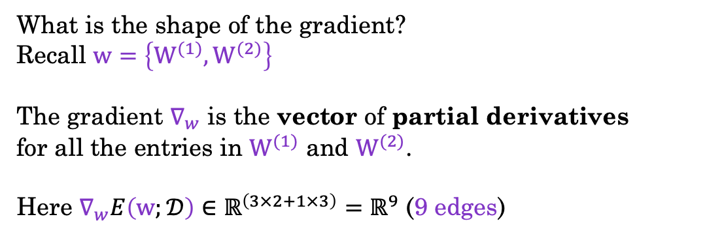


Computing the Gradient
Computing the gradient $∇_{w}$ of the negative log likelihood with respect to $w$:
Hidden
Layer
$$p\left(t=1 | x,w\right)=y(x,w)=σ\left(W^{\left(2\right)}σ\left(W^{\left(1\right)}x\right)\right)$$
$$E\left(w;𝒟\right)=−\sum_{n=1}^{N}{\left[t_{n} ln\left(y(x_{n},w)\right)+\left(1−t_{n}\right)\ln\left(1−y(x_{n},w)\right) \right]}$$
Inputs
$$z_{1}^{\left(1\right)}$$
$$x_{1}$$
Output
What is the shape of the gradient?
Recall $w=\left\{W^{(1)},W^{(2)}\right\}$
The gradient $∇_{w}$ is the vector of partial derivatives
for all the entries in $W^{(1)}$ and $W^{(2)}$.
Here $∇_{w}E\left(w;𝒟\right)∈ℝ^{\left(3×2+1×3\right)}=ℝ^{9}$ (9 edges)
$$W^{\left(1\right)}$$
1
$$W^{\left(2\right)}$$
$$z_{2}^{\left(1\right)}$$
$$y$$
3
3
2
$$x_{2}$$
$$z_{3}^{\left(1\right)}$$
Sigmoid Activation Function
$$σ(t)=\frac{1}{1+e^{−t}}$$

Slide 9

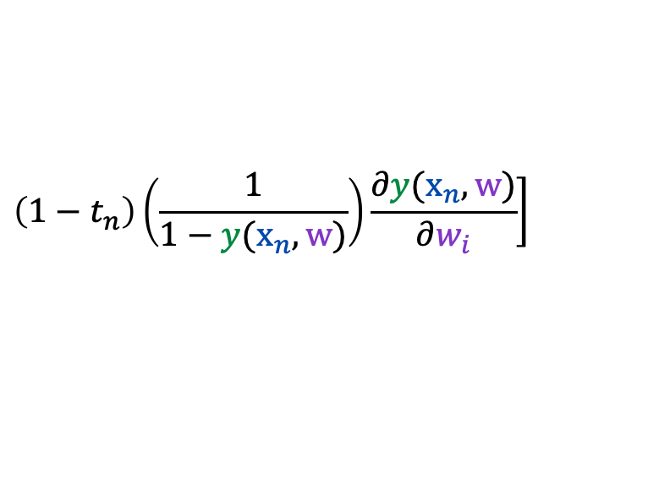
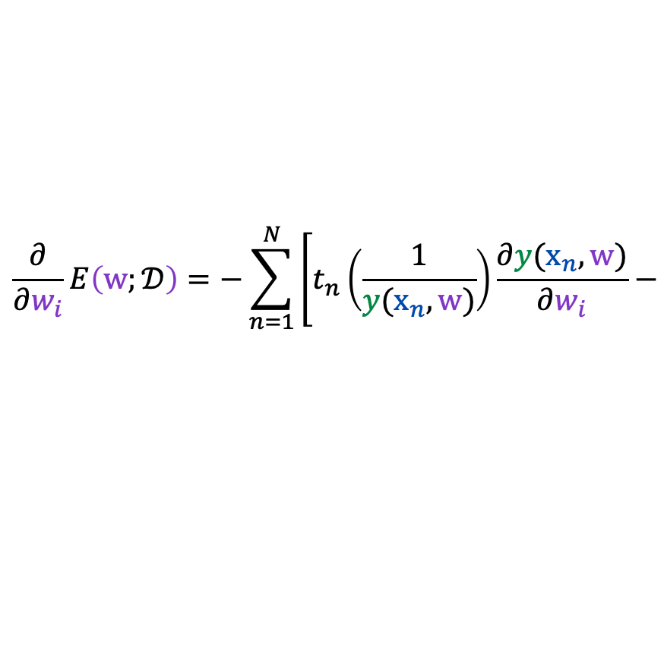
Computing the Gradient
Using the chain rule to compute the partial derivative with respect to $w_{i}$
Hidden
Layer
$$p\left(t=1 | x,w\right)=y(x,w)=σ\left(W^{\left(2\right)}σ\left(W^{\left(1\right)}x\right)\right)$$
$$E\left(w;𝒟\right)=−\sum_{n=1}^{N}{\left[t_{n} ln\left(y(x_{n},w)\right)+\left(1−t_{n}\right)\ln\left(1−y(x_{n},w)\right) \right]}$$
Inputs
$$z_{1}^{\left(1\right)}$$
$$x_{1}$$
Output
Recall that $\frac{∂}{∂q}ln\left(q\right)=\frac{1}{q}$ then with the chain rule:
$$z_{2}^{\left(1\right)}$$
$$y$$
$$\frac{∂}{∂w_{i}}E\left(w;𝒟\right)=−\sum_{n=1}^{N}{\left[t_{n}\left(\frac{1}{y(x_{n},w)}\right)\frac{∂y(x_{n},w)}{∂w_{i}}−\right.}$$
$$x_{2}$$
$$z_{3}^{\left(1\right)}$$
$$\left.\left(1−t_{n}\right)\left(\frac{1}{1−y(x_{n},w)}\right)\frac{∂y(x_{n},w)}{∂w_{i}}\right]$$
Sigmoid Activation Function
$$σ(t)=\frac{1}{1+e^{−t}}$$
We need to compute the partial derivative of the network $y(x,w)$ with respect to each weight $w_{i}$
Notes:
Use chain rule
Apply to first term
Apply to second term
Get the common dy/dw term

Slide 10
PyTorch

Slide 11
What is PyTorch?
PyTorch is a package used to build and train neural networks.
torch.tensor is the basic datatype used to encode data, weights, and activations and is very similar numpy.ndarrays.
Neural networks are built using the many primitives in the torch.nn module and defining the forward process of making a prediction.
PyTorch uses automatic differentiation to efficiently compute the gradient.
Training is accomplished by (you) implementing some variation of gradient descent.
Notes:
Two building blocks: torch.tensor and torch.nn

Slide 12
torch.nn.Module
When building a new model you extend the nn.Module
class MLP(nn.Module):
def __init__(self, dims, activation="relu"):
super().__init__()
self.layers = nn.ModuleList(
[nn.Linear(dims[i], dims[i+1]) for i in range(len(dims)-1)])
if activation == "relu": self.act = nn.functional.relu
else: self.act = torch.tanh
def forward(self, x):
for i, layer in enumerate(self.layers):
x = layer(x)
if i < len(self.layers)-1:
x = self.act(x)
return x
Extend nn.Module
Add modules to your module. These add parameters.
Compute the forward pass using the layer modules.

Slide 13
Implement Gradient Descent with Optimizer
In PyTorch you implement your own gradient descent loop but you can use built in update rules (e.g., Adam) called optimizers.
Minibatch SGD DataLoader
loader = DataLoader(tr_data, batch_size=32, shuffle=True)
optimizer = torch.optim.Adam(model.parameters(),eta)
for epoch in range(nepochs):
for (x, t) in loader:
optimizer.zero_grad()
loss = loss_fn(model(x), t)
loss.backward()
optimizer.step()
Adam optimizer
Epoch is one pass over data
Load one minibatch at a time
Compute the gradient of the loss
Use optimizer to update all the parameters (1-step)

Slide 14

Demo
PyTorch

Slide 15
Numerical Differentiation

Slide 16
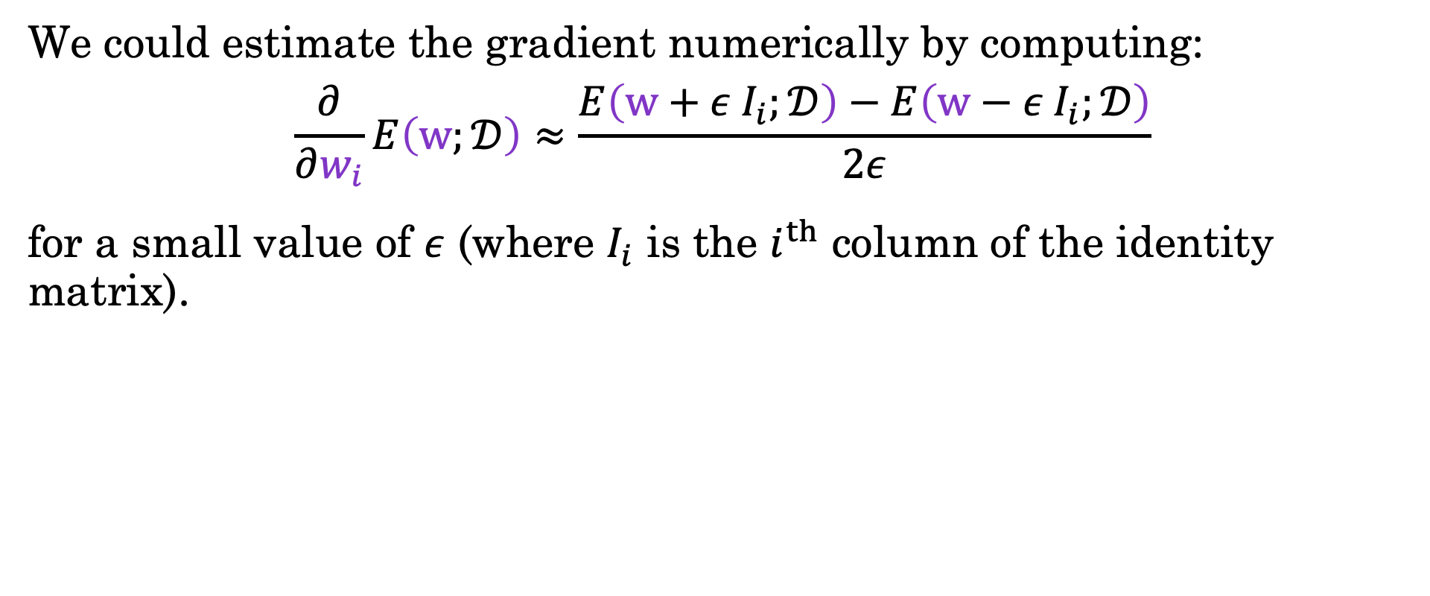
Proposal: Numerical Differentiation
We could estimate the gradient numerically by computing:
$$\frac{∂}{∂w_{i}}E\left(w;𝒟\right)≈\frac{E\left(w+ε I_{i};𝒟\right)−E\left(w−ε I_{i};𝒟\right)}{2ε}$$
for a small value of $ε$ (where $I_{i}$ is the $i^{th}$ column of the identity matrix).
def numeric_gradient(f, x1, x2, h=1e-6):
"""
Central difference estimate of the gradient of f at (x1, x2).
"""
return [(f(x1 + h, x2) - f(x1 - h, x2)) / (2 * h),
(f(x1, x2 + h) - f(x1, x2 - h)) / (2 * h)]
numeric_gradient(f, 1, 2)
[16.778112197357586, 8.805202936557066]
Notes:
Literal definition of the gradient

Slide 17
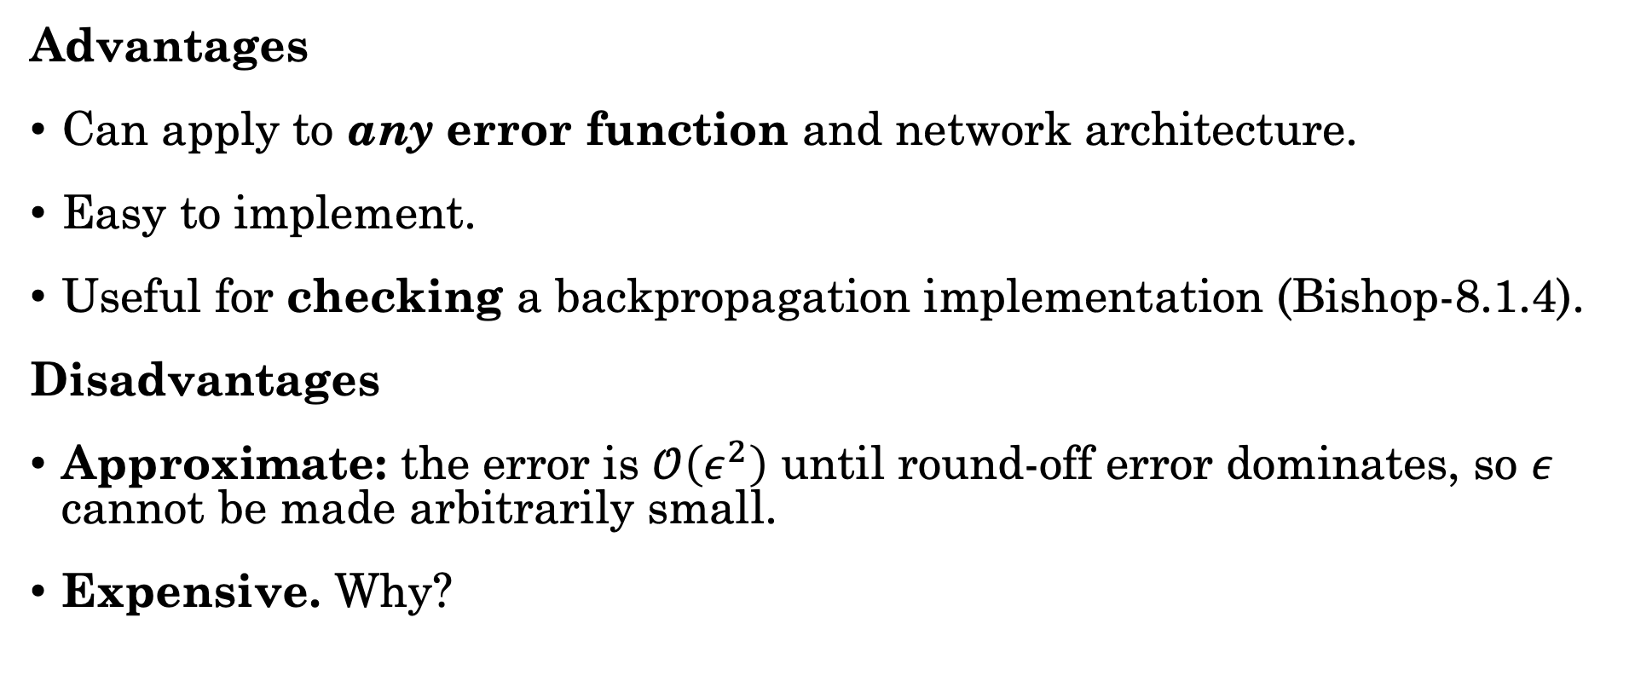
Proposal: Numerical Differentiation
Advantages
Can apply to any error function and network architecture.
Easy to implement.
Useful for checking a backpropagation implementation (Bishop-8.1.4).
Disadvantages
Approximate: the error is $𝒪\left(ε^{2}\right)$ until round-off error dominates, so $ε$ cannot be made arbitrarily small.
Expensive. Why?
Notes:
To show that the error is $𝒪\left(ε^{2}\right)$ construct taylor expansion of f(x) around x and then compute f(x+\eps) – f(x-\eps) / \epsilon … even terms will cancel and the and f(x)’ + \epsilon^2/6 f’’’(x) will remain.

Slide 18
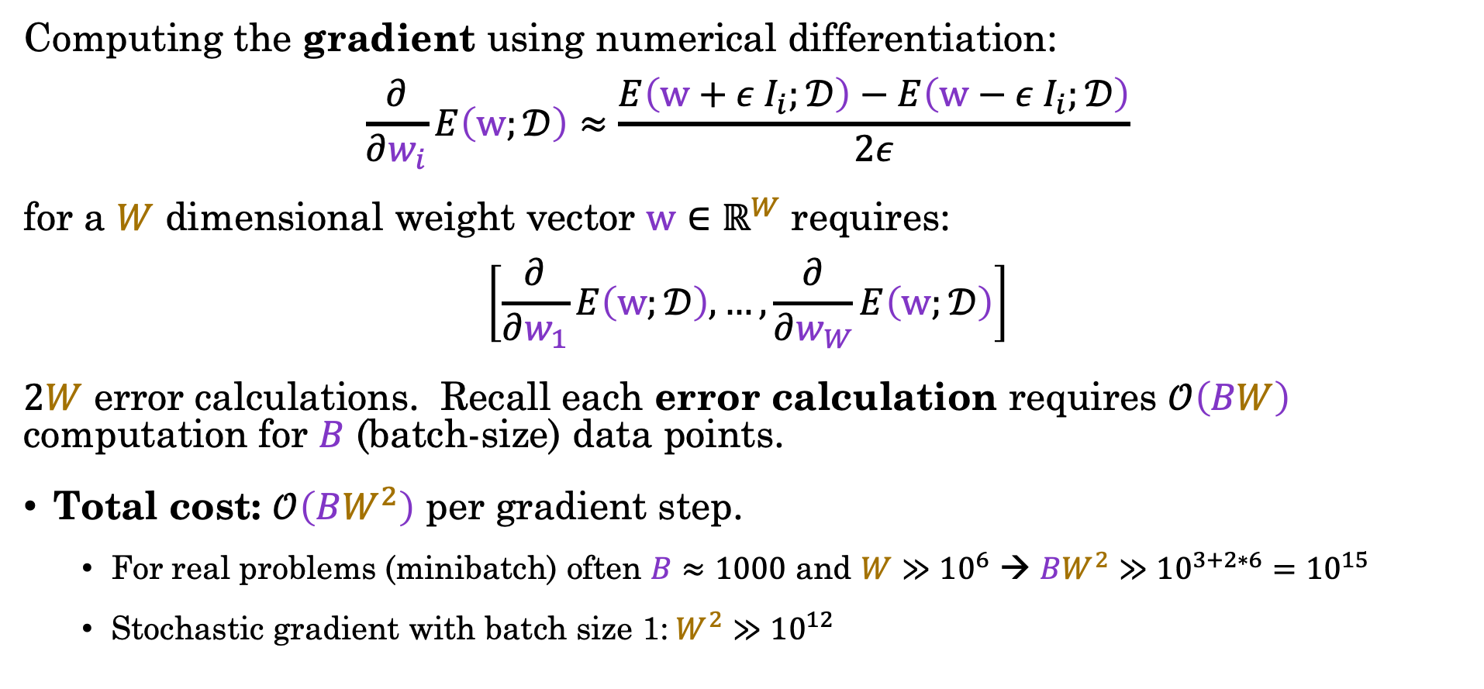
Cost of Numerical Differentiation
Computing the gradient using numerical differentiation:
$$\frac{∂}{∂w_{i}}E\left(w;𝒟\right)≈\frac{E\left(w+ε I_{i};𝒟\right)−E\left(w−ε I_{i};𝒟\right)}{2ε}$$
for a $W$ dimensional weight vector $w∈ℝ^{W}$ requires:
$$\left[\frac{∂}{∂w_{1}}E\left(w;𝒟\right), …,\frac{∂}{∂w_{W}}E\left(w;𝒟\right)\right]$$
$2W$ error calculations. Recall each error calculation requires $𝒪\left(BW\right)$ computation for $B$ (batch-size) data points.
Total cost: $𝒪\left(BW^{2}\right)$ per gradient step.
  For real problems (minibatch) often $B≈1000$ and $W≫{10}^{6}$ → $BW^{2}$ $≫{10}^{3+2∗6}={10}^{15}$
  Stochastic gradient with batch size 1:$W^{2}$ $≫{10}^{12}$
Notes:
Need two forward passes for every weight parameter

Slide 19
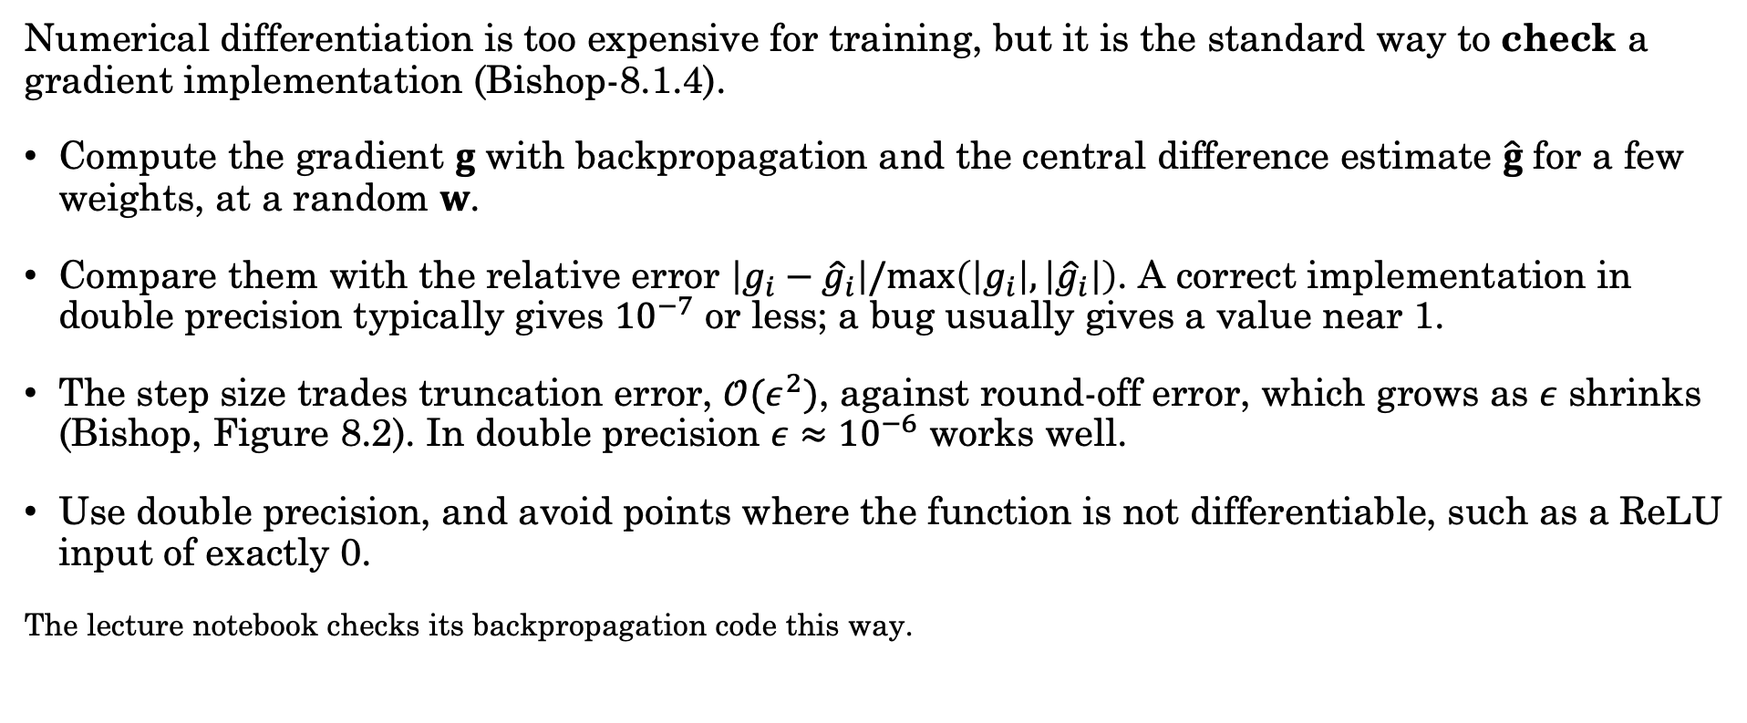
Gradient Checking
Numerical differentiation is too expensive for training, but it is the standard way to check a gradient implementation (Bishop-8.1.4).
Compute the gradient $g$ with backpropagation and the central difference estimate $\hat{g}$ for a few weights, at a random $w$.
Compare them with the relative error $\left|g_{i}−{\hat{g}}_{i}\right|/max\left(\left|g_{i}\right|,\left|{\hat{g}}_{i}\right|\right)$. A correct implementation in double precision typically gives $10^{−7}$ or less; a bug usually gives a value near 1.
The step size trades truncation error, $𝒪(ε^{2})$, against round-off error, which grows as $ε$ shrinks (Bishop, Figure 8.2). In double precision $ε≈10^{−6}$ works well.
Use double precision, and avoid points where the function is not differentiable, such as a ReLU input of exactly 0.
The lecture notebook checks its backpropagation code this way.

Slide 20
Symbolic Differentiation

Slide 21
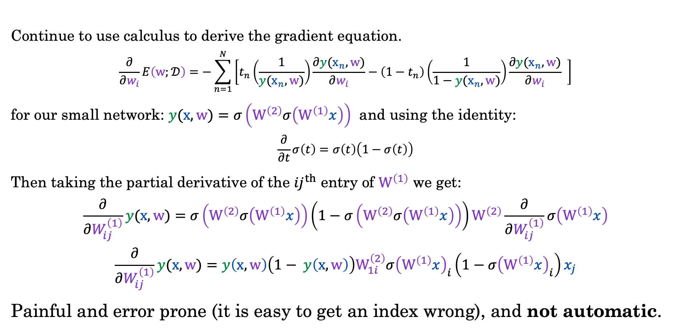
Proposal: Symbolic Differentiation
Continue to use calculus to derive the gradient equation.
$$\frac{∂}{∂w_{i}}E\left(w;𝒟\right)=−\sum_{n=1}^{N}{\left[t_{n}\left(\frac{1}{y(x_{n},w)}\right)\frac{∂y(x_{n},w)}{∂w_{i}}−\left(1−t_{n}\right)\left(\frac{1}{1−y(x_{n},w)}\right)\frac{∂y(x_{n},w)}{∂w_{i}} \right]}$$
for our small network: $y(x,w)=σ\left(W^{\left(2\right)}σ\left(W^{\left(1\right)}x\right)\right)$ and using the identity:
$$\frac{∂}{∂t}σ\left(t\right)=σ\left(t\right)\left(1−σ\left(t\right)\right)$$
Then taking the partial derivative of the ${ij}^{th}$ entry of $W^{\left(1\right)}$ we get:
$$\frac{∂}{∂W_{ij}^{\left(1\right)}}y(x,w)=σ\left(W^{\left(2\right)}σ\left(W^{\left(1\right)}x\right)\right)\left(1−σ\left(W^{\left(2\right)}σ\left(W^{\left(1\right)}x\right)\right)\right)W^{\left(2\right)}\frac{∂}{∂W_{ij}^{\left(1\right)}}σ\left(W^{\left(1\right)}x\right)$$
$$\frac{∂}{∂W_{ij}^{\left(1\right)}}y(x,w)=y\left(x,w\right)\left(1− y\left(x,w\right)\right)W_{1i}^{\left(2\right)}σ{\left(W^{\left(1\right)}x\right)}_{i}\left(1−σ{\left(W^{\left(1\right)}x\right)}_{i}\right)x_{j}$$
Painful and error prone (it is easy to get an index wrong), and not automatic.
Notes:
Do the math
Equation for output
Identity
Take partial derivative for each entry
Apply identity and chain rule
Substitution and chain rule again

Slide 22
Symbolic Computer Algebra Systems
Computer algebra systems like SymPy can be used to automate the differentiation process.
Express functions
symbolically
Automatically
construct
derivative
expressions
n = sp.symbols('n', integer=True) # number of data points (symbolic length)
i = sp.Idx('i', n) # index variable for summation
w0, w1 = sp.symbols('w0 w1') # weights
x = sp.IndexedBase('x', shape=(n,)) # indexed variable for x data
y = sp.IndexedBase('y', shape=(n,)) # indexed variable for y data
E_i = (y[i] - sp.sin(w0 + w1 * x[i]))**2
E = sp.summation(E_i, (i, 0, n - 1)) / n
gE = [sp.diff(E, var) for var in (w0, w1)]
gE
[Sum(-2*(-sin(w0 + w1*x[i]) + y[i])*cos(w0 + w1*x[i]), (i, 0, n - 1))/n,
Sum(-2*(-sin(w0 + w1*x[i]) + y[i])*cos(w0 + w1*x[i])*x[i], (i, 0, n - 1))/n]

Slide 23
Demo
Numerical Differentiation + SymPy
import sympy as sp
# define our symbols
x1, x2 = sp.symbols('x1 x2')
# define a symbolic expression for the error
E = x1 * x2 + sp.exp(x1 * x2) - sp.sin(x2)
# compute the gradient of E with respect to x1 and x2
gE = [sp.diff(E, var) for var in (x1, x2)]
gE
Notes:
[Fa26 changes] MODIFIED
- Code screenshot replaced by editable text (Consolas, VS Code Dark+ colors, pptlib.code_box; tools/port_l13_codeboxes.py). The code and output are the actual code and results.

Slide 24
Symbolic Computer Algebra Systems
Computer algebra systems like SymPy can be used to automate the differentiation process.
Express functions symbolically
Automatically construct derivative expressions
Advantages:
Automatic: algebraic systems can be applied to “any” expression
  Some issues with error functions that contain control flow/loops.
Exact: Doesn’t require epsilon approximation
Disadvantages:
Inefficient: algebraic derivative expressions could be significantly larger and contain many repeated expressions:
  Why?

Slide 25
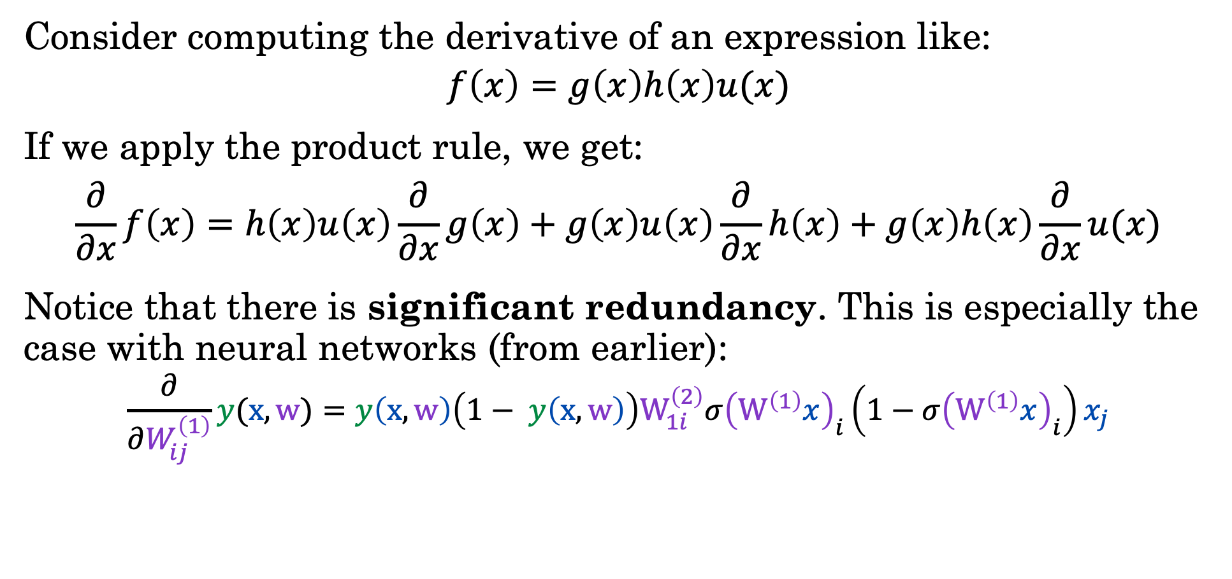
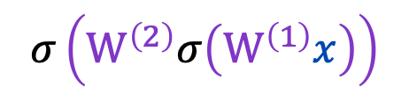
Expression Swell
Consider computing the derivative of an expression like:
$$f\left(x\right)=g\left(x\right)h\left(x\right)u(x)$$
If we apply the product rule, we get:
$$\frac{∂}{∂x}f\left(x\right)=h\left(x\right)u\left(x\right)\frac{∂}{∂x}g\left(x\right)+g\left(x\right)u\left(x\right)\frac{∂}{∂x}h\left(x\right)+g\left(x\right)h\left(x\right)\frac{∂}{∂x}u(x)$$
Notice that there is significant redundancy. This is especially the case with neural networks (from earlier):
$$\frac{∂}{∂W_{ij}^{\left(1\right)}}y(x,w)=y\left(x,w\right)\left(1− y\left(x,w\right)\right)W_{1i}^{\left(2\right)}σ{\left(W^{\left(1\right)}x\right)}_{i}\left(1−σ{\left(W^{\left(1\right)}x\right)}_{i}\right)x_{j}$$
$$σ\left(W^{\left(2\right)}σ\left(W^{\left(1\right)}x\right)\right)$$
Notes:
The redundancies can be hard to catch once everything gets expanded

Slide 26
Automatic Differentiation

Slide 27
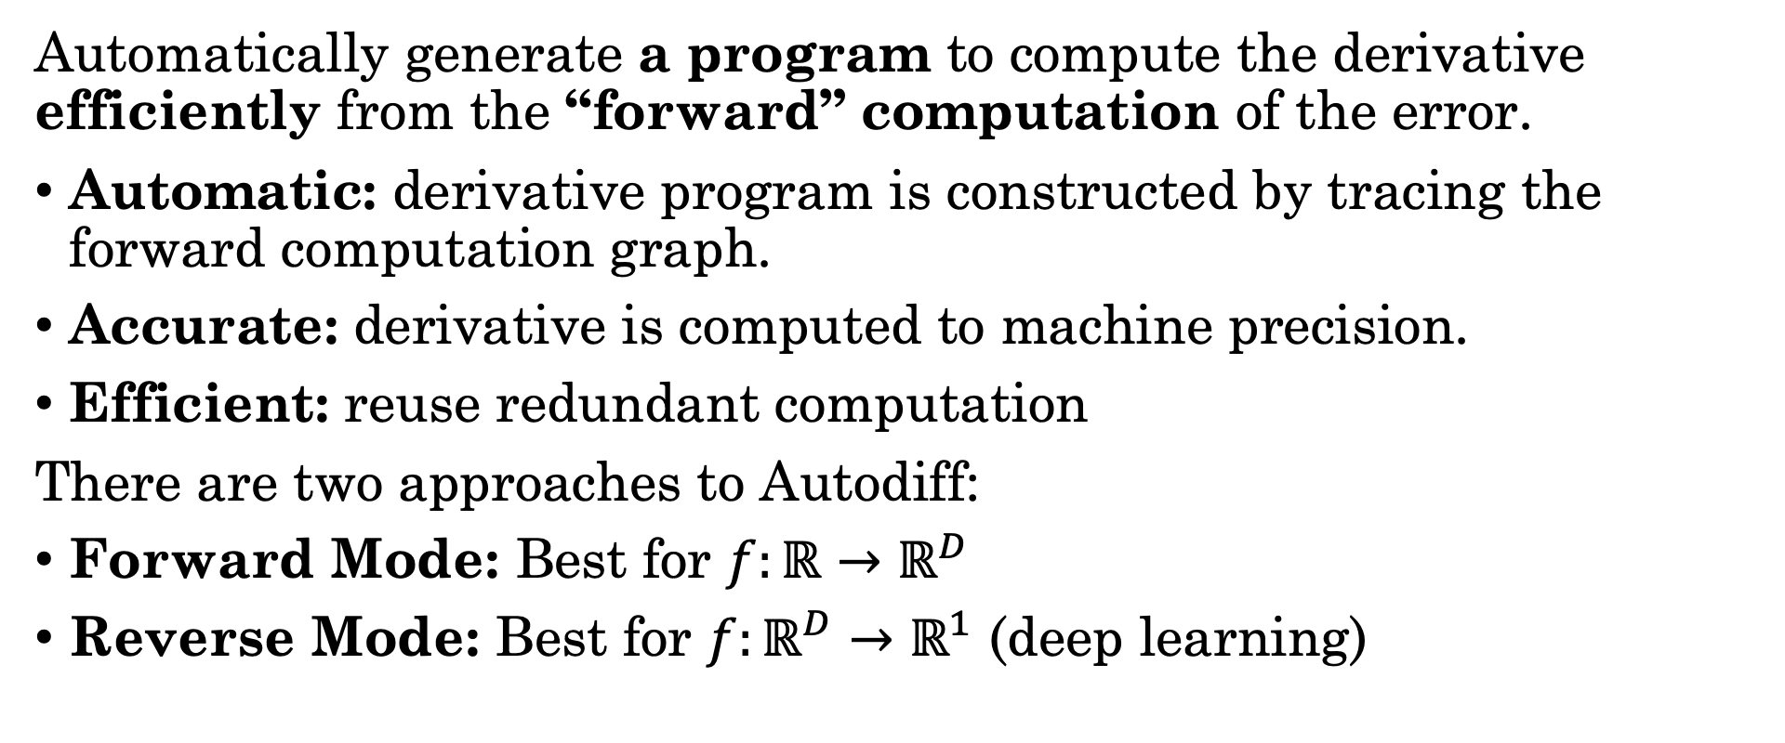
Automatic Differentiation (Autodiff)
Automatically generate a program to compute the derivative efficiently from the “forward” computation of the error.
Automatic: derivative program is constructed by tracing the forward computation graph.
Accurate: derivative is computed to machine precision.
Efficient: reuse redundant computation
There are two approaches to Autodiff:
Forward Mode: Best for $f:ℝ→ℝ^{D}$
Reverse Mode: Best for $f:ℝ^{D}→ℝ^{1}$ (deep learning)
Notes:
We'll come back to forward if we have time at the end, but at a high level as you pass through the network you track the derivative with respect to the single input, hence why it's good for one-to-many

Slide 28





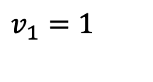







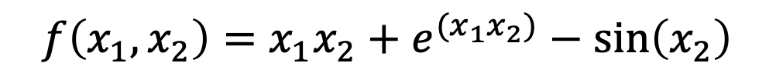



Forward Tracing the Computation Graph
We construct the graph by evaluating the forward computation:
$$f\left(x_{1},x_{2}\right)=x_{1}x_{2}+e^{(x_{1}x_{2})}−\sin\left(x_{2}\right)$$
Program:
0: v1 = x1
1: v2 = x2
2: v3 = v1 * v2
3: v4 = exp(v3)
4: v5 = sin(v2)
5: v6 = v4 + v3
6: v7 = v6 – v5
$$x_{1}=1$$
$$v_{1}=x_{1}$$
$$v_{4}=e^{v_{3}}$$
$$v_{1}=1$$
$$v_{4}=7.39$$
$$v_{3}=v_{1}v_{2}$$
$$v_{6}=v_{4}+v_{3}$$
$$v_{3}=2$$
$$v_{6}=9.39$$
$$x_{2}=2$$
$$v_{2}=x_{2}$$
$$v_{5}=\sin\left(v_{2}\right)$$
$$v_{7}=v_{6}−v_{5}$$
$$v_{2}=2$$
$$v_{5}=0.91$$
$$v_{7}=8.48$$
In this program we have broken each expression into a separate line.
Notes:
We'll run through the scalar example from the demo, and you'll extend it to matrices and tensors in the homework
Step through calculations one by one
We end up with the intermediate value at each node

Slide 29


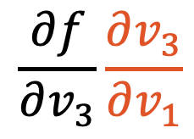

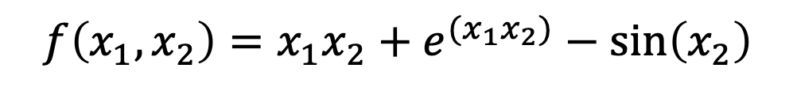



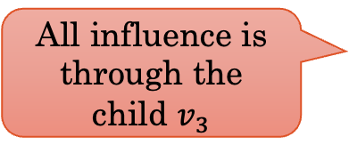




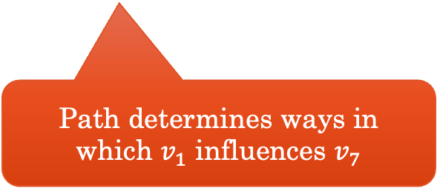

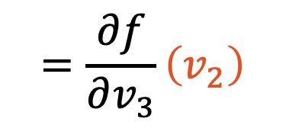



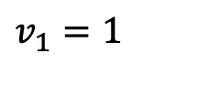
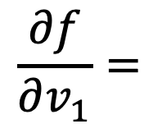
Differentiating wrt $v_{1}$ Using the Chain Rule
Computing the derivative of $\frac{∂f}{∂v_{1}}$ by observing the path from $v_{1}$ to $v_{7}$.
$$\frac{∂f}{∂v_{1}}=$$
$$\frac{∂f}{∂v_{3}}\frac{∂v_{3}}{∂v_{1}}$$
$$=\frac{∂f}{∂v_{3}}\left(v_{2}\right)$$
$$x_{1}=1$$
$$v_{1}=x_{1}$$
$$v_{4}=e^{v_{3}}$$
$$v_{1}=1$$
$$v_{4}=7.39$$
Compute this using the
same process
All influence is through the child $v_{3}$
$$v_{3}=v_{1}v_{2}$$
$$v_{6}=v_{4}+v_{3}$$
$$v_{3}=2$$
$$v_{6}=9.39$$
Path determines ways in which $v_{1}$ influences $v_{7}$
$$x_{2}=2$$
$$v_{2}=x_{2}$$
$$v_{5}=\sin\left(v_{2}\right)$$
$$v_{7}=v_{6}−v_{5}$$
$$v_{2}=2$$
$$v_{5}=0.91$$
$$v_{7}=8.48$$
$$f\left(x_{1},x_{2}\right)=x_{1}x_{2}+e^{(x_{1}x_{2})}−\sin\left(x_{2}\right)$$
Notes:
So to calculate df/dv_1, we need the local derivative dv_3/dv_1 and the child's derivative

Slide 30



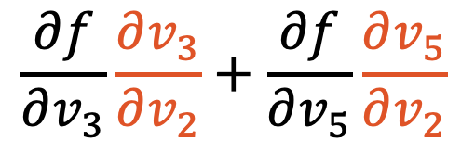
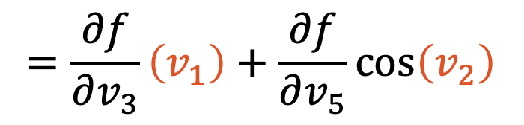
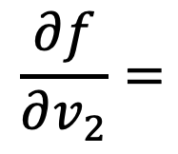
Differentiating wrt $v_{2}$ Using the Chain Rule
Computing the derivative of $\frac{∂f}{∂v_{2}}$ by observing the paths from $v_{2}$ to $v_{7}$.
$$\frac{∂f}{∂v_{2}}=$$
$$\frac{∂f}{∂v_{3}}\frac{∂v_{3}}{∂v_{2}}+\frac{∂f}{∂v_{5}}\frac{∂v_{5}}{∂v_{2}}$$
$$x_{1}=1$$
$$v_{1}=x_{1}$$
$$v_{4}=e^{v_{3}}$$
$$v_{1}=1$$
$$v_{4}=7.39$$
$$=\frac{∂f}{∂v_{3}}\left(v_{1}\right)+\frac{∂f}{∂v_{5}}\cos\left(v_{2}\right)$$
$$v_{3}=v_{1}v_{2}$$
$$v_{6}=v_{4}+v_{3}$$
$$v_{3}=2$$
$$v_{6}=9.39$$
$$x_{2}=2$$
$$v_{2}=x_{2}$$
$$v_{5}=\sin\left(v_{2}\right)$$
$$v_{7}=v_{6}−v_{5}$$
Compute these using the
same process
$$v_{2}=2$$
$$v_{5}=0.91$$
$$v_{7}=8.48$$
$$f\left(x_{1},x_{2}\right)=x_{1}x_{2}+e^{(x_{1}x_{2})}−\sin\left(x_{2}\right)$$
Notes:
Why can you just add? We'll get to this later, but it's due to the multivariate chain rule
Again, we need the local derivatives and the children's derivatives

Slide 31


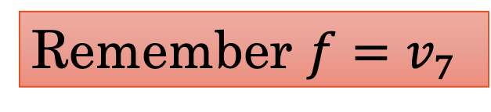



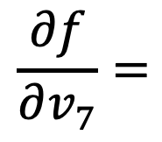
Differentiating wrt $v_{7}$ Using the Chain Rule
Computing the derivative of $\frac{∂f}{∂v_{7}}$ by observing the paths from $v_{7}$ to $v_{7}$.
$$\frac{∂f}{∂v_{7}}=$$
Remember $f=v_{7}$
$$1$$
$$x_{1}=1$$
$$v_{1}=x_{1}$$
$$v_{4}=e^{v_{3}}$$
$$v_{1}=1$$
$$v_{4}=7.39$$
Base Case!
$$v_{3}=v_{1}v_{2}$$
$$v_{6}=v_{4}+v_{3}$$
$$v_{3}=2$$
$$v_{6}=9.39$$
$$x_{2}=2$$
$$v_{2}=x_{2}$$
$$v_{5}=\sin\left(v_{2}\right)$$
$$v_{7}=v_{6}−v_{5}$$
$$v_{2}=2$$
$$v_{5}=0.91$$
$$v_{7}=8.48$$
$$f\left(x_{1},x_{2}\right)=x_{1}x_{2}+e^{(x_{1}x_{2})}−\sin\left(x_{2}\right)$$

Slide 32

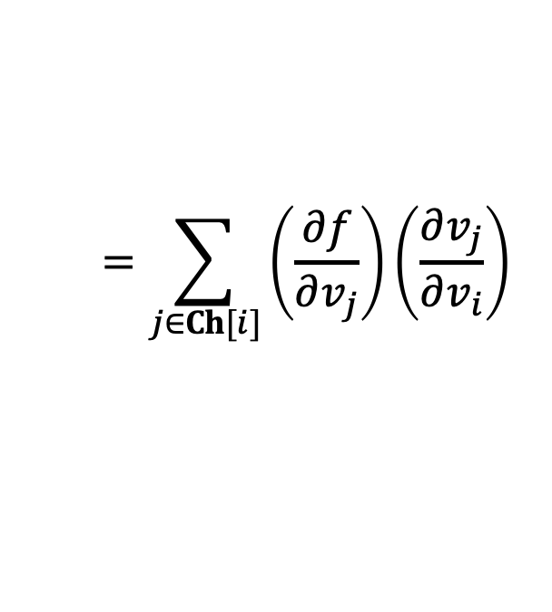
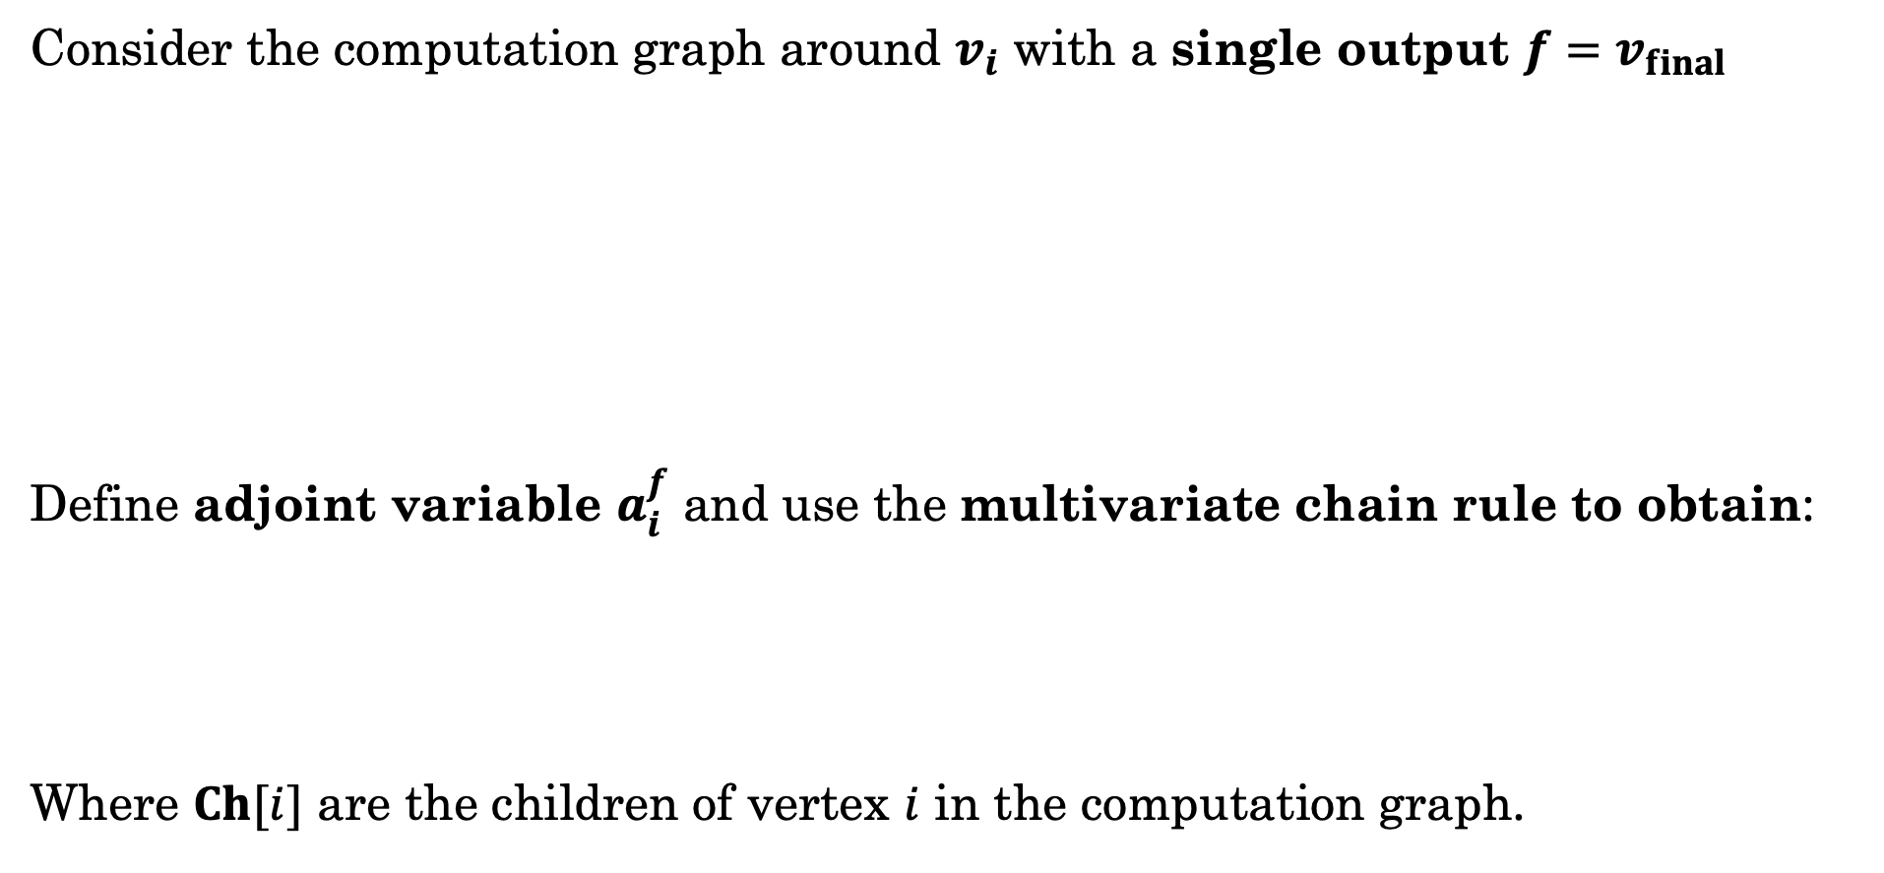

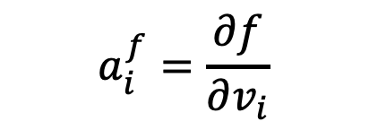






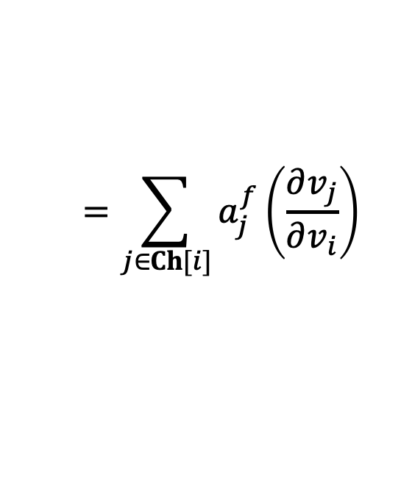
Backward Propagation (Recursion)
Consider the computation graph around $v_{i}$ with a single output ${f=v}_{final}$
Define adjoint variable $a_{i}^{f}$ and use the multivariate chain rule to obtain:
Where $Ch[i]$ are the children of vertex $i$ in the computation graph.
Parents
Children
$$v_{Pa{\left[i\right]}_{1} }$$
$$v_{Ch{\left[i\right]}_{1} }$$
$$v_{Pa{\left[i\right]}_{2} }$$
$$v_{i}$$
$$v_{Ch{\left[i\right]}_{2} }$$
$${f=v}_{final}$$
$$v_{Pa{\left[i\right]}_{\left|Pa\left[i\right]\right|} }$$
$$v_{Ch{\left[i\right]}_{\left|Ch\left[i\right]\right|} }$$
$$a_{i}^{f}=\frac{∂f}{∂v_{i}}$$
$$=\sum_{j∈Ch[i]}{\left(\frac{∂f}{∂v_{j}}\right)\left(\frac{∂v_{j}}{∂v_{i}}\right)}$$
$$=\sum_{j∈Ch[i]}{a_{j}^{f}\left(\frac{∂v_{j}}{∂v_{i}}\right)}$$
Recursion:
Notes:
So calculating the local derivatives is relatively simple. To get the children's derivatives, we just need to recurse
We call it the adjoint

Slide 33
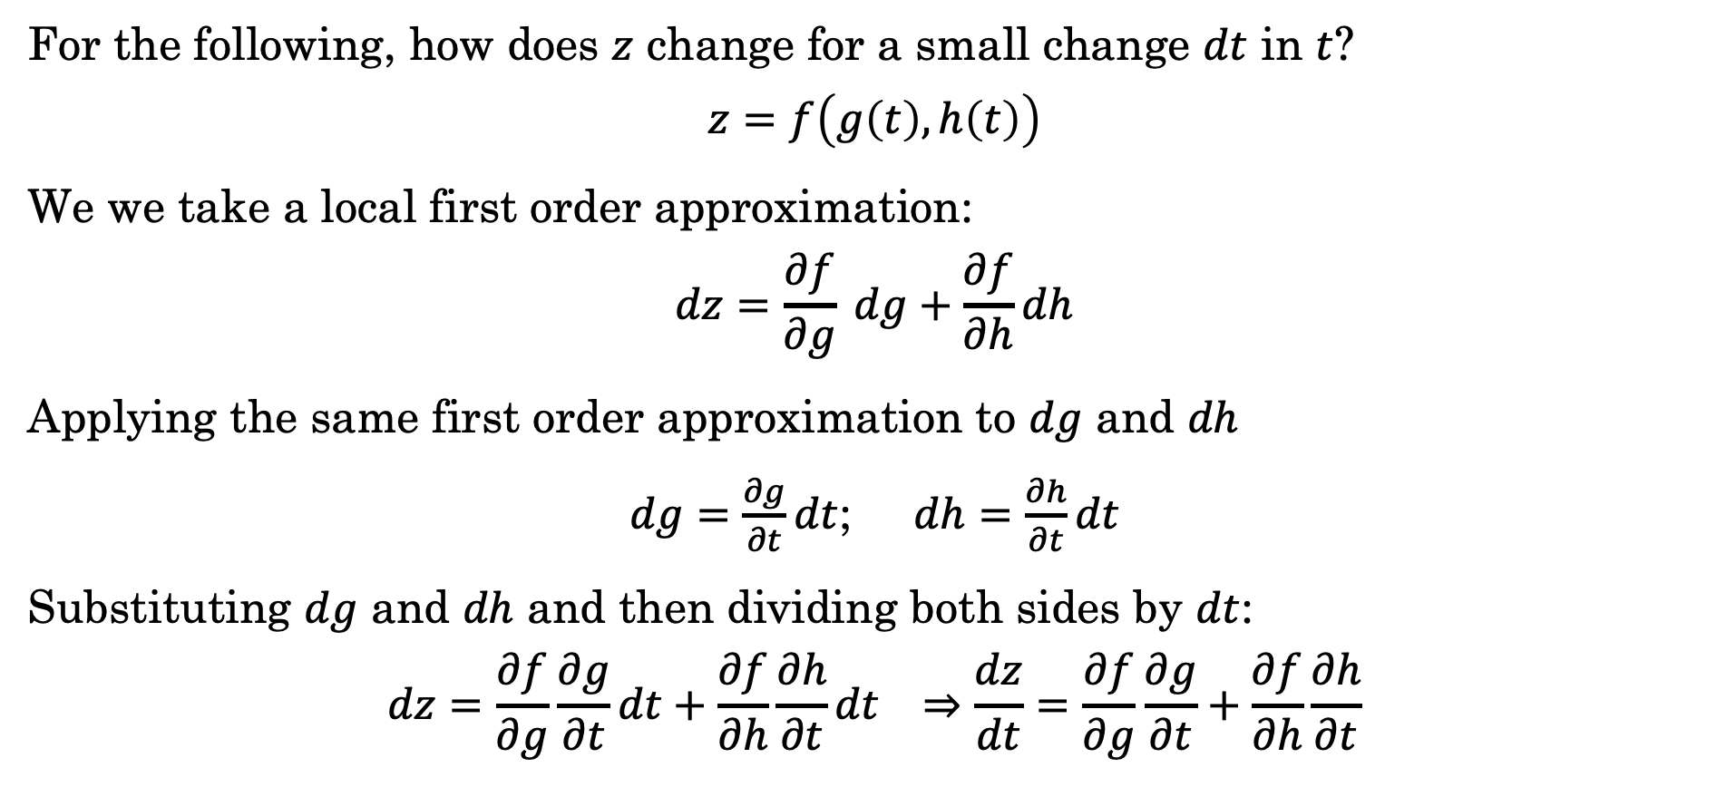
Intuition Behind the Multivariate Chain Rule
For the following, how does $z$ change for a small change $dt$ in $t$?
$$z=f\left(g\left(t\right), h\left(t\right)\right)$$
We we take a local first order approximation:
$$dz=\frac{∂f}{∂g} dg+\frac{∂f}{∂h}dh$$
Applying the same first order approximation to $dg$ and $dh$
$dg=\frac{∂g}{∂t}dt$; $dh=\frac{∂h}{∂t}dt$
Substituting $dg$ and $dh$ and then dividing both sides by $dt$:
$$dz=\frac{∂f}{∂g}\frac{∂g}{∂t}dt+\frac{∂f}{∂h}\frac{∂h}{∂t}dt ⇒\frac{dz}{dt}=\frac{∂f}{∂g}\frac{∂g}{∂t}+\frac{∂f}{∂h}\frac{∂h}{∂t}$$
Small changes in response to each input accumulate.

Slide 34



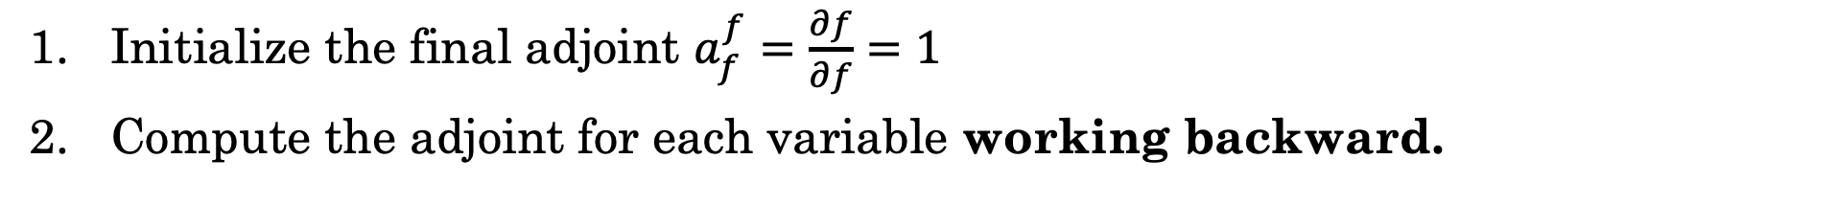




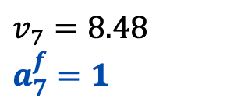






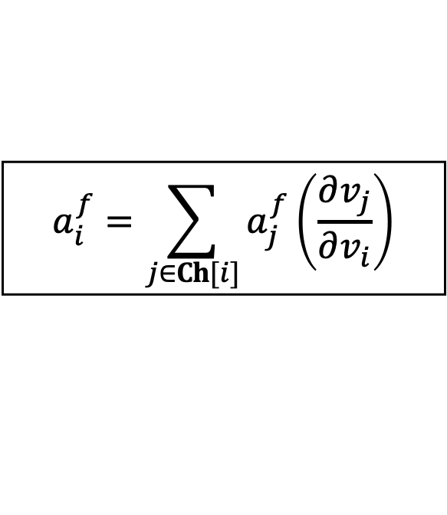

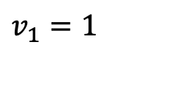
Backward Autodiff Example
$$a_{i}^{f}=\sum_{j∈Ch[i]}{a_{j}^{f}\left(\frac{∂v_{j}}{∂v_{i}}\right)}$$
Initialize the final adjoint $a_{f}^{f}=\frac{∂f}{∂f}=1$
Compute the adjoint for each variable working backward.
$$x_{1}=1$$
$$v_{1}=x_{1}$$
$$v_{4}=e^{v_{3}}$$
$$v_{1}=1$$
$$v_{4}=7.39$$
$$v_{3}=v_{1}v_{2}$$
$$v_{6}=v_{4}+v_{3}$$
$$v_{3}=2$$
$$v_{6}=9.39$$
$$x_{2}=2$$
$$v_{2}=x_{2}$$
$$v_{5}=\sin\left(v_{2}\right)$$
$$v_{7}=v_{6}−v_{5}$$
$$v_{2}=2$$
$$v_{5}=0.91$$
$$v_{7}=8.48$$
$$a_{7}^{f}=1$$
9803087
Notes:
So we've done our forward pass and have all the intermediate values
Now we start the backward pass to calculate all the adjoints

Slide 35




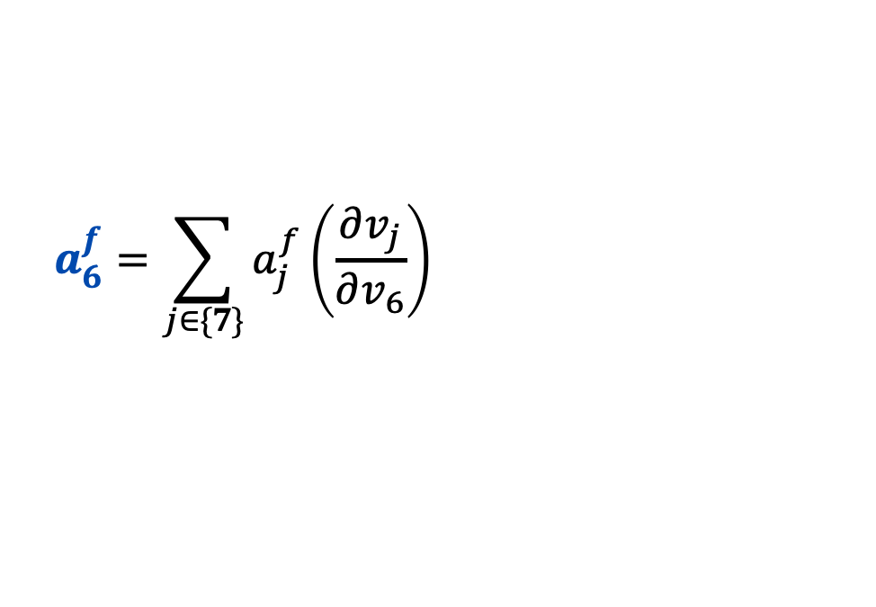

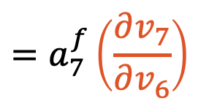
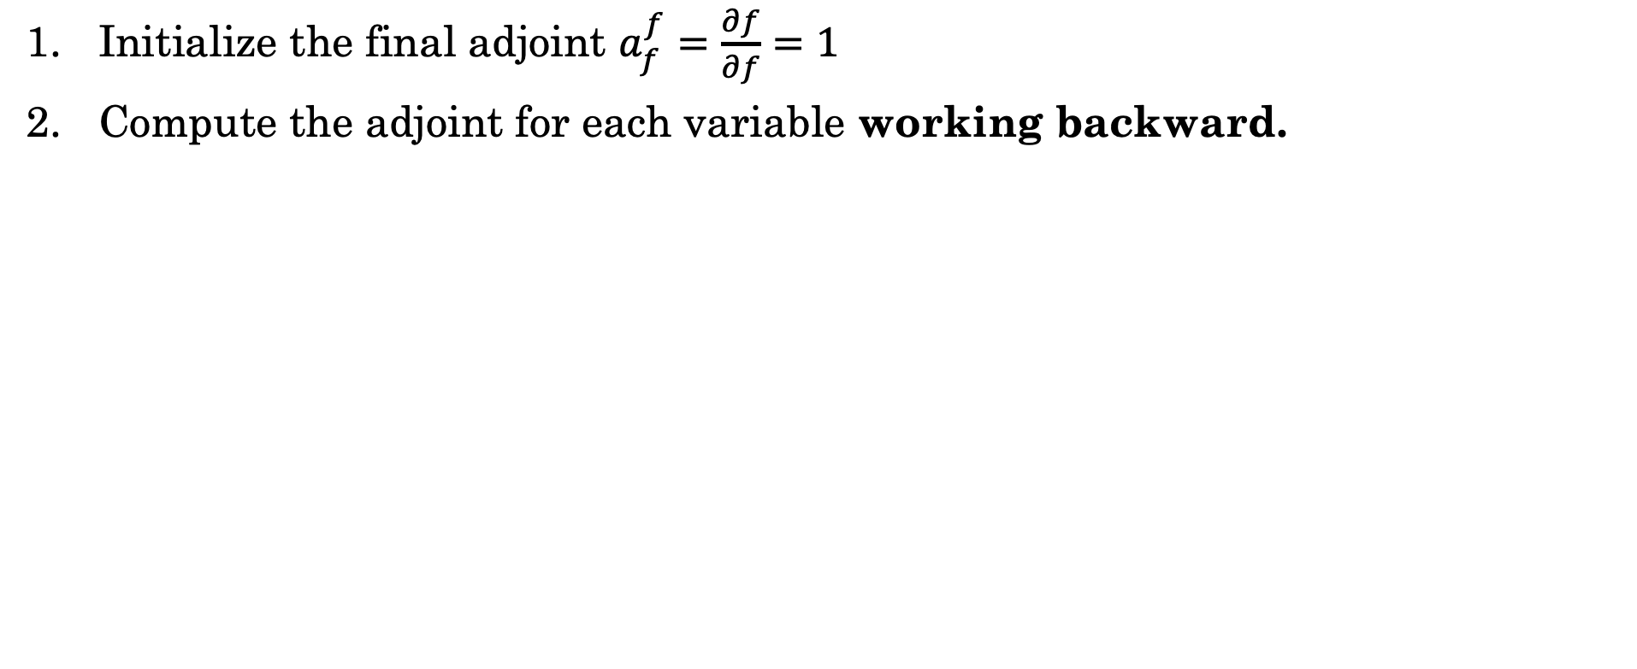
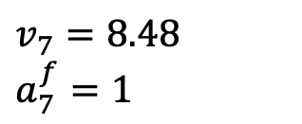
Backward Autodiff $a_{6}^{f}$
$$a_{i}^{f}=\sum_{j∈Ch[i]}{a_{j}^{f}\left(\frac{∂v_{j}}{∂v_{i}}\right)}$$
Initialize the final adjoint $a_{f}^{f}=\frac{∂f}{∂f}=1$
Compute the adjoint for each variable working backward.
$$a_{6}^{f}=\sum_{j∈\{7\}}{a_{j}^{f}\left(\frac{∂v_{j}}{∂v_{6}}\right)}$$
$$=a_{7}^{f}\left(\frac{∂v_{7}}{∂v_{6}}\right)$$
$$x_{1}=1$$
$$v_{1}=x_{1}$$
$$v_{4}=e^{v_{3}}$$
$$v_{1}=1$$
$$v_{4}=7.39$$
$$=1∗1$$
$$v_{3}=v_{1}v_{2}$$
$$v_{6}=v_{4}+v_{3}$$
$$v_{3}=2$$
$$v_{6}=9.39$$
$$a_{6}^{f}=1$$
$$x_{2}=2$$
$$v_{2}=x_{2}$$
$$v_{5}=\sin\left(v_{2}\right)$$
$$v_{7}=v_{6}−v_{5}$$
$$v_{2}=2$$
$$v_{5}=0.91$$
$$v_{7}=8.48$$
$$a_{7}^{f}=1$$
9803087

Slide 36

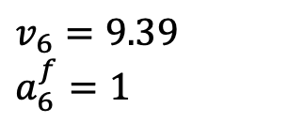






Backward Autodiff $a_{5}^{f}$
$$a_{i}^{f}=\sum_{j∈Ch[i]}{a_{j}^{f}\left(\frac{∂v_{j}}{∂v_{i}}\right)}$$
Initialize the final adjoint $a_{f}^{f}=\frac{∂f}{∂f}=1$
Compute the adjoint for each variable working backward.
$$a_{5}^{f}=\sum_{j∈\{7\}}{a_{j}^{f}\left(\frac{∂v_{j}}{∂v_{5}}\right)}$$
$$=a_{7}^{f}\left(\frac{∂v_{7}}{∂v_{5}}\right)$$
$$x_{1}=1$$
$$v_{1}=x_{1}$$
$$v_{4}=e^{v_{3}}$$
$$v_{1}=1$$
$$v_{4}=7.39$$
$$=1∗(−1)$$
$$v_{3}=v_{1}v_{2}$$
$$v_{6}=v_{4}+v_{3}$$
$$v_{3}=2$$
$$v_{6}=9.39$$
$$a_{6}^{f}=1$$
$$x_{2}=2$$
$$v_{2}=x_{2}$$
$$v_{5}=\sin\left(v_{2}\right)$$
$$v_{7}=v_{6}−v_{5}$$
$$v_{2}=2$$
$$v_{5}=0.91$$
$$v_{7}=8.48$$
$$a_{7}^{f}=1$$
$$a_{5}^{f}=−1$$
9803087

Slide 37










Backward Autodiff $a_{4}^{f}$
$$a_{i}^{f}=\sum_{j∈Ch[i]}{a_{j}^{f}\left(\frac{∂v_{j}}{∂v_{i}}\right)}$$
Initialize the final adjoint $a_{f}^{f}=\frac{∂f}{∂f}=1$
Compute the adjoint for each variable working backward.
$$a_{4}^{f}=\sum_{j∈\{6\}}{a_{j}^{f}\left(\frac{∂v_{j}}{∂v_{4}}\right)}$$
$$=a_{6}^{f}\left(\frac{∂v_{6}}{∂v_{4}}\right)$$
$$x_{1}=1$$
$$v_{1}=x_{1}$$
$$v_{4}=e^{v_{3}}$$
$$v_{1}=1$$
$$v_{4}=7.39$$
$$=1∗(1)$$
$$a_{4}^{f}=1$$
$$v_{3}=v_{1}v_{2}$$
$$v_{6}=v_{4}+v_{3}$$
$$v_{3}=2$$
$$v_{6}=9.39$$
$$a_{6}^{f}=1$$
$$x_{2}=2$$
$$v_{2}=x_{2}$$
$$v_{5}=\sin\left(v_{2}\right)$$
$$v_{7}=v_{6}−v_{5}$$
$$v_{2}=2$$
$$v_{5}=0.91$$
$$v_{7}=8.48$$
$$a_{7}^{f}=1$$
$$a_{5}^{f}=−1$$
9803087

Slide 38





Backward Autodiff $a_{3}^{f}$
$$a_{i}^{f}=\sum_{j∈Ch[i]}{a_{j}^{f}\left(\frac{∂v_{j}}{∂v_{i}}\right)}$$
Initialize the final adjoint $a_{f}^{f}=\frac{∂f}{∂f}=1$
Compute the adjoint for each variable working backward.
$$a_{3}^{f}=\sum_{j∈\{4,6\}}{a_{j}^{f}\left(\frac{∂v_{j}}{∂v_{3}}\right)}$$
$$x_{1}=1$$
$$v_{1}=x_{1}$$
$$v_{4}=e^{v_{3}}$$
$$v_{1}=1$$
$$v_{4}=7.39$$
$$a_{4}^{f}=1$$
$$v_{3}=v_{1}v_{2}$$
$$v_{6}=v_{4}+v_{3}$$
$$v_{3}=2$$
$$v_{6}=9.39$$
$$a_{6}^{f}=1$$
$$x_{2}=2$$
$$v_{2}=x_{2}$$
$$v_{5}=\sin\left(v_{2}\right)$$
$$v_{7}=v_{6}−v_{5}$$
$$v_{2}=2$$
$$v_{5}=0.91$$
$$v_{7}=8.48$$
$$a_{7}^{f}=1$$
$$a_{5}^{f}=−1$$
9803087

Slide 39
Do not edit
How to change the design
What is the value of the adjoint variable a_3?
The Slido app must be installed on every computer you’re presenting from
Notes:
[Fa26 changes] MODIFIED
- Question text "a_3." now an equation with a question mark. The poll text is stored in Slido, so edit it there as well.
8.39

Slide 40




Backward Autodiff $a_{3}^{f}$
$$a_{i}^{f}=\sum_{j∈Ch[i]}{a_{j}^{f}\left(\frac{∂v_{j}}{∂v_{i}}\right)}$$
Initialize the final adjoint $a_{f}^{f}=\frac{∂f}{∂f}=1$
Compute the adjoint for each variable working backward.
$$a_{3}^{f}=\sum_{j∈\{4,6\}}{a_{j}^{f}\left(\frac{∂v_{j}}{∂v_{3}}\right)}$$
$$=a_{4}^{f}\left(\frac{∂v_{4}}{∂v_{3}}\right)+a_{6}^{f}\left(\frac{∂v_{6}}{∂v_{3}}\right)$$
$$x_{1}=1$$
$$v_{1}=x_{1}$$
$$v_{4}=e^{v_{3}}$$
$$v_{1}=1$$
$$v_{4}=7.39$$
$=1\left(e^{v_{3}}\right)+1\left(1\right)$
$$a_{4}^{f}=1$$
$=1\left(7.39\right)+1\left(1\right)$
$$v_{3}=v_{1}v_{2}$$
$$v_{6}=v_{4}+v_{3}$$
$$v_{3}=2$$
$$v_{6}=9.39$$
$$a_{6}^{f}=1$$
$$a_{3}^{f}=8.39$$
$$x_{2}=2$$
$$v_{2}=x_{2}$$
$$v_{5}=\sin\left(v_{2}\right)$$
$$v_{7}=v_{6}−v_{5}$$
$$v_{2}=2$$
$$v_{5}=0.91$$
$$v_{7}=8.48$$
$$a_{7}^{f}=1$$
$$a_{5}^{f}=−1$$
9803087

Slide 41











Backward Autodiff $a_{2}^{f}$
$$a_{i}^{f}=\sum_{j∈Ch[i]}{a_{j}^{f}\left(\frac{∂v_{j}}{∂v_{i}}\right)}$$
Initialize the final adjoint $a_{f}^{f}=\frac{∂f}{∂f}=1$
Compute the adjoint for each variable working backward.
$$a_{2}^{f}=\sum_{j∈\{3,5\}}{a_{j}^{f}\left(\frac{∂v_{j}}{∂v_{2}}\right)}$$
$$=a_{3}^{f}\left(\frac{∂v_{3}}{∂v_{2}}\right)+a_{5}^{f}\left(\frac{∂v_{5}}{∂v_{2}}\right)$$
$$x_{1}=1$$
$$v_{1}=x_{1}$$
$$v_{4}=e^{v_{3}}$$
$$v_{1}=1$$
$$v_{4}=7.39$$
$=8.39\left(1\right)+\left(−1\right)\left(\cos\left(v_{2}\right)\right)$
$$a_{4}^{f}=1$$
$=8.39\left(1\right)+\left(−1\right)\left(−0.42\right)$
$$v_{3}=v_{1}v_{2}$$
$$v_{6}=v_{4}+v_{3}$$
$$v_{3}=2$$
$$v_{6}=9.39$$
$$a_{6}^{f}=1$$
$$a_{3}^{f}=8.39$$
$$x_{2}=2$$
$$v_{2}=x_{2}$$
$$v_{5}=\sin\left(v_{2}\right)$$
$$v_{7}=v_{6}−v_{5}$$
$$v_{2}=2$$
$$v_{5}=0.91$$
$$v_{7}=8.48$$
$$a_{7}^{f}=1$$
$$a_{2}^{f}=8.81$$
$$a_{5}^{f}=−1$$
9803087

Slide 42










Backward Autodiff $a_{1}^{f}$
$$a_{i}^{f}=\sum_{j∈Ch[i]}{a_{j}^{f}\left(\frac{∂v_{j}}{∂v_{i}}\right)}$$
Initialize the final adjoint $a_{f}^{f}=\frac{∂f}{∂f}=1$
Compute the adjoint for each variable working backward.
$$a_{1}^{f}=\sum_{j∈\{3\}}{a_{j}^{f}\left(\frac{∂v_{j}}{∂v_{1}}\right)}$$
$$=a_{3}^{f}\left(\frac{∂v_{3}}{∂v_{1}}\right)$$
$$x_{1}=1$$
$$v_{1}=x_{1}$$
$$v_{4}=e^{v_{3}}$$
$$v_{1}=1$$
$$v_{4}=7.39$$
$$=8.39 \left(v_{2}\right)$$
$$a_{1}^{f}=16.78$$
$$a_{4}^{f}=1$$
$$v_{3}=v_{1}v_{2}$$
$$v_{6}=v_{4}+v_{3}$$
$$=8.39 (2)$$
$$v_{3}=2$$
$$v_{6}=9.39$$
$$a_{6}^{f}=1$$
$$a_{3}^{f}=8.39$$
$$x_{2}=2$$
$$v_{2}=x_{2}$$
$$v_{5}=\sin\left(v_{2}\right)$$
$$v_{7}=v_{6}−v_{5}$$
$$v_{2}=2$$
$$v_{5}=0.91$$
$$v_{7}=8.48$$
$$a_{7}^{f}=1$$
$$a_{2}^{f}=8.81$$
$$a_{5}^{f}=−1$$
9803087

Slide 43




Obtaining the Gradient
$$a_{i}^{f}=\sum_{j∈Ch[i]}{a_{j}^{f}\left(\frac{∂v_{j}}{∂v_{i}}\right)}$$
Initialize the final adjoint $a_{f}^{f}=\frac{∂f}{∂f}=1$
Compute the adjoint for each variable working backward.
The final input adjoint variables are the gradient.
$$x_{1}=1$$
$$v_{1}=x_{1}$$
$$v_{4}=e^{v_{3}}$$
$$v_{1}=1$$
$$v_{4}=7.39$$
$$a_{1}^{f}=16.78$$
$$a_{4}^{f}=1$$
$$v_{3}=v_{1}v_{2}$$
$$v_{6}=v_{4}+v_{3}$$
$$v_{3}=2$$
$$v_{6}=9.39$$
$$a_{6}^{f}=1$$
$$a_{3}^{f}=8.39$$
$$x_{2}=2$$
$$v_{2}=x_{2}$$
$$v_{5}=\sin\left(v_{2}\right)$$
$$v_{7}=v_{6}−v_{5}$$
$$v_{2}=2$$
$$v_{5}=0.91$$
$$v_{7}=8.48$$
$$a_{7}^{f}=1$$
$$a_{2}^{f}=8.81$$
$$a_{5}^{f}=−1$$

Slide 44
















Cost Analysis
Backpropagation is efficient when there is a single output and many inputs.
Need to run backpropagation repeatedly for multiple outputs.
Only need to maintain single adjoint variable at each step.
Often reuse computation from the forward step.
Need to cache or recompute intermediate values
$$x_{1}=1$$
$$v_{1}=x_{1}$$
$$v_{4}=e^{v_{3}}$$
$$v_{1}=1$$
$$a_{1}^{f}=16.78$$
$$v_{4}=7.39$$
$$a_{4}^{f}=1$$
$$v_{3}=v_{1}v_{2}$$
$$v_{6}=v_{4}+v_{3}$$
$$v_{3}=2$$
$$a_{3}^{f}=8.39$$
$$v_{6}=9.39$$
$$a_{6}^{f}=1$$
$$x_{2}=2$$
$$v_{2}=x_{2}$$
$$v_{5}=\sin\left(v_{2}\right)$$
$$v_{7}=v_{6}−v_{5}$$
$$v_{2}=2$$
$$a_{2}^{f}=8.81$$
$$v_{5}=0.91$$
$$a_{5}^{f}=−1$$
$$v_{7}=8.48$$
$$a_{7}^{f}=1$$

Slide 45

Cost of Computing the Gradient
For a network with $W$ weights, evaluating the error for one data point costs $𝒪(W)$ (Bishop-8.1.4). For the gradient:
Numerical differentiation: $2W$ error evaluations, $𝒪(W^{2})$.
Symbolic differentiation: expression swell; shared subexpressions are repeated.
Backpropagation (reverse mode autodiff) : one forward and one backward pass, $𝒪(W)$.
The hidden cost of backpropagation is memory: all the intermediate values of the forward pass are must be stored (or recomputed) for the backward pass.
For modern hardware, memory (not compute) is often a bottleneck and so we often keep some of the activations and recompute the rest.

Slide 46
Computing Activations
During the Forward Pass
Memory
Forward Pass
∇E
A
B
C
D
E
E
Label
D
Loss
∇A
∇B
∇C
∇D
∇E
C
Backward Pass
B
A
Time

Slide 47
Using Activations During Backward Pass
Memory
Forward Pass
∇E
∇D
A
B
C
D
E
E
Label
D
Loss
∇A
∇B
∇C
∇D
∇E
C
Backward Pass
B
A
Time

Slide 48
Using Activations During Backward Pass
Memory
Forward Pass
∇E
∇D
∇C
A
B
C
D
E
E
Label
D
Loss
∇A
∇B
∇C
∇D
∇E
C
Backward Pass
B
A
Time

Slide 49
Using Activations During Backward Pass
Memory
Peak Memory
Forward Pass
∇E
∇D
∇C
∇B
∇A
A
B
C
D
E
E
Label
D
Loss
∇A
∇B
∇C
∇D
∇E
C
Backward Pass
B
A
Time
Notes:
Finally, during the backward pass, we can free unused activations, but the peak memory usage is quite high.

Slide 50
Memory-optimized backpropagation policy
Recompute layers as needed
Memory
Naïve
Backpropagation
How can we use less memory?
Free early & recompute
Memory Optimized
Backpropagation
Compute
Notes:
I'll present a memory conserving optimization for backpropogation.

Slide 51
Limit Memory During Forward Pass
Memory
Peak Memory (no recomputation)
Forward Pass
A
B
C
D
E
Label
D
Loss
∇A
∇B
∇C
∇D
∇E
C
Backward Pass
B
A
Time
Notes:
So returning to our prior example, because we have begun to train and we realized we are going to run out of memory on the accelerator. How can we use less memory. One key insight is to free some nodes early. And then re compute some layers during the backwards pass.

Slide 52
Clear Activations from Memory
Memory
Peak Memory (no recomputation)
Forward Pass
A
B
C
D
E
Label
Loss
∇A
∇B
∇C
∇D
∇E
C
D
E
∇E
∇D
Backward Pass
B
A
B
C
A
Time
Notes:
However, we cannot compute the gradient for C. We must recompute A, B and C during the backward pass.

Slide 53
Recompute Activations During Backprop
Peak Memory (no recomputation)
Forward Pass
A
B
C
D
E
Label
Loss
∇A
∇B
∇C
∇D
∇E
C
D
E
∇E
∇D
A
B
C
Backward Pass
B
A
B
C
A
Time
Notes:
However, we cannot compute the gradient for C. We must recompute A, B and C during the backward pass.

Slide 54
Recompute Activations During Backprop
Memory
Peak Memory (no recomputation)
Forward Pass
A
B
C
D
E
Label
Peak RAM
Loss
∇A
∇B
∇C
∇D
∇E
C
D
E
∇E
∇D
A
B
C
∇C
Backward Pass
B
A
B
C
A
Time
Notes:
This substantially reduces memory consumption, but at a great increase in runtime.

Slide 55
How to choose which layers to recompute?
Forward Pass
A
B
C
C
C
C
C
D
E
Loss
∇A
∇B
∇C
∇C
∇C
∇C
∇C
∇D
∇E
Backward Pass
Notes:
How to choose which layers in a neural network to recompute? Let's visualize the forward pass only for simplicity.

Slide 56
How to choose which layers to recompute?
Forward Pass
Label

Slide 57




Keep only every $\sqrt{L}$ for an $L$ layer neural network.
Forward Pass
Label
Backward Pass
$$O(\sqrt{L})$$
$$O(\sqrt{L})$$
$$O(\sqrt{L})$$
Memory: $O(\sqrt{L})$ for $L$ layers.
Compute: $O(L)$ for $L$ layers.
Notes:
A natural solution is to only save checkpoints at fixed intervals. During the backwards pass, each segment is recomputed in reverse-order as needed. If we are clever and choose checkpoints at square root n intervals, we will incur a linear 2x slowdown.
Chen et al solution

Slide 58
Backpropagation at Scale
Activation checkpointing / recomputation: Save only selected activations during the forward pass and recompute others during backward → trades compute for memory.
Gradient accumulation:
  Issue: Processing a large minibatch at once requires storing activations for the entire minibatch until they are used during backpropagation.
  Solution: Split the minibatch into smaller microbatches, run forward + backward on each, and accumulate the gradients.
    In PyTorch, loss.backward() adds to .grad; call optimizer.zero_grad() only after optimizer.step().

Slide 59

Demo
This demo may be helpful for the homework!
3940975
C
Autodiff
A
B
G
D
E
F
Reminder:
Make sure to traverse in reverse topological ordering.
  The adjoint at B can’t be computed until the adjoint at D is computed.
The adjoint at C is zero (no path from C to G).
Notes:
[Fa26 changes] MODIFIED
- Hint: "does not depend on the adjoint at C (an inactive path)" changed to "The adjoint at C is zero (no path from C to G)". The adjoint at B sums over all children, including C, but C contributes zero.

Slide 60
Homework 3 Overview

Slide 61
From Scalars to Tensors
Coding Part 1:
Implement autograd for tensors
  Lecture demo notebook that implemented autograd for scalars will be helpful!
Implement optimizers
Build and train a model using your implementations
  This is literally (a simpler version of) PyTorch!
Coding Part 2:
Introduction to PyTorch
Building models
Creating dataloaders
Training and Evaluation

Slide 62


Optimizers
You'll be reading about optimizers.
Adam
AdamW (w/ weight decay)
The papers are super dense, but some very nice blog posts:
Understanding Deep Learning Optimizers
Adam vs. AdamW
And discussion from CS 182 (Spring 2021):
Section 3 of Discussion 2
The blogs and CS 182 Discussion suffice for the HW, but you're welcome to read the papers as well.

Slide 63
Homework Summary
Coding
Written
Paper (Blog) Reading
Pt1: Autograd for matrices + Optimizers
Pt2: Introduction to PyTorch
Logistic Regression
Backprop
Optimizers
Normalization (next lecture!)
Blogs:
  Understanding Deep Learning Optimizers
  Adam vs AdamW
CS 182 Sp21:
  Section 3 of Disc 2
(Optional) Papers:
  Adam
  AdamW

Slide 64
Important HW3 Dates
Releases tomorrow (Friday, Oct. 9)
You are responsible for 4 assignments on Pensive:
  HW 3 Written (Friday, Oct. 23)
  HW 3 Paper Write-Up (Friday, Oct. 23)
  HW 3 Coding Part 1 (Friday, Oct. 23)
    Submit the exported zip file; the autograder will automatically upload to HW 3 Coding Part 1 PDF
    Watch the setup and submission walkthroughs on Askademia
  HW 3 Coding Part 2 (Friday, Oct. 30)
    The autograder will automatically upload to HW 3 Coding Part 2 PDF
Start early!
Good luck and have fun :)

Slide 65
Additional Reading
Bishop and Bishop, Deep Learning: Foundations and Concepts, Chapter 8
Automatic Differentiation in Machine Learning: A Survey (2018)
A Gentle Introduction to torch.autograd

Slide 66
Backpropagation
Lecture 13
Reading: Chapter 8 in Bishop Deep Learning Textbook

Slide 67

Homework Hints:
Backward Rules for Matrix Operations
Each operation maps the adjoint of its output, $G=∂E/∂C$, to the adjoints of its inputs. Every adjoint has the same shape as its variable.
Matrix product $C=AB$: $\frac{∂E}{∂A}=GB^{T}$, $\frac{∂E}{∂B}=A^{T}G$
Elementwise function $C=h(A)$: $\frac{∂E}{∂A}=G⊙h′(A)$
Elementwise product $C=A⊙B$: $\frac{∂E}{∂A}=G⊙B$, $\frac{∂E}{∂B}=G⊙A$
Broadcasting, e.g., adding a bias row vector $b$ to every row of $A$: $∂E/∂b$ is $G$ summed over the rows.
Sum $c=\sum_{i,j}{A_{ij}}$: $∂E/∂A_{ij}=G$ for every entry.
Applying these rules in reverse topological order is what loss.backward() does in PyTorch.
Notes:
[Fa26 changes] NEW
- New slide: the backward rules for matrix operations (matmul, elementwise functions and products, broadcasting, sum). These connect the scalar computation graph to tensor autodiff and are exactly the backward functions in the MyTorch code in the lecture notebook.

Slide 68
Forward Differentiation
Bonus Material

Slide 69












Chain Rule on The Computation Graph
$$x_{1}$$
$$v_{1}=x_{1}$$
$$v_{4}=e^{v_{3}}$$
$$v_{3}=v_{1}v_{2}$$
$$v_{6}=v_{4}+v_{3}$$
$$x_{2}$$
$$v_{2}=x_{2}$$
$$v_{5}=\sin\left(v_{2}\right)$$
$$v_{7}=v_{6}−v_{5}$$
If we want to compute the derivative $\frac{∂}{∂x_{2}}f$ using the chain rule:
We can generalize these expressions with:
$$\frac{∂v_{i}}{∂x_{2}}=\sum_{j∈Pa\left[i\right]}{\left(\frac{∂v_{i}}{∂v_{j}}\right)\left(\frac{∂v_{j}}{∂x_{2}}\right)}$$
where $Pa\left[i\right]$ are the parents of $i$ in the computation graph.
$$\frac{∂v_{7}}{∂x_{2}}=\frac{∂v_{7}}{∂v_{6}}\left(\frac{∂v_{6}}{∂x_{2}}\right)+\frac{∂v_{7}}{∂v_{5}}\left(\frac{∂v_{5}}{∂x_{2}}\right)=\left(\frac{∂v_{6}}{∂x_{2}}\right)−\left(\frac{∂v_{5}}{∂x_{2}}\right)$$
$$\frac{∂v_{3}}{∂x_{2}}=\frac{∂v_{3}}{∂v_{1}}\left(\frac{∂v_{1}}{∂x_{2}}\right)+\frac{∂v_{3}}{∂v_{2}}\left(\frac{∂v_{2}}{∂x_{2}}\right)=v_{2}\left(\frac{∂v_{1}}{∂x_{2}}\right)+v_{1}\left(\frac{∂v_{2}}{∂x_{2}}\right)$$

Slide 70

Chain Rule on The Computation Graph
$$x_{1}$$
$$v_{1}=x_{1}$$
$$v_{4}=e^{v_{3}}$$
$$v_{3}=v_{1}v_{2}$$
$$v_{6}=v_{4}+v_{3}$$
$$x_{2}$$
$$v_{2}=x_{2}$$
$$v_{5}=\sin\left(v_{2}\right)$$
$$v_{7}=v_{6}−v_{5}$$
If we define a new tangent variable representing the partial derivative $∂_{x_{k}}^{i}=\frac{∂v_{i}}{∂x_{k}}$
$$∂_{x_{k}}^{i}=\frac{∂v_{i}}{∂x_{k}}=\sum_{j∈Pa\left[i\right]}{\left(\frac{∂v_{i}}{∂v_{j}}\right)\left(\frac{∂v_{j}}{∂x_{k}}\right)}=\sum_{j∈Pa\left[i\right]}{\left(\frac{∂v_{i}}{∂v_{j}}\right)∂_{x_{k}}^{j}}$$
During the forward computation we can compute the value of $v_{i}$ and $∂_{x_{k}}^{i}$:
Notice that $v_{i}$ and $∂_{x_{k}}^{i}$ only depend on their parents.
Need to maintain separate $∂_{x_{k}}^{i}$ for each variable $k$

Slide 71





















Forward Autodiff Example
$$∂_{x_{k}}^{i}=\sum_{j∈Pa\left[i\right]}{\left(\frac{∂v_{i}}{∂v_{j}}\right)∂_{x_{k}}^{j}}$$
Derivation
$$∂_{x_{1}}^{3}=\sum_{j∈\{1,2\}}{\left(\frac{∂v_{3}}{∂v_{j}}\right)∂_{x_{1}}^{j}}$$
$$x_{1}=1$$
$$v_{1}=x_{1}$$
$$v_{4}=e^{v_{3}}$$
$=v_{2}∂_{x_{1}}^{1}+v_{1}∂_{x_{1}}^{2}$
$$v_{1}=1$$
$∂_{x_{1}}^{1}=1$
$$∂_{x_{2}}^{1}=0$$
$$=2∗1 + 1∗0$$
$$=2$$
$$v_{3}=v_{1}v_{2}$$
$$v_{6}=v_{4}+v_{3}$$
$$∂_{x_{2}}^{3}=\sum_{j∈\{1,2\}}{\left(\frac{∂v_{3}}{∂v_{j}}\right)∂_{x_{2}}^{j}}$$
$$v_{3}=2$$
$∂_{x_{1}}^{3}=2$
$$∂_{x_{2}}^{3}=1$$
$=v_{2}∂_{x_{2}}^{1}+v_{1}∂_{x_{2}}^{2}$
$$=2∗0 + 1∗1$$
$$x_{2}=2$$
$$v_{2}=x_{2}$$
$$v_{5}=\sin\left(v_{2}\right)$$
$$v_{7}=v_{6}−v_{5}$$
$$v_{2}=2$$
$∂_{x_{1}}^{2}=0$
$$∂_{x_{2}}^{2}=1$$
$$=1$$

Slide 72









Forward Autodiff Example
MODIFIED
$$∂_{x_{k}}^{i}=\sum_{j∈Pa\left[i\right]}{\left(\frac{∂v_{i}}{∂v_{j}}\right)∂_{x_{k}}^{j}}$$
Derivation
$$∂_{x_{1}}^{4}=\sum_{j∈\{3\}}{\left(\frac{∂v_{4}}{∂v_{j}}\right)∂_{x_{1}}^{j}}$$
$$v_{1}=x_{1}$$
$$v_{4}=e^{v_{3}}$$
$=\left(\frac{∂}{∂v_{3}} e^{v_{3}}\right)∂_{x_{1}}^{3}$
$$x_{1}=1$$
$$v_{1}=1$$
$∂_{x_{1}}^{1}=1$
$$∂_{x_{2}}^{1}=0$$
$$v_{4}=7.39$$
$∂_{x_{1}}^{4}=14.78$
$$∂_{x_{2}}^{4}=7.39$$
$=\left(e^{v_{3}}\right)∂_{x_{1}}^{3}$
$=\left(v_{4}\right) 2=14.78$
$$v_{3}=v_{1}v_{2}$$
$$v_{6}=v_{4}+v_{3}$$
$$∂_{x_{2}}^{4}=\sum_{j∈\{3\}}{\left(\frac{∂v_{4}}{∂v_{j}}\right)∂_{x_{2}}^{j}}$$
$$v_{3}=2$$
$∂_{x_{1}}^{3}=2$
$$∂_{x_{2}}^{3}=1$$
$=\left(\frac{∂}{∂v_{3}} e^{v_{3}}\right)∂_{x_{2}}^{3}$
$$v_{2}=x_{2}$$
$$v_{5}=\sin\left(v_{2}\right)$$
$$v_{7}=v_{6}−v_{5}$$
$=\left(v_{4}\right)∂_{x_{2}}^{3}$
$$x_{2}=2$$
$$v_{2}=2$$
$∂_{x_{1}}^{2}=0$
$$∂_{x_{2}}^{2}=1$$
$=\left(v_{4}\right) 1=7.39$

Slide 73









Forward Autodiff Example
$$∂_{x_{k}}^{i}=\sum_{j∈Pa\left[i\right]}{\left(\frac{∂v_{i}}{∂v_{j}}\right)∂_{x_{k}}^{j}}$$
Derivation
$$∂_{x_{1}}^{5}=\sum_{j∈\{2\}}{\left(\frac{∂v_{5}}{∂v_{j}}\right)∂_{x_{1}}^{j}}$$
$$v_{1}=x_{1}$$
$$v_{4}=e^{v_{3}}$$
$=\left(\frac{∂}{∂v_{2}}\sin\left(v_{2}\right)\right)∂_{x_{1}}^{2}$
$$x_{1}=1$$
$$v_{1}=1$$
$∂_{x_{1}}^{1}=1$
$$∂_{x_{2}}^{1}=0$$
$$v_{4}=7.39$$
$∂_{x_{1}}^{4}=14.78$
$$∂_{x_{2}}^{4}=7.39$$
$=\left(\cos\left(v_{2}\right)\right)∂_{x_{1}}^{2}$
$=\left(−0.42\right)0=0$
$$v_{3}=v_{1}v_{2}$$
$$v_{6}=v_{4}+v_{3}$$
$$∂_{x_{2}}^{5}=\sum_{j∈\{2\}}{\left(\frac{∂v_{5}}{∂v_{j}}\right)∂_{x_{2}}^{j}}$$
$$v_{3}=2$$
$∂_{x_{1}}^{3}=2$
$$∂_{x_{2}}^{3}=1$$
$=\left(\frac{∂}{∂v_{2}}\sin\left(v_{2}\right)\right)∂_{x_{2}}^{2}$
$=\left(\cos\left(v_{2}\right)\right)∂_{x_{2}}^{2}$
$$x_{2}=2$$
$$v_{2}=x_{2}$$
$$v_{5}=\sin\left(v_{2}\right)$$
$$v_{7}=v_{6}−v_{5}$$
$=\left(−0.42\right)1=−0.42$
$$v_{2}=2$$
$∂_{x_{1}}^{2}=0$
$$∂_{x_{2}}^{2}=1$$
$$v_{5}=0.91$$
$∂_{x_{1}}^{5}=0$
$$∂_{x_{2}}^{5}=−0.42$$

Slide 74


Forward Autodiff Example
$$∂_{x_{k}}^{i}=\sum_{j∈Pa\left[i\right]}{\left(\frac{∂v_{i}}{∂v_{j}}\right)∂_{x_{k}}^{j}}$$
$$x_{1}=1$$
$$v_{1}=x_{1}$$
$$v_{4}=e^{v_{3}}$$
$$v_{1}=1$$
$∂_{x_{1}}^{1}=1$
$$∂_{x_{2}}^{1}=0$$
$$v_{4}=7.39$$
$∂_{x_{1}}^{4}=14.78$
$$∂_{x_{2}}^{4}=7.39$$
$$v_{3}=v_{1}v_{2}$$
$$v_{6}=v_{4}+v_{3}$$
$$v_{3}=2$$
$∂_{x_{1}}^{3}=2$
$$∂_{x_{2}}^{3}=1$$
$$v_{6}=9.39$$
$∂_{x_{1}}^{6}=16.78$
$$∂_{x_{2}}^{6}=8.39$$
$$x_{2}=2$$
$$v_{2}=x_{2}$$
$$v_{5}=\sin\left(v_{2}\right)$$
$$v_{7}=v_{6}−v_{5}$$
$$v_{2}=2$$
$∂_{x_{1}}^{2}=0$
$$∂_{x_{2}}^{2}=1$$
$$v_{5}=0.91$$
$∂_{x_{1}}^{5}=0$
$$∂_{x_{2}}^{5}=−0.42$$
$$v_{7}=8.48$$
$∂_{x_{1}}^{7}=16.78$
$$∂_{x_{2}}^{7}=8.81$$

Slide 75



















Support multiple outputs
Additional function output can reuse computation.
$v_{7}=f_{1}\left(x_{1},x_{2}\right)=x_{1}x_{2}+e^{(x_{1}x_{2})}−\sin\left(x_{2}\right)$
$v_{8}=f_{2}\left(x_{1},x_{2}\right)=\left(x_{1}x_{2}+e^{\left(x_{1}x_{2}\right)}\right)e^{\left(x_{1}x_{2}\right)}$
$$x_{1}=1$$
$$v_{1}=x_{1}$$
$$v_{4}=e^{v_{3}}$$
$$v_{8}=v_{6}v_{4}$$
$$v_{1}=1$$
$∂_{x_{1}}^{1}=1$
$$∂_{x_{2}}^{1}=0$$
$$v_{4}=7.39$$
$∂_{x_{1}}^{4}=14.78$
$$∂_{x_{2}}^{4}=7.39$$
$$v_{8}=69.38$$
$∂_{x_{1}}^{8}=262.73$
$$∂_{x_{2}}^{8}=131.36$$
Essentially, we computed the gradient at every step!
?
$$v_{3}=v_{1}v_{2}$$
$$v_{6}=v_{4}+v_{3}$$
$$v_{3}=2$$
$∂_{x_{1}}^{3}=2$
$$∂_{x_{2}}^{3}=1$$
$$v_{6}=9.39$$
$∂_{x_{1}}^{6}=16.78$
$$∂_{x_{2}}^{6}=8.39$$
$$x_{2}=2$$
$$v_{2}=x_{2}$$
$$v_{5}=\sin\left(v_{2}\right)$$
$$v_{7}=v_{6}−v_{5}$$
$$v_{2}=2$$
$∂_{x_{1}}^{2}=0$
$$∂_{x_{2}}^{2}=1$$
$$v_{5}=0.91$$
$∂_{x_{1}}^{5}=0$
$$∂_{x_{2}}^{5}=−0.42$$
$$v_{7}=8.48$$
$∂_{x_{1}}^{7}=16.78$
$$∂_{x_{2}}^{7}=8.81$$
Notes:
[Fa26 changes] MODIFIED
- Layout (slide_review): the callout "Essentially, we computed the gradient at every step!" covered the tangent values of v2 and v3. It now sits in the free space right of the v8 values (2.25 x 1.75 in, same text at 20 pt instead of 24 pt) with its tail pointing at the v6 values; the smiley moved with it.

Slide 76
















Expensive for Lots of Variables
Need to maintain full gradient at every intermediate step.
$$x_{1}=1$$
$$v_{1}=x_{1}$$
$$v_{4}=e^{v_{3}}$$
$$v_{1}=1$$
$∂_{x_{1}}^{1}=1$
$$∂_{x_{2}}^{1}=0$$
$$v_{4}=7.39$$
$∂_{x_{1}}^{4}=14.78$
$$∂_{x_{2}}^{4}=7.39$$
For models with billions of parameters, need to store and update billion-dimension vector for every arithmetic operation.
$$v_{3}=v_{1}v_{2}$$
$$v_{6}=v_{4}+v_{3}$$
$$v_{3}=2$$
$∂_{x_{1}}^{3}=2$
$$∂_{x_{2}}^{3}=1$$
$$v_{6}=9.39$$
$∂_{x_{1}}^{6}=16.78$
$$∂_{x_{2}}^{6}=8.39$$
$$x_{2}=2$$
$$v_{2}=x_{2}$$
$$v_{5}=\sin\left(v_{2}\right)$$
$$v_{7}=v_{6}−v_{5}$$
$$v_{2}=2$$
$∂_{x_{1}}^{2}=0$
$$∂_{x_{2}}^{2}=1$$
$$v_{5}=0.91$$
$∂_{x_{1}}^{5}=0$
$$∂_{x_{2}}^{5}=−0.42$$
$$v_{7}=8.48$$
$∂_{x_{1}}^{7}=16.78$
$$∂_{x_{2}}^{7}=8.81$$

Slide 77










Adjoint vs Tangent Variables
We have now defined tangent and adjoint variables for forward and backward autodiff respectively:
Notice how they build from one side of the graph to the other:
Tangent Variables
Adjoint Variables
$$∂_{x_{k}}^{i}=\sum_{j∈Pa\left[i\right]}{\left(\frac{∂v_{i}}{∂v_{j}}\right)∂_{x_{k}}^{j}}$$
$$a_{i}^{f}=\sum_{j∈Ch[i]}{a_{j}^{f}\left(\frac{∂v_{j}}{∂v_{i}}\right)}$$
Parents
Children
$$v_{Pa{\left[i\right]}_{1} }$$
$$v_{Ch{\left[i\right]}_{1} }$$
$$v_{Pa{\left[i\right]}_{2} }$$
$$v_{i}$$
$$v_{Ch{\left[i\right]}_{2} }$$
$${f=v}_{final}$$
$$v_{Pa{\left[i\right]}_{\left|Pa\left[i\right]\right|} }$$
$$v_{Ch{\left[i\right]}_{\left|Ch\left[i\right]\right|} }$$

